Slide 1

A Tactical Exploration of Cybersecurity Foundations
SEC290
Cody Kyser
April 24, 2025

Slide 2
Introduction
Welcome to my SEC290 Final Project Presentation
This project showcases the essential skills I’ve developed in infrastructure security, focusing on protecting systems, identifying vulnerabilities, and responding to cyber threats. Throughout the course, I worked with industry-relevant tools such as Wireshark, Snort, OpenSSL, and Volatility to simulate real-world security scenarios. Each module built upon the last, providing a strong foundation in both theoretical knowledge and hands-on experience across areas like firewall configuration, intrusion detection, cryptography, and memory forensics.

Slide 3
Project Overview
This project explores the fundamentals of infrastructure security through hands-on implementation of industry relevant techniques and tools. Each module provided practical experience in identifying, mitigating, and analyzing threats in modern IT environments. Activities include: Configuring firewall rules for secure system access
Deploying and testing Snort intrusion detection sensors
Analyzing network traffic using Wireshark to detect malicious patterns
Implementing and validating SSL encryption for secure communications
Performing vulnerability assessments and simulated exploitations
Conducting live memory analysis to uncover hidden threats
These tasks simulated real-world cybersecurity responsibilities and helped build a foundation in defensive security strategies, aligned with the expectations of today’s IT and cybersecurity job market.

Slide 4

Manual Vulnerability Analysis

Slide 5
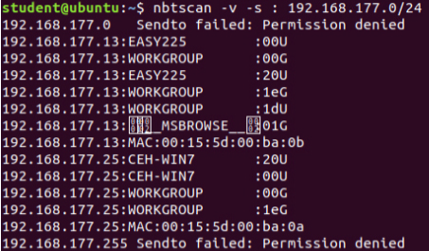
Target Discovery with nbtscan
The nbtscan command was used to enumerate devices on the local subnet (192.168.177.0/24).
Two key targets were identified:
192.168.177.13 – Hostname: EASY225 (Windows Server 2003)
192.168.177.25 – Hostname: CEH-WIN7 (Windows 7)
These hosts were selected for further vulnerability scanning and exploitation.

Slide 6
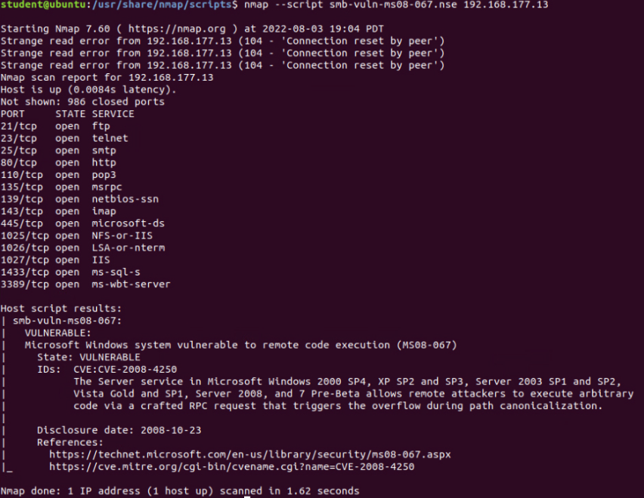
Vulnerability Scanning with Nmap Script
Ran an Nmap NSE script to detect known SMB vulnerabilities:nmap --script smb-vuln-ms08-067.nse 192.168.177.13
Host 192.168.177.13 was found to be vulnerable to MS08-067.
This vulnerability allows remote code execution via a buffer overflow in the Server service.
Confirmed presence of open ports such as FTP, Telnet, RPC, and SMB services that further expose the system.

Slide 7

Intrusion Analysis Using Wireshark

Slide 8
Basic Attack Analysis
Look at captures no. 20 and 22. (You can use the “Go” link at the top of the Wireshark screen to quickly go to a specific capture) Both packets are ICMP traffic but there are subtle differences between them. Compare the time-to-live and data field sizes in the two packets. What differences do you see? Capture 20 Packet – TTL = 64, size = 98. Capture 22 Packet – TTL = 128, size = 740 Different operating systems used for both packets.
Do a little Internet research to discover which operating systems use the specific values in their ping commands. What operating system generated the echo request in capture 20? Linux/MAC OS has a TTL value of 64
Review packet no. 37 and beyond, what do you think is taking place here? Port Scan
Look at capture 22846. What is suspicious about the flag settings in this packet? Stealth Scan A proper connection termination should follow the FIN-ACK-FIN-ACK sequence rather than a FIN + PSH + URG combo.
What is the IP address of the host being targeted? 192.168.25.50
This section demonstrates the use of Wireshark to analyze network packet captures and identify early-stage attack activity. By inspecting TTL values, packet structures, and flag behavior, I was able to detect signs of operating system fingerprinting, port scanning, and stealth-based intrusion attempts. These skills are foundational for network monitoring and early threat detection in cybersecurity operations.

Slide 9

Fundamentals of Infrastructure Security

Slide 10
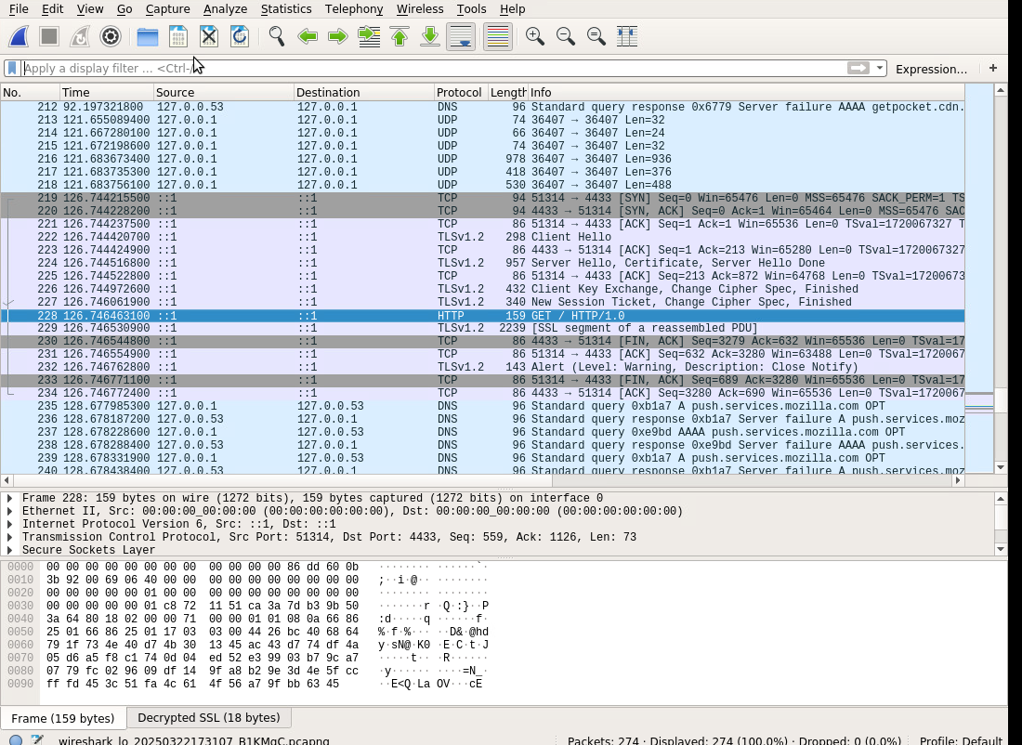
Creating and testing an SSL/TLS file
This Wireshark capture shows the establishment and termination of a secure TLSv1.2 session. It includes the TCP three-way handshake, TLS handshake, an encrypted HTTP GET request, and a proper session close using a TLS alert and FIN-ACK sequence.

Slide 11
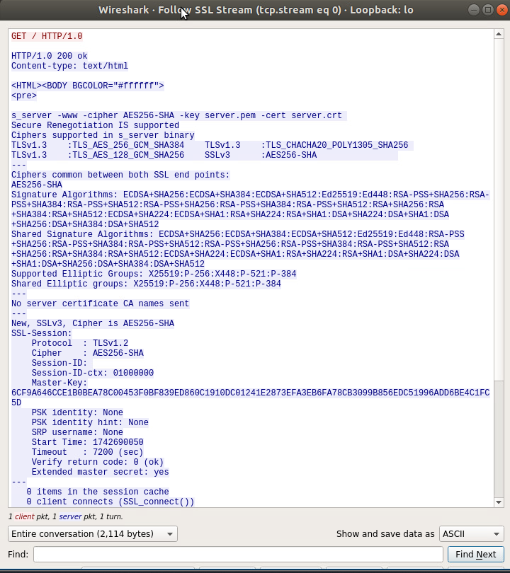
Creating and testing an SSL/TLS file cont’d
This slide displays the decrypted SSL/TLS stream in Wireshark. It confirms successful session negotiation and encryption parameters, including protocol version, cipher suite, and session keys, along with the visible HTTP GET request data.

Slide 12

Snort

Slide 13
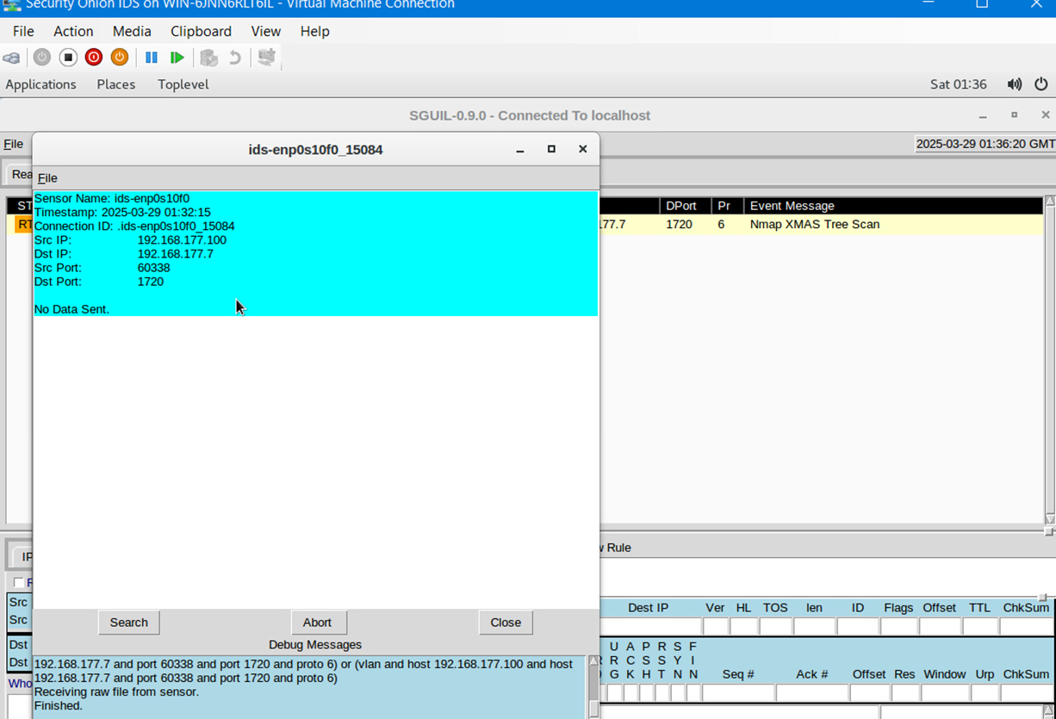
Testing Snort rules
This slide captures Snort successfully detecting an Nmap XMAS scan. The alert includes source and destination IPs and ports, confirming that the custom Snort rule triggered correctly based on the unique TCP flag pattern associated with stealth scanning techniques.

Slide 14
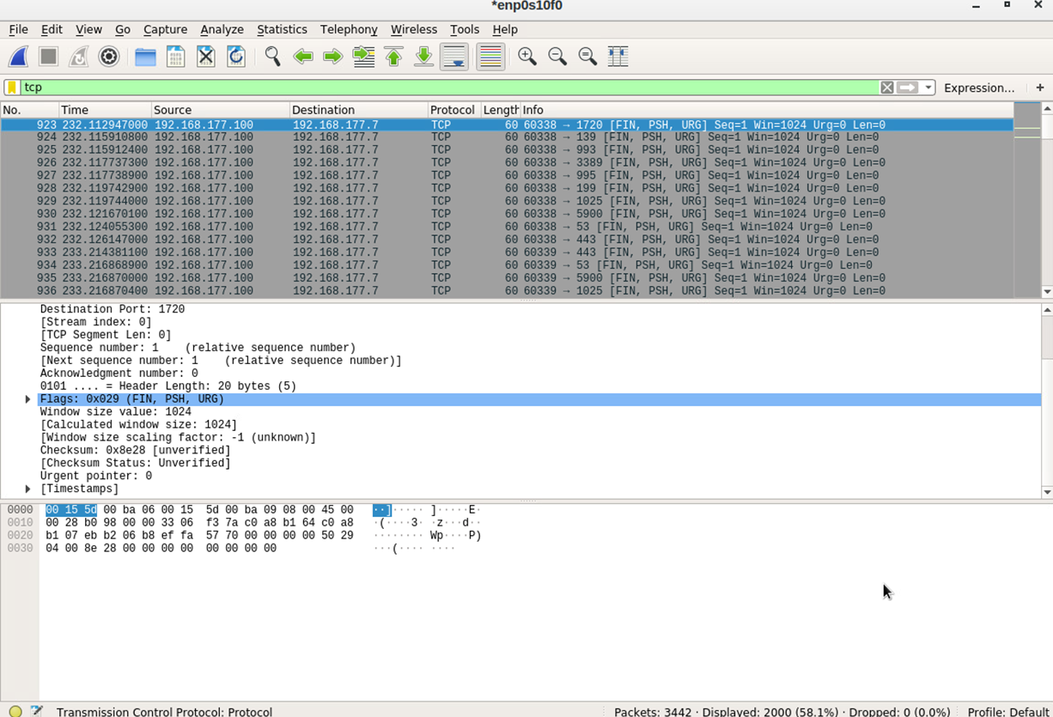
Testing Snort Rules Continued
This slide shows the raw TCP packets generated by the Nmap XMAS scan. The flagged packets display the FIN, PSH, and URG bits set—hallmarks of an XMAS scan used to probe for open or filtered ports while evading basic firewall detection.

Slide 15
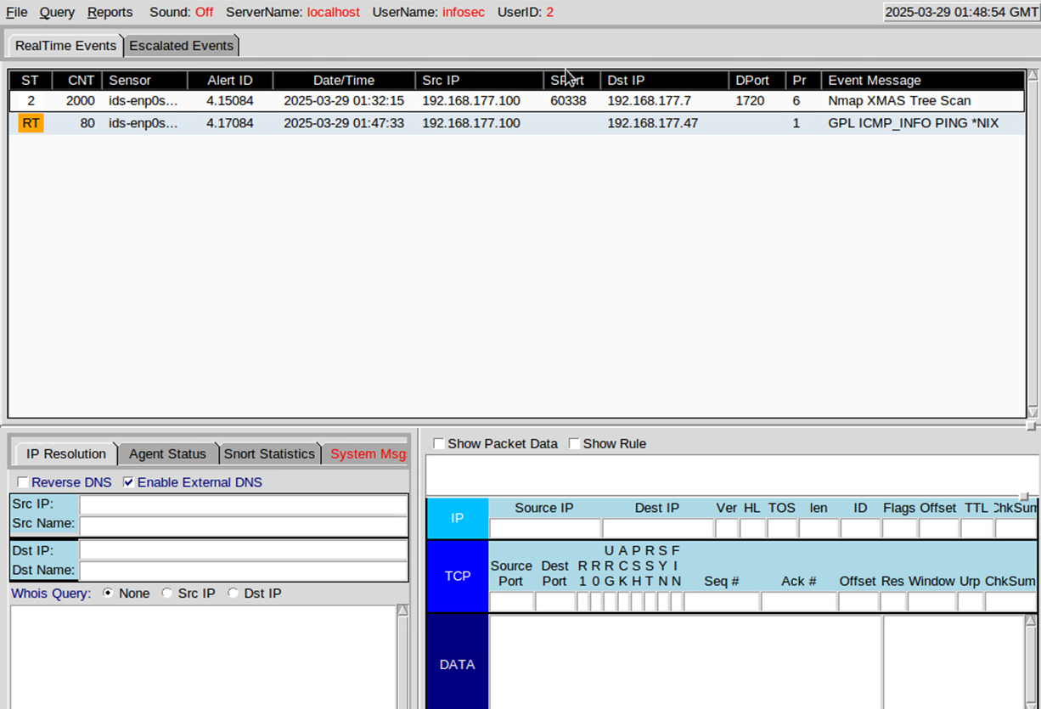
Creating Snort Rules
This slide shows Snort triggering an alert for ICMP ping activity. The event message confirms detection of a typical nix-based ICMP echo request, demonstrating successful rule creation for basic network reconnaissance monitoring.

Slide 16
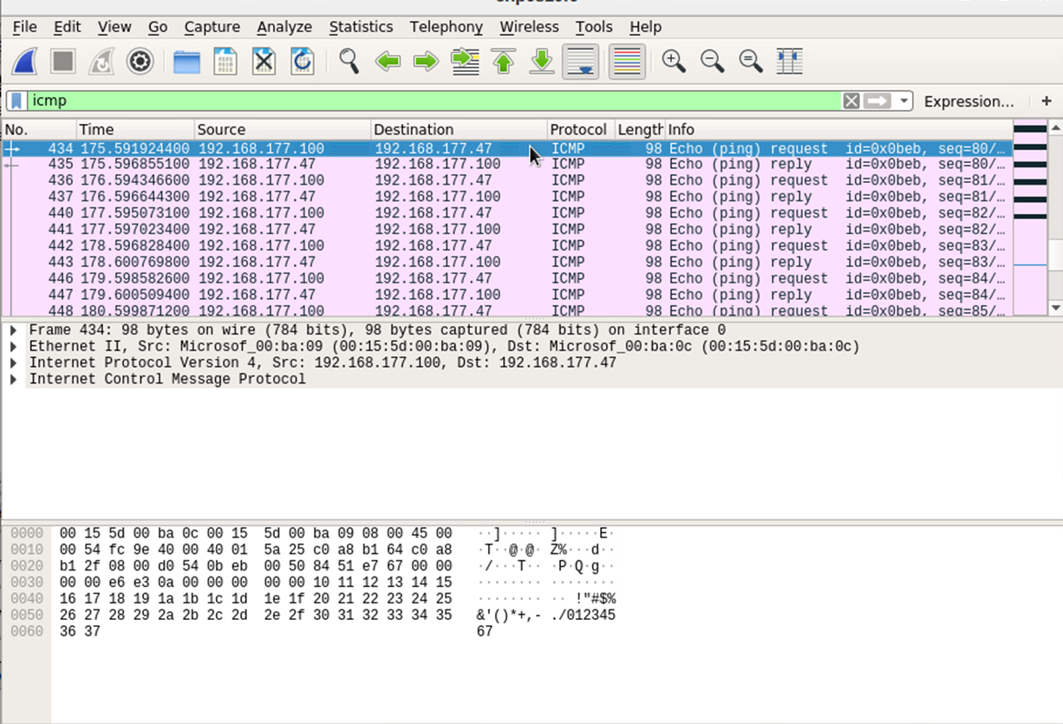
Creating Snort Rules Continued
This slide displays the ICMP Echo Request and Echo Reply packets captured during the ping test. These packets validate the network connectivity test and demonstrate how Snort can detect and log basic reconnaissance activity using custom rules.

Slide 17

Live Memory Analysis

Slide 18
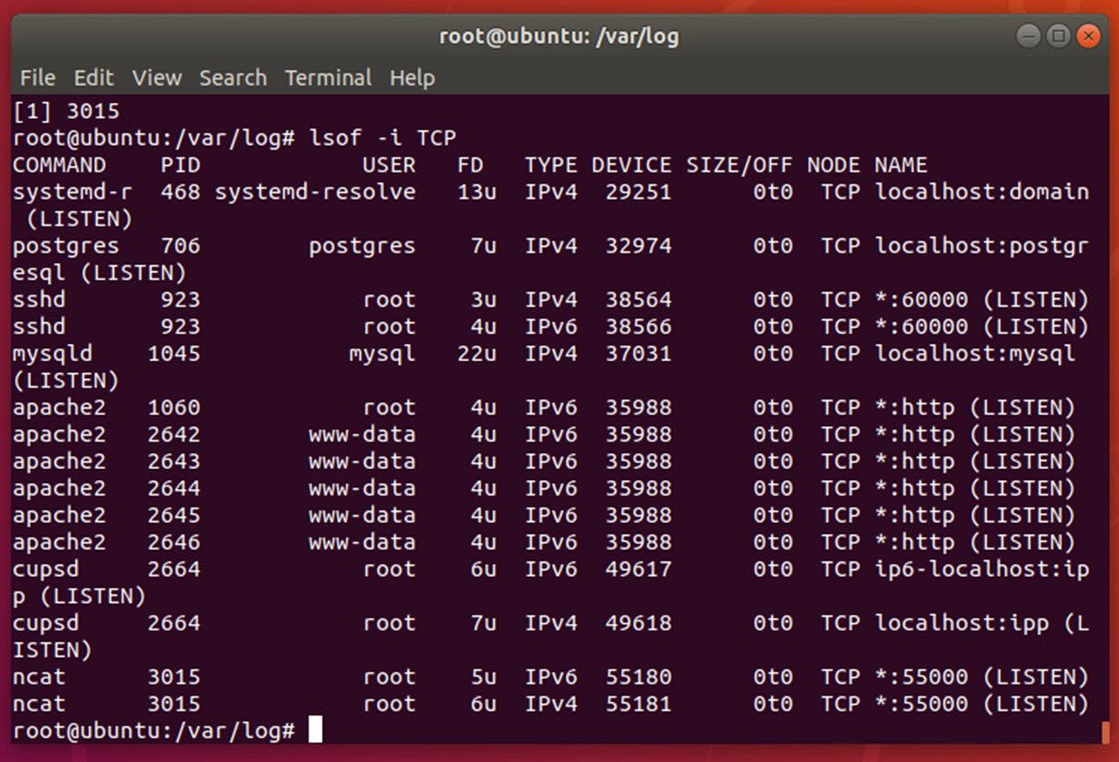
Linux Processes
This slide confirms that port 55000 is actively listening on both IPv4 and IPv6 interfaces. The output from the lsof command validates that the service bound to this port is accessible via multiple IP protocols, which is critical for ensuring compatibility and connectivity across different network environments

Slide 19
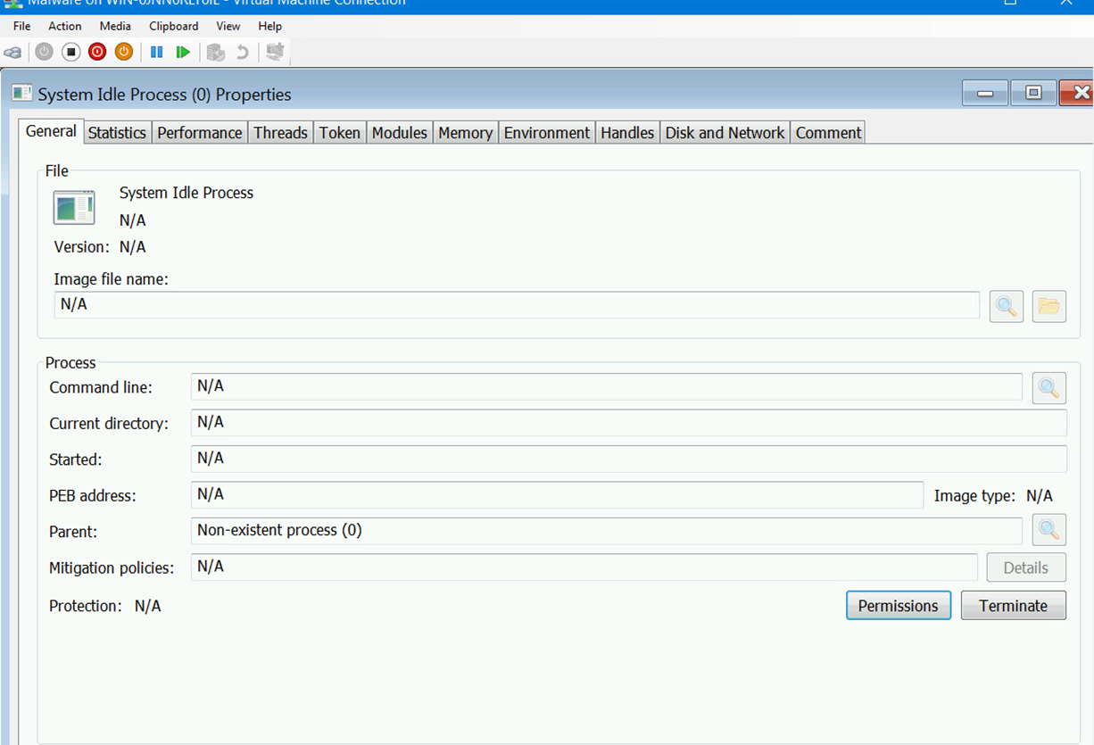
Process Hacker
This slide displays the properties of a selected system process using Process Hacker. It provides detailed insights into the process attributes, including command line, parent process, memory usage, and protection status, which are crucial for identifying and analyzing system behavior.

Slide 20
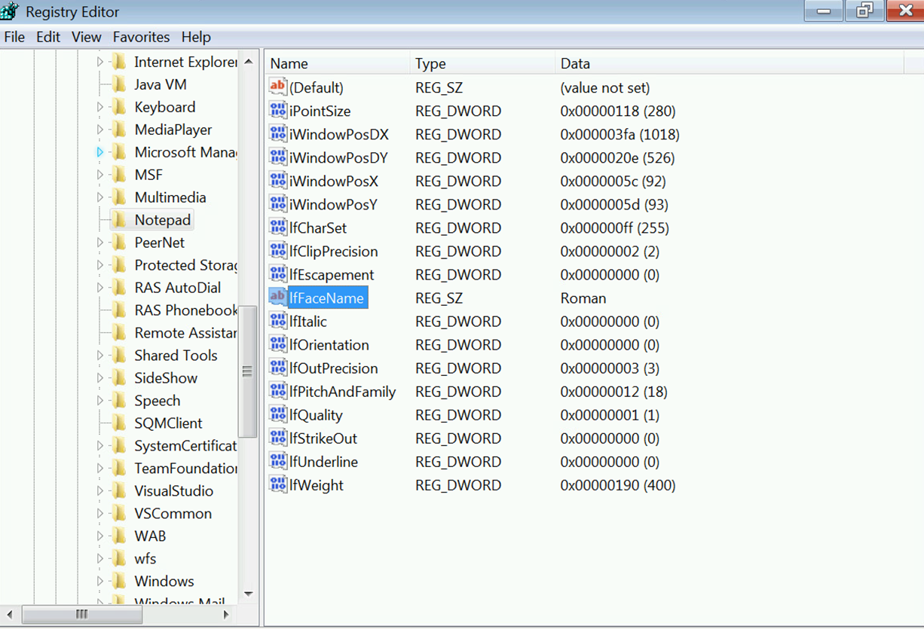
Process Monitor
This slide presents a registry snapshot captured using Process Monitor. It highlights the modification of the ifFaceName registry value under Notepad settings, confirming that the font was set to "Roman"—demonstrating successful tracking of system configuration changes.

Slide 21

Firewall

Slide 22
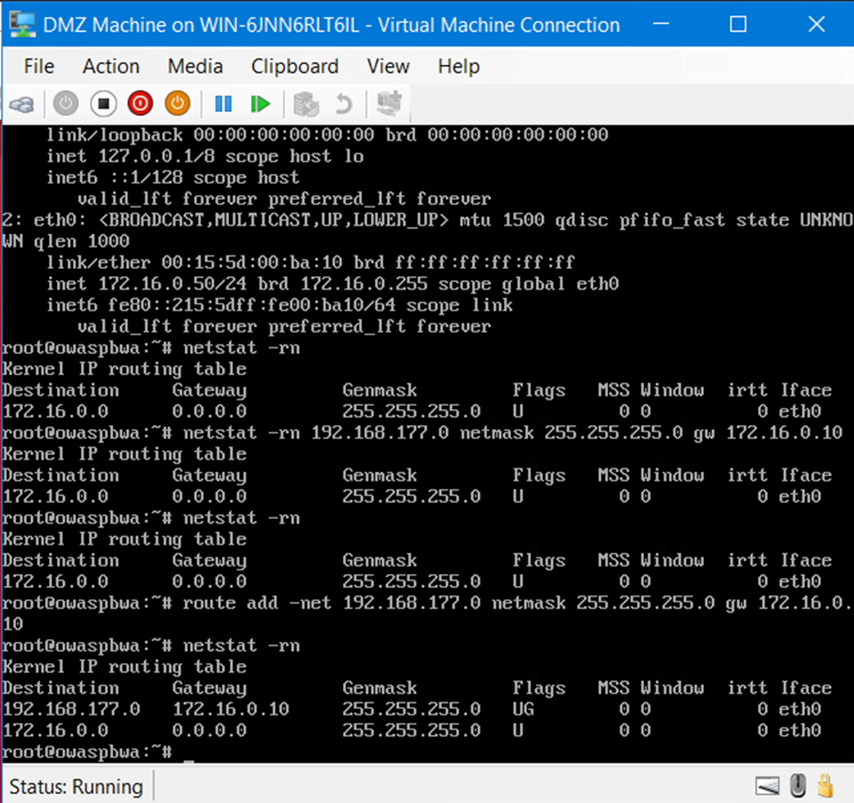
Time-based Access
This slide displays the output of the DMZ route table after applying time-based access controls. The routing table reflects the addition of a new route, verifying successful configuration of scheduled access to the internal network via the specified gateway.

Slide 23
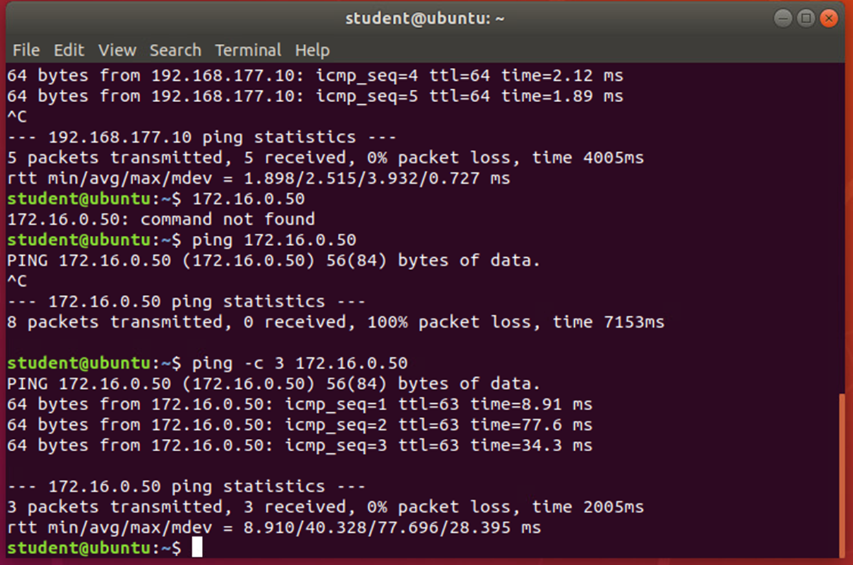
Time-based Access
This slide demonstrates successful time-based access by showing a ping from the Ubuntu Web VM to the DMZ VM. Initially blocked, the ping is later successful after the appropriate access time window is enabled, confirming the rule's effectiveness.

Slide 24
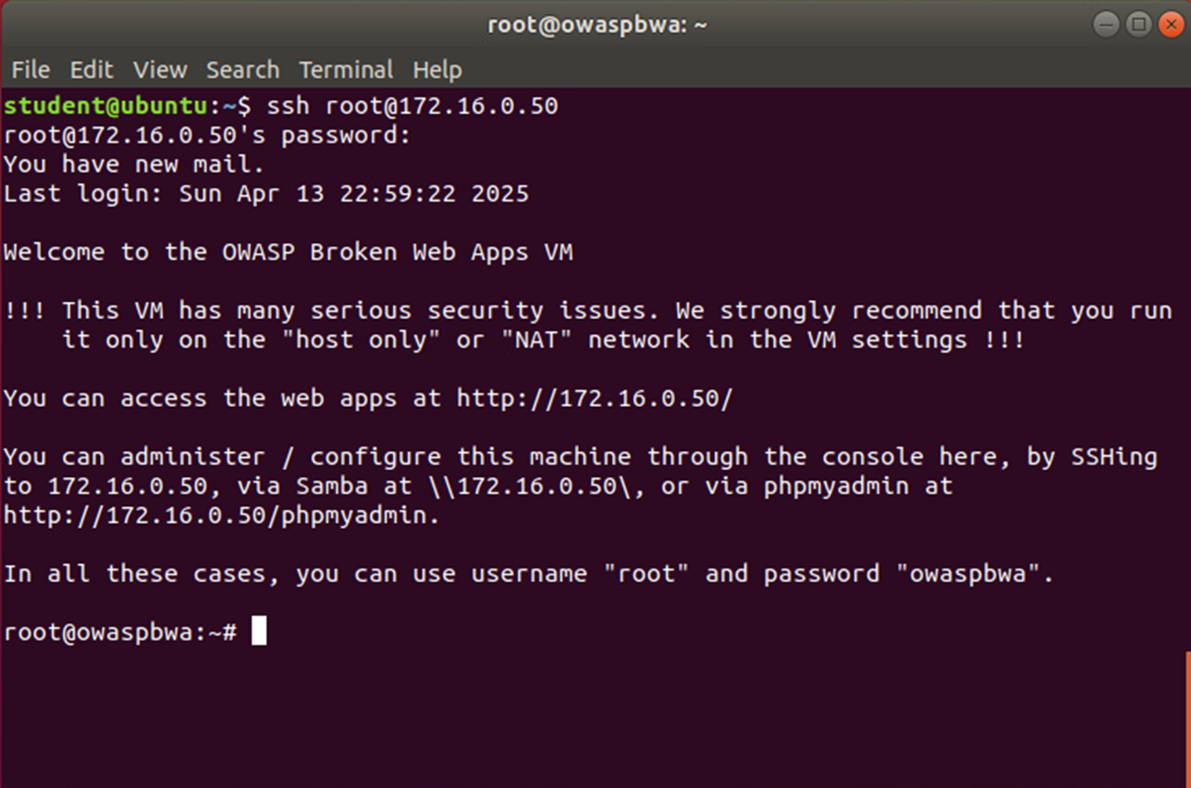
Time-based Access
This slide confirms successful remote SSH login to the OWASP Broken Web Apps VM. The output reflects the implementation of time-based access control rules in the FORWARD chain, enabling secure and scheduled connections.

Slide 25
Challenges Faced
Configuring Snort rules to detect specific network behaviors like XMAS scans and pings
Decrypting SSL/TLS traffic and validating HTTP GET requests
Analyzing packet details in Wireshark and identifying correct flags and sequences
Interpreting IP tables and route configurations in Linux environments
Troubleshooting unexpected behavior in virtual machines and capturing accurate data

Slide 26
Career Skills Gained
Threat Analysis: Gained hands-on experience identifying and interpreting network attacks using tools like Wireshark and Snort
Incident Response: Practiced real-time detection and alerting methods essential for cybersecurity operations
Linux & Networking: Strengthened command-line skills and deepened understanding of routing, IP tables, and open ports
Security Monitoring: Used SSL/TLS decryption and log analysis to monitor encrypted traffic
Tool Proficiency: Built confidence working with Snort, Process Monitor, Process Hacker, and virtual environments
Critical Thinking: Learned how to troubleshoot, validate findings, and correlate logs with expected outcomes

Slide 27
Conclusion
This project provided a comprehensive overview of infrastructure security concepts in action
Reinforced key skills in threat detection, analysis, and secure network practices
Hands-on labs with real tools like Wireshark and Snort helped simulate real-world cybersecurity scenarios
Developed confidence in managing incidents, configuring systems, and interpreting logs
Prepared to apply these foundational skills in professional cybersecurity environments

Slide 28
References
https://www.imperva.com/learn/performance/time-to-live-ttl/
https://www.geeksforgeeks.org/tcp-connection-termination/
https://wiki.openssl.org/index.php/Command_Line_Utilities
https://wireshark.org/docs/

