Slide 1

NETW191 Final Course Project
SOHO router configurations, subnetting, connectivity testing, network documentation, and SOHO wireless network security
Cody Kyser

Slide 2

Introduction
Beginning with the crucial role of SOHO networks in our interconnected world, we dive into router configurations for seamless connectivity. We address subnetting for optimal address space utilization, proactive strategies for connectivity testing, and the importance of comprehensive network documentation. This project concludes with a focus on wireless security protocols.

Slide 3

IPv4 Addressing

Slide 4
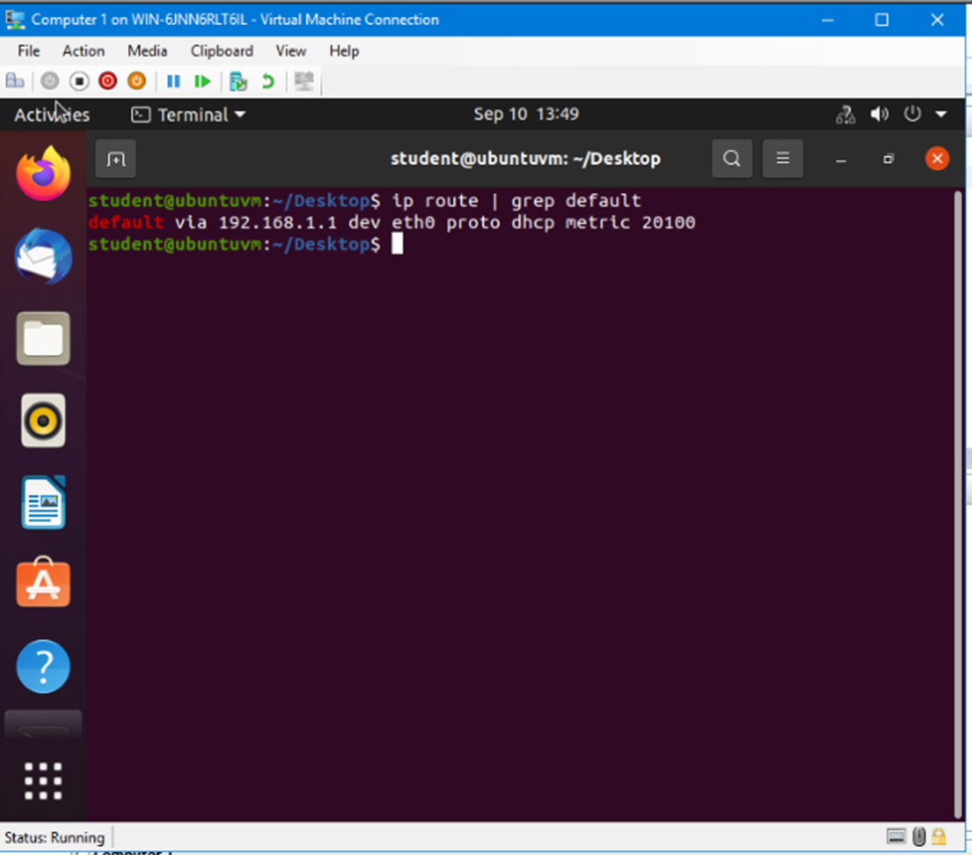
Preparation
Screenshot of terminal window showing the default gateway IP address

Slide 5
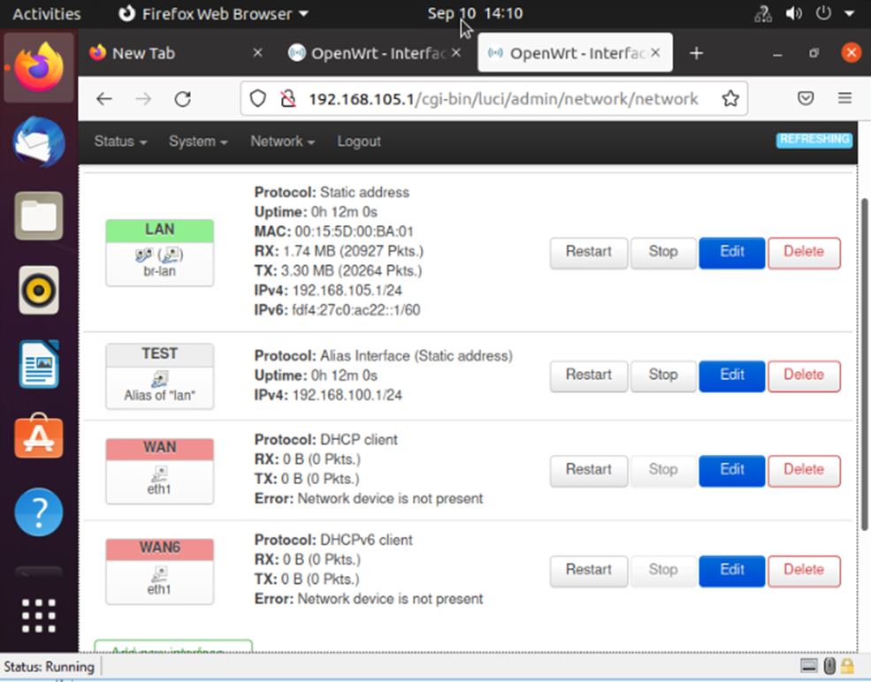
IPv4 Address Assignment
Screenshot of interfaces page that shows the new IPv4 address on the LAN interface.

Slide 6

Network Connectivity Test

Slide 7
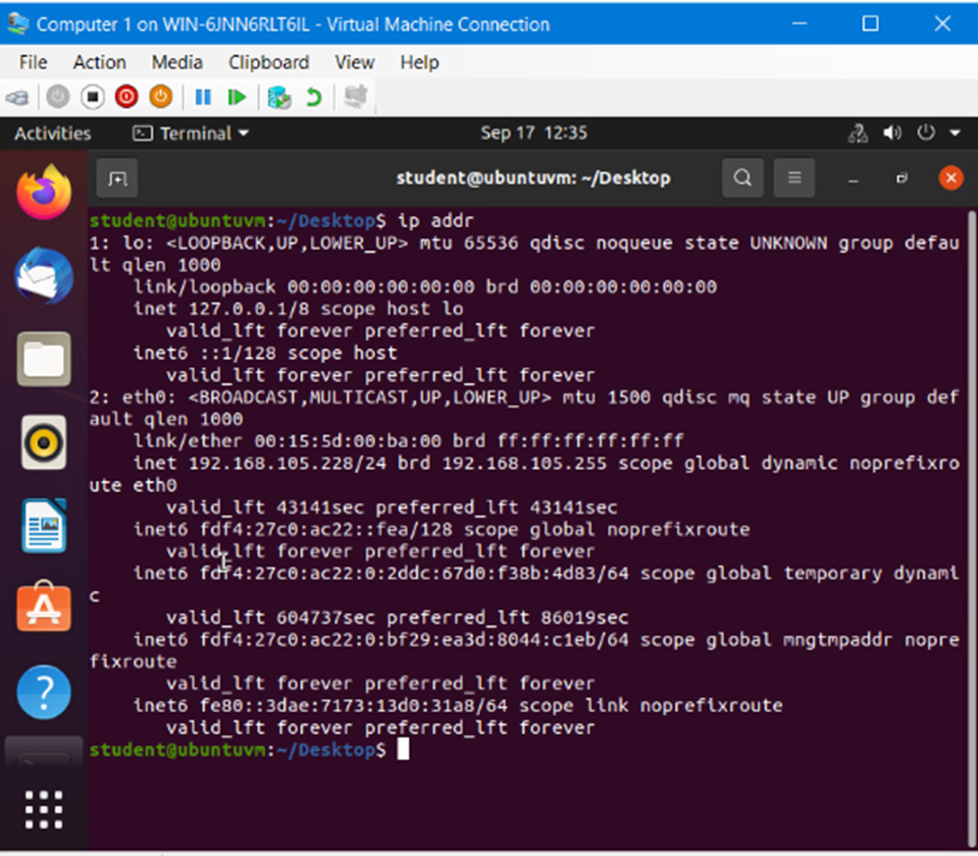
Dynamic IP Address Assignment
Screenshot of the IPv4 address of the Computer 1 VM.

Slide 8
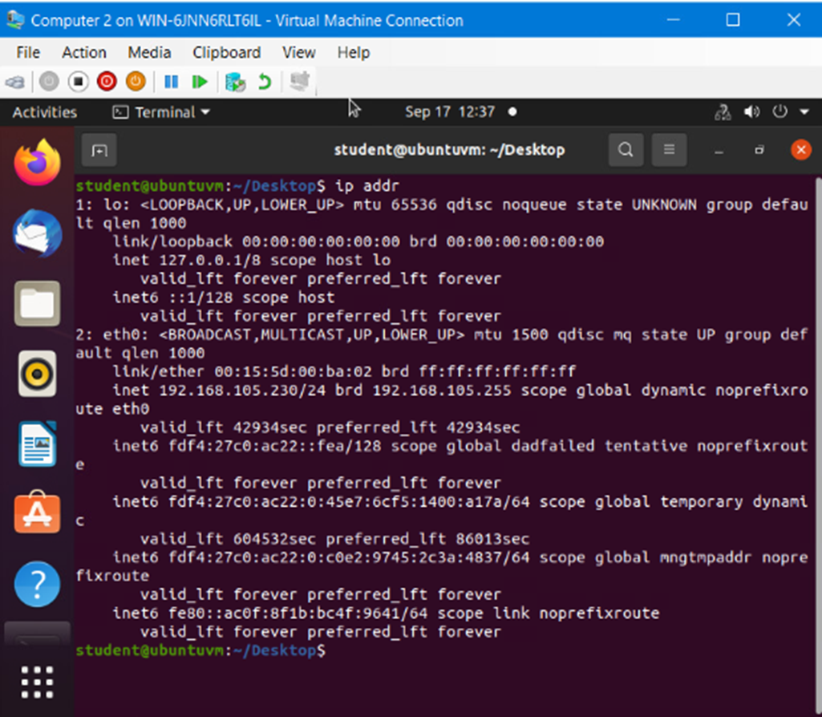
Dynamic IP Address Assignment
Screenshot of the IPv4 address of the Computer 2 VM.

Slide 9
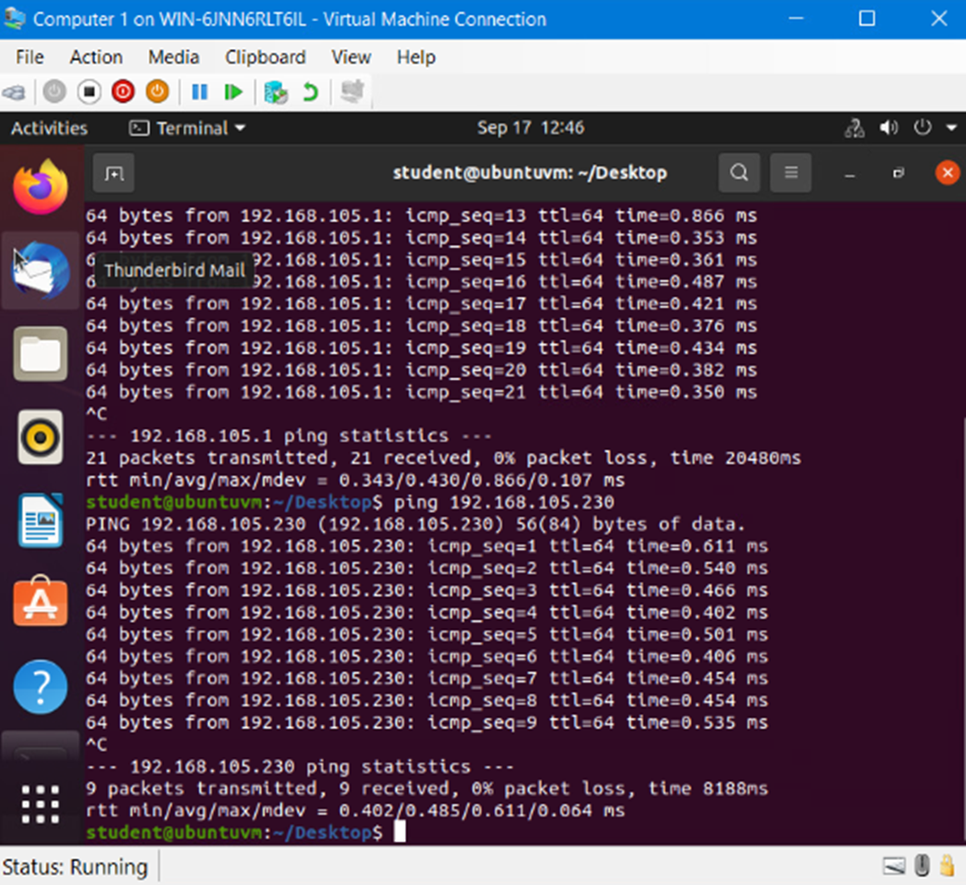
Connectivity Test
Screenshot showing the connectivity test between Computer 1 VM and the other two devices (i.e., the SOHO Router VM, and Computer 2 VM.

Slide 10
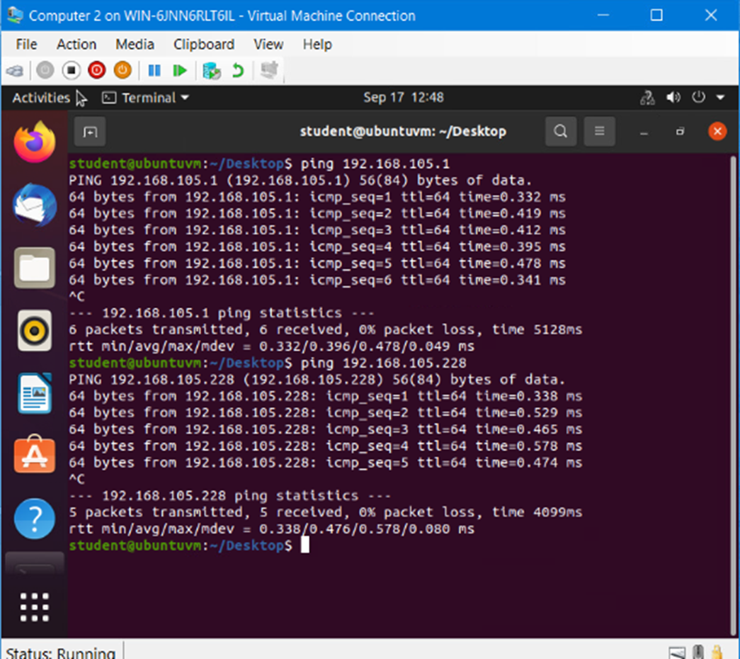
Connectivity Test
Screenshot showing the connectivity tests between the Computer 2 VM and the other two devices (i.e., the SOHO Router VM and Computer 1 VM.

Slide 11

IP Subnetting and Loopback Interface

Slide 12
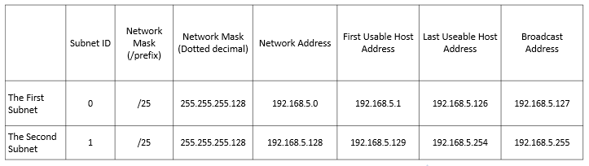
Subnetting Table
This table includes two /25 subnets, listing the subnet notation, network address, first usable host address, last usable host address, and broadcast address of each subnet.

Slide 13
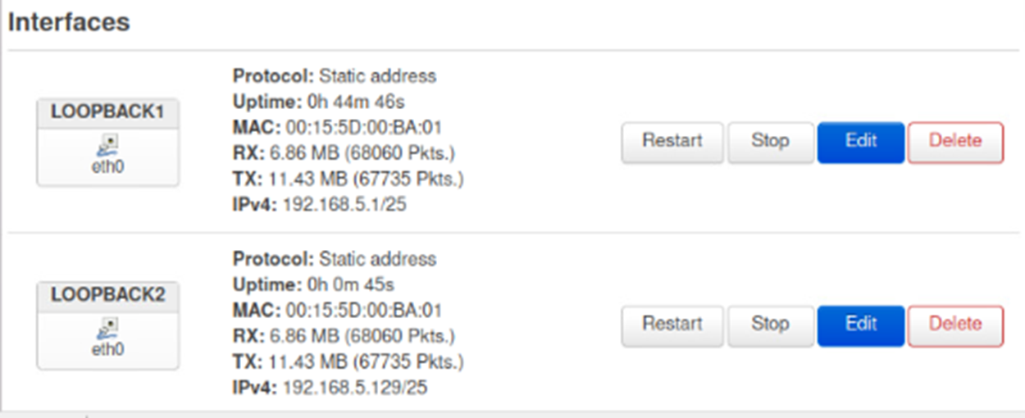
Loopback Interfaces
Screenshot showing both Loopback1 and Loopback2 interfaces and their correct IPv4 addresses.

Slide 14
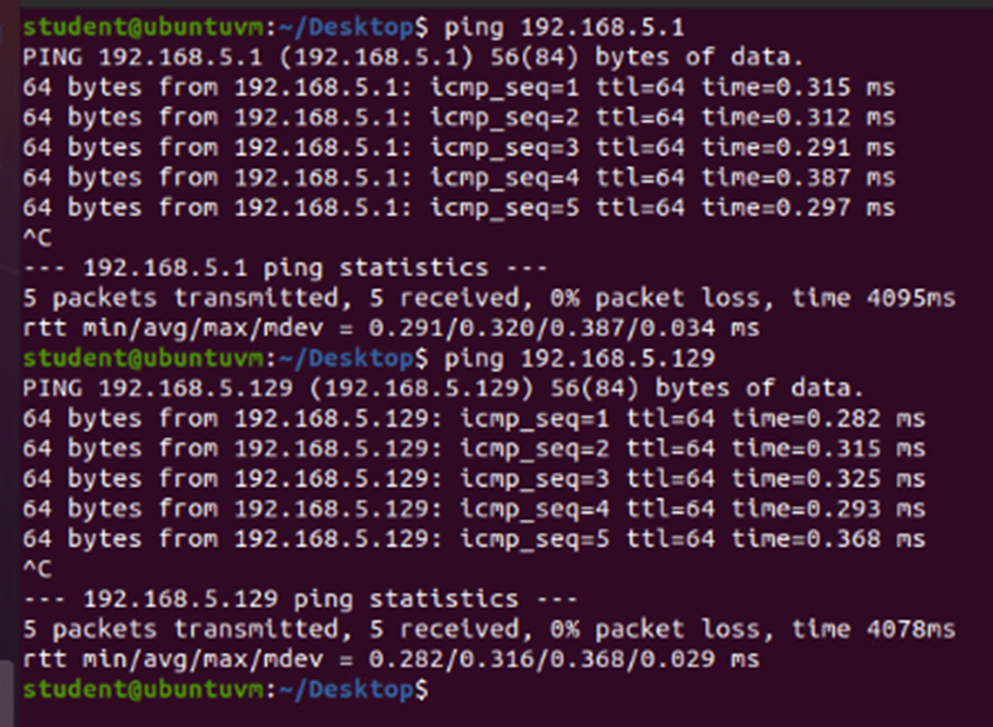
Connectivity Tests
Screenshot showing two successful ping tests from the Computer 1 VM to the Loopback 1 and Loopback 2 interfaces.

Slide 15

Visio Network Diagram

Slide 16
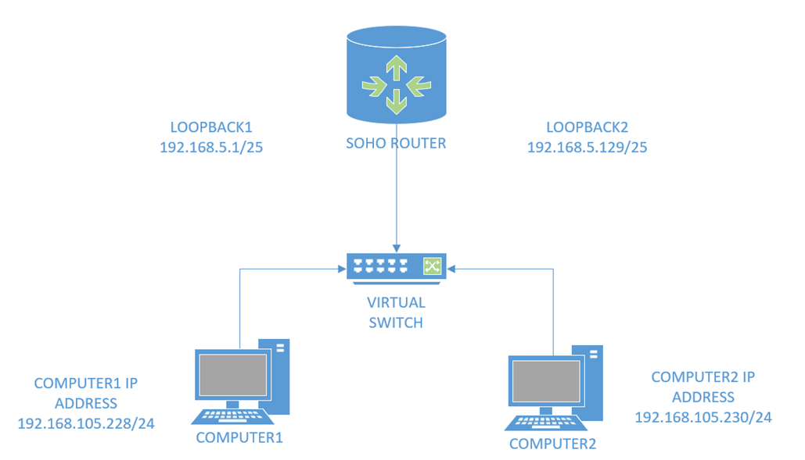
Microsoft Visio Network Diagram
This diagram illustrates the interconnection of the Computer 1 VM, the Computer 2 VM, and the SOHO Router VM along with proper addressing and labeling.

Slide 17

SOHO Wireless Network Security

Slide 18
SOHO Wireless Network Security
1. What are the factory default username and password of a TP-Link router? Why is it important to change the default username and password of a SOHO router?
Answer: The default username and password of a TP-Link router is as follows;
Username-admin Password-admin. It is important to change your username and password as soon as possible since anyone can look online to find the defaults for any router and obtain access to your network.
2. To protect a SOHO wireless network with a small number of devices, which address management method provides more control, configuring the device IP addresses manually (static IP) or using a DHCP server (dynamic IP)? Why?
Answer: Static IP address configuration allows precise control over which IP addresses are configured to each device. This provides more predictability for troubleshooting connectivity issues and network topology.
3. What does MAC filtering do? If needed, when would you use deny filtering rules and when would you use allow filtering rules? What happens to devices that want to connect, if the “Allow the stations specified by any enabled entries in the list to access” function is enabled but there are no entries in the list?
Answer: MAC filtering controls which devices are allowed to connect to a network. MAC addresses are unique identifiers assigned to the network interface card (NIC). It creates a list of approved or denied MAC addresses. You would use deny filtering rules to identify problematic devices, or to block specific devices from accessing the network. Allow filtering rules creates a list of specific devices allowed to connect to the network. Higher security level information access would utilize the allow access filtering. Allow filtering with an empty list would deny access to all devices as the list is blank.

Slide 19
SOHO Wireless Network Security
1. What wireless security settings are displayed on the Wireless Security page? Which one is recommended by the vendor? Why?
Answer: WPA2-PSK is the default security setting. It is not recommended to disable wireless security as the wireless stations will be able to connect the device without encryption. WPA/WPA2-Personal, WPA/WPA2-Enterprise is recommended. WEP is outdated and not as secure due to significant vulnerabilities.
2. Among the configurations you explored in this module, which one is a true security function? Why?
Answer: WPA2 Enterprise is going to be the best option for security. Utilizing individual user authentication along with a centralized authentication server, account management, reduced passphrase sharing, and extensible authentication protocol (EAP), although more complex, only adds to the higher level of security.
3. What would you do to protect your wireless network at home? Why?
Answer: Changing the default credentials along with a strong Wi-Fi password, MAC address filtering, and network segmentation for guests would be a start for a default router. Personally, I utilize a Raspberry Pi 4 as a router with built-in VPN and proxy chains.

Slide 20
Challenges
1. Security Tightrope: Balancing accessibility and security in SOHO wireless networks
2. Subnetting Puzzle: Unraveling the complexities of subnetting demands precision to optimize space
3. Connectivity Hurdles: Proactively testing connectivity across diverse platforms to ensure uninterrupted operations.
4.Documentation Dilemmas: Comprehensive network documentation
5. User Friendly Configurations: Maintaining user-friendliness while configuring routers for optimal performance.

Slide 21
Career Skills
Network Administration: Router configuration and subnetting.
Network Optimization: Connectivity testing
Documentation and Troubleshooting: Documenting efficient network management and troubleshooting.
Cybersecurity: Implementing security protocols for SOHO wireless networks and addressing potential vulnerabilities.
Project Management: Planning and executing a project involving various components of SOHO networks.

Slide 22

Conclusion
This project has equipped us with a skill set crucial in todays world of network administration. This project demanded technical prowess, adaptability, and effective communication, which are key in today’s tech landscape. In conclusion this project has taught us SOHO router configuration, subnetting, connectivity testing and wireless security. All in all, this has better prepared us in shaping the networks of the future.

Slide 23
Resources
1. https://www.securew2.com/blog/should-wpa2-enterprise-be-used-for-my-home-network#:~:text=Wi%2DFi%20Protected%20Access%20(WPA,businesses%20%E2%80%93%20is%20even%20more%20secure.
2. https://www.geeksforgeeks.org/mac-filtering-in-computer-network/
3. https://medium.com/an-internet-website/creating-a-wireless-proxy-vpn-router-with-a-raspberry-pi-3e1b346cfef4

