Slide 1
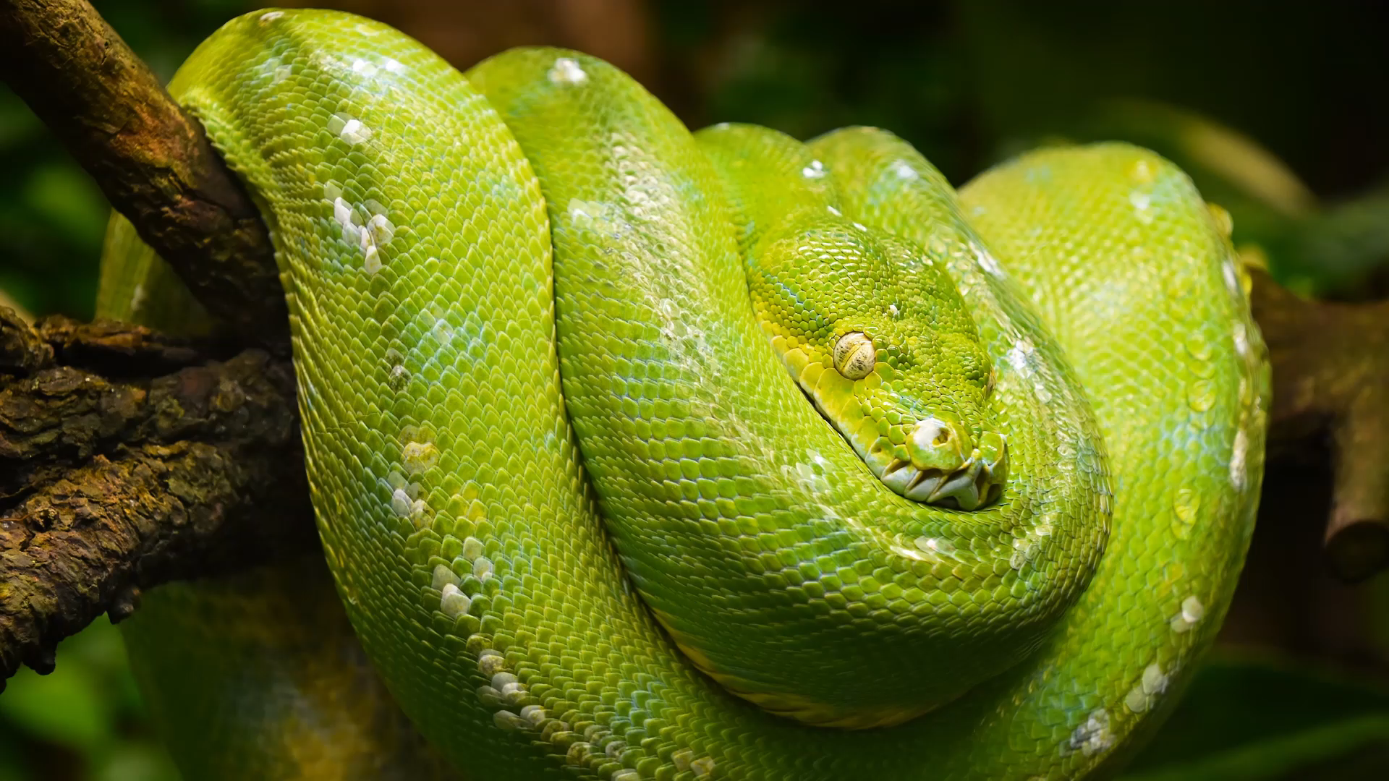
Python Stock Tracking Program

Slide 2
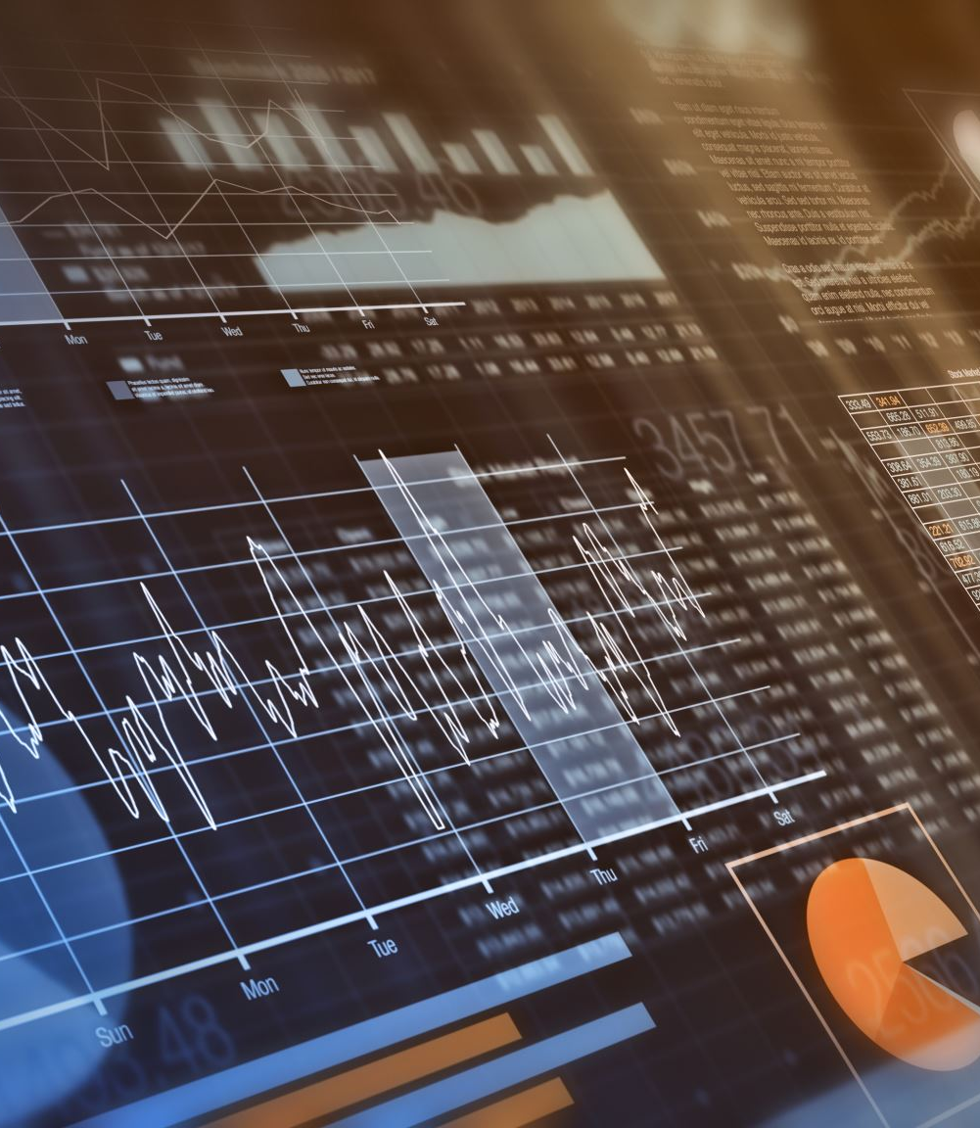
Introduction
The following program was designed to analyze stock market data and chart profit/loss through generating graphs to visualize data. By utilizing object-oriented programming in Python, I was able to create a user interface to import historical data. Once imported, I was able to use various Python libraries to analyze stock data and create visual graphs displaying stock data. Finally, creating a graphical user interface (GUI) simplified usability to input the stock data of the end user’s choosing and upload historical data to analyze stocks.

Slide 3

Software Environment Setup
Objectives:
Install Anaconda
Chose an IDE for your Project
Create a python program
Knowledge Gained:
These tasks provided foundational knowledge in Python environment setup, selecting development tools, and the basics of Python programming

Slide 4
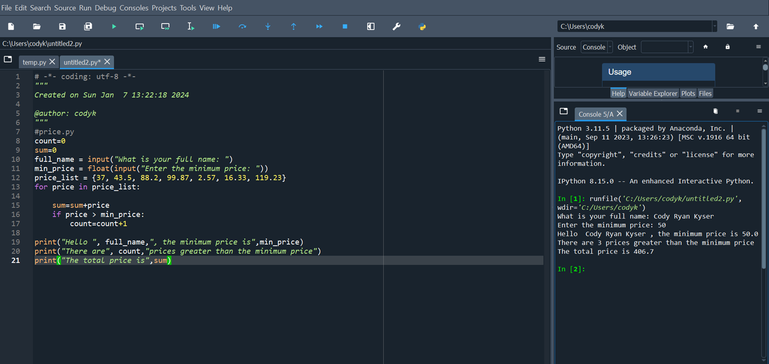
Program
Screen shot of Python program running successfully.

Slide 5
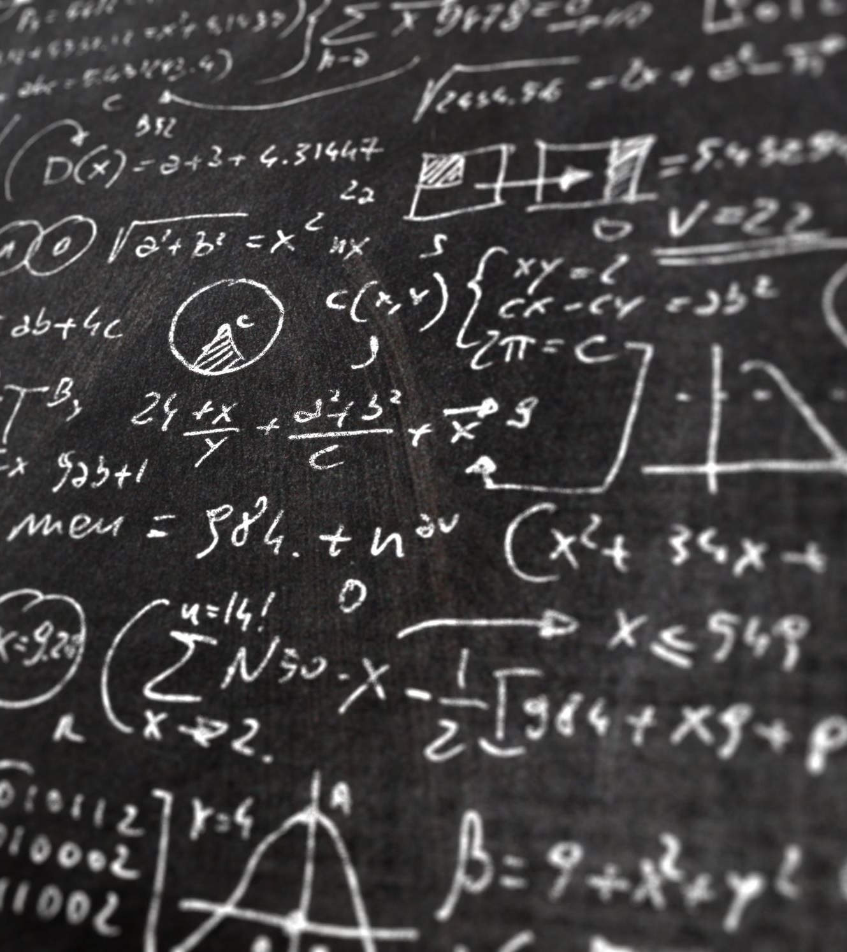
Class Diagrams, Class Coding, Unit Testing
Objectives:
Create Class Diagrams
Create Classes
Run Unit Test
Knowledge Gained:
These tasks contribute to an understanding of software development, particularly in the context of object-oriented programming, system design, coding practices, and quality assurance through testing.

Slide 6
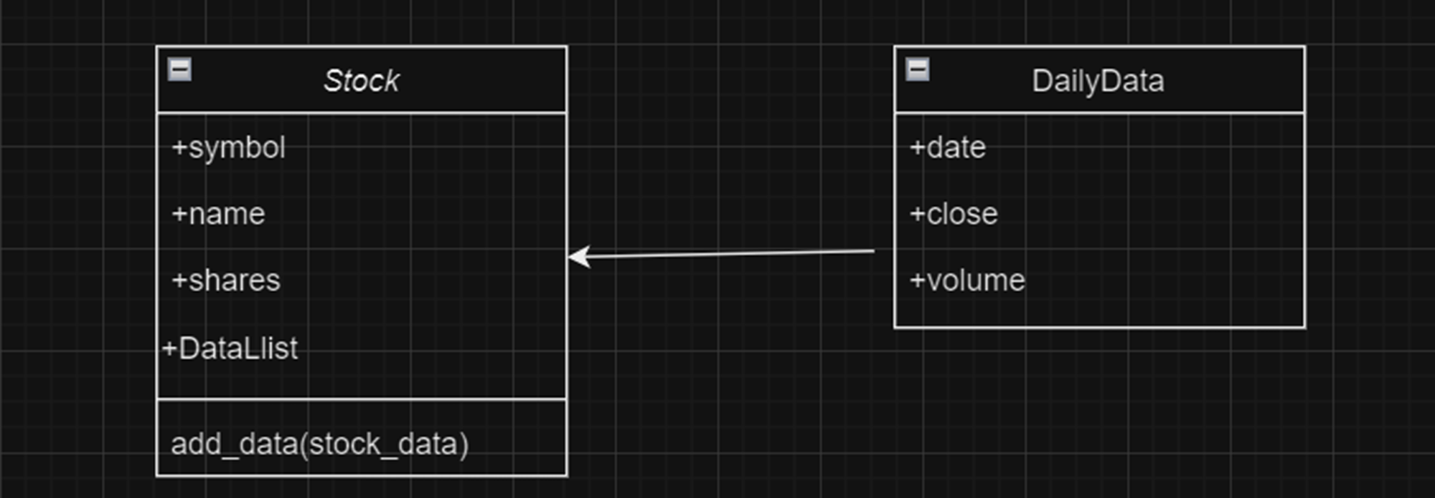
Class Diagram
Screenshot of Visio Class Diagram

Slide 7
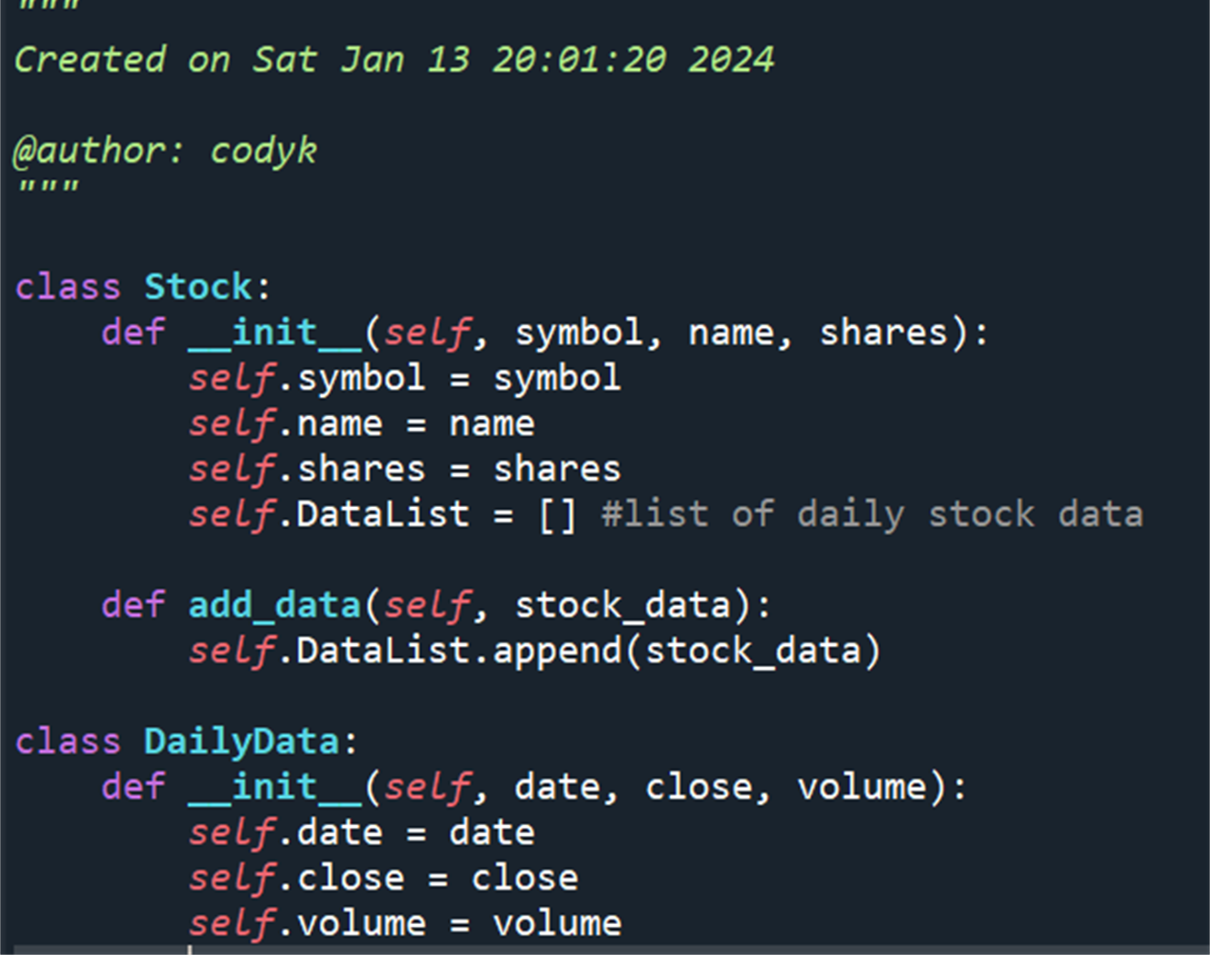
Class Code
Screen Shot of my stock_class.py file.

Slide 8
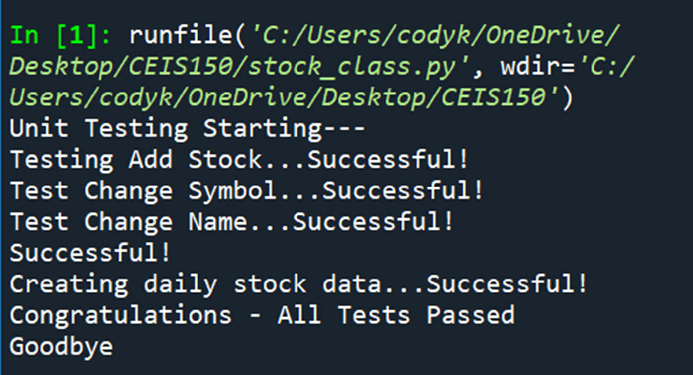
Unit Test
Screen Shot of my successful unit test.

Slide 9
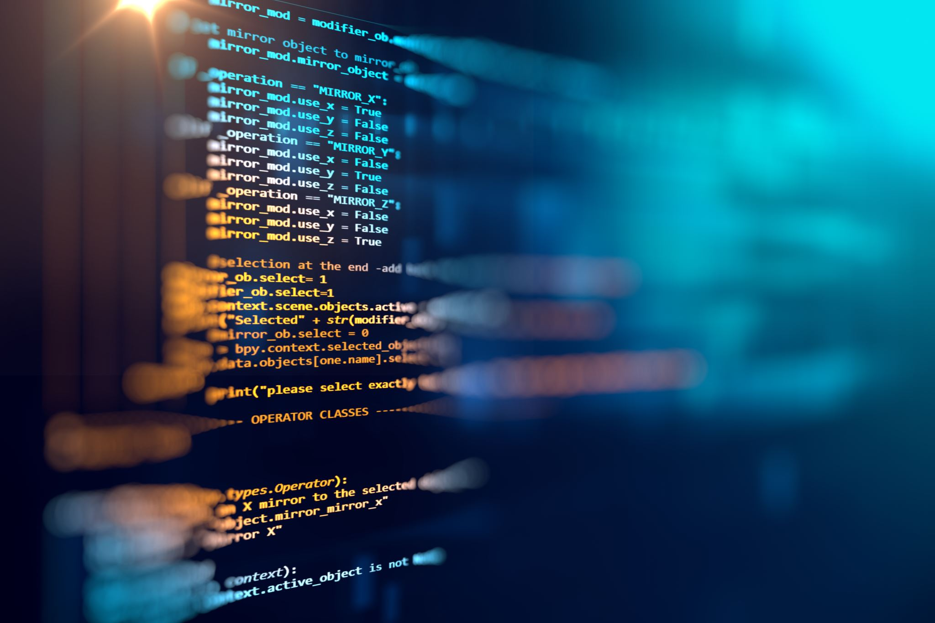
Text-Based User Interface & Summary Report
Objectives:
Create a Menu-Driven User Interface to Add/List/Delete Stocks, and to Track Price and Volume History
Create Functions to handle menu items
Knowledge Gained:
User interface design, data management, database operations, financial concepts, and various programming and software engineering principles.
Basic programming skills also encompassing user interface design, logical thinking, and an understanding of modular and efficient code organization.

Slide 10
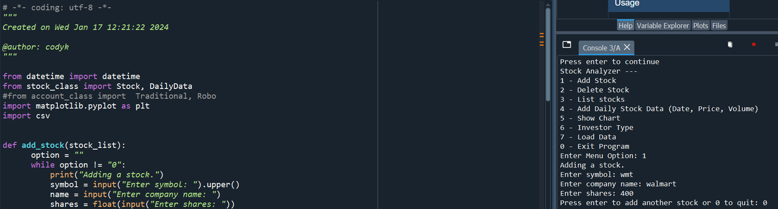
Adding a Stock
Screen shot of my working Stock program.

Slide 11
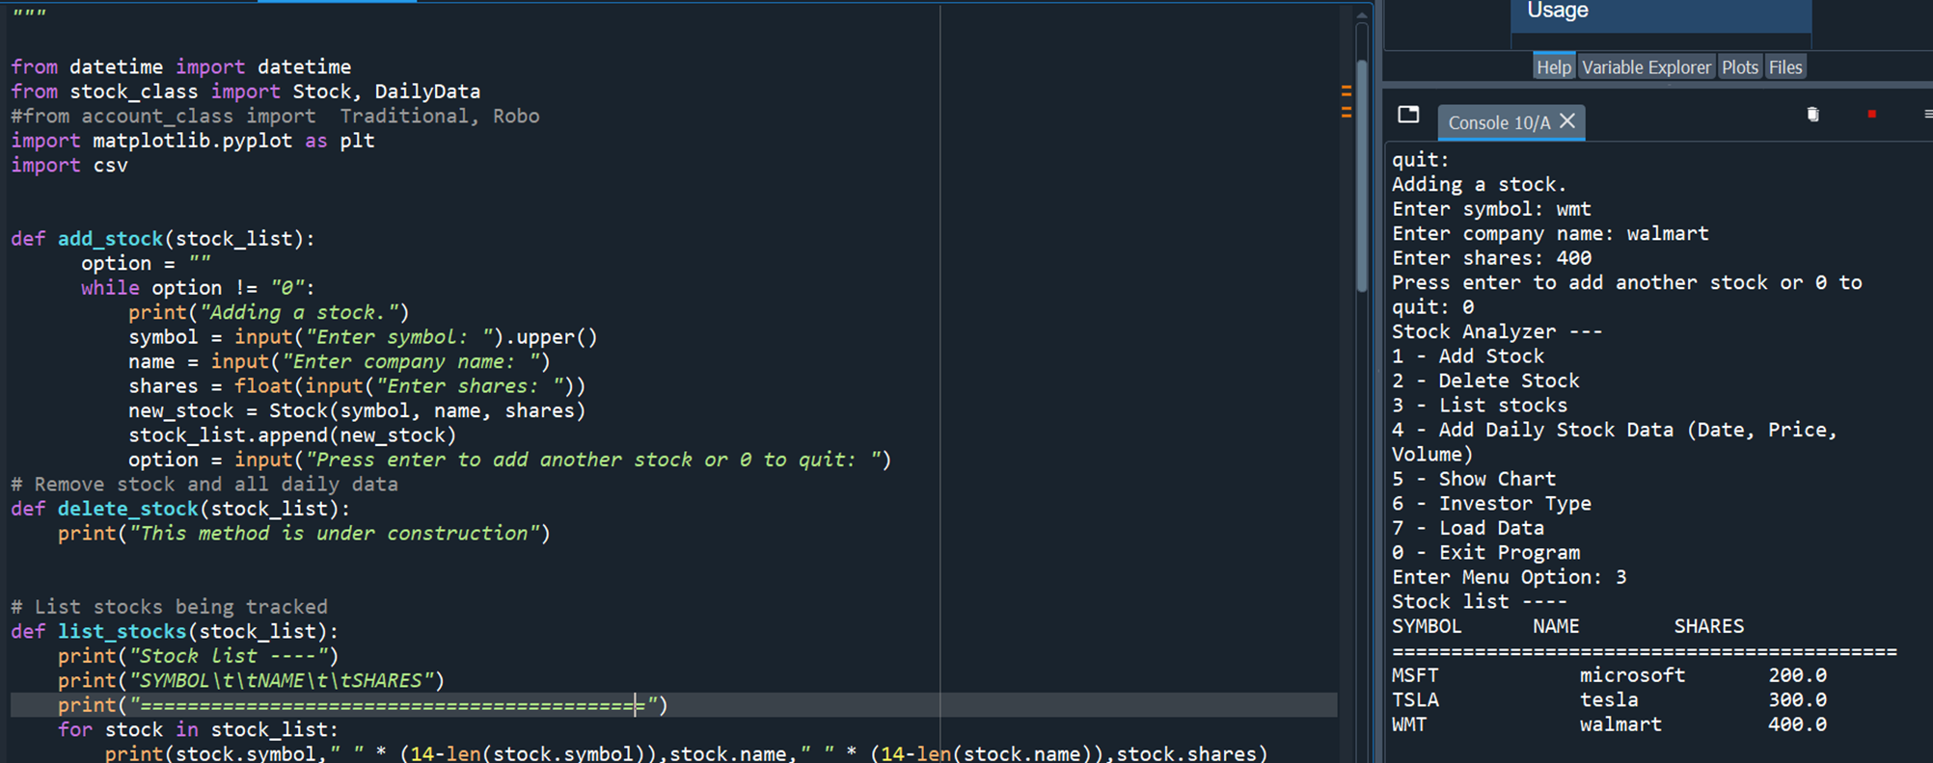
Listing 3 Stocks
Screen shot of my working Stock program.

Slide 12
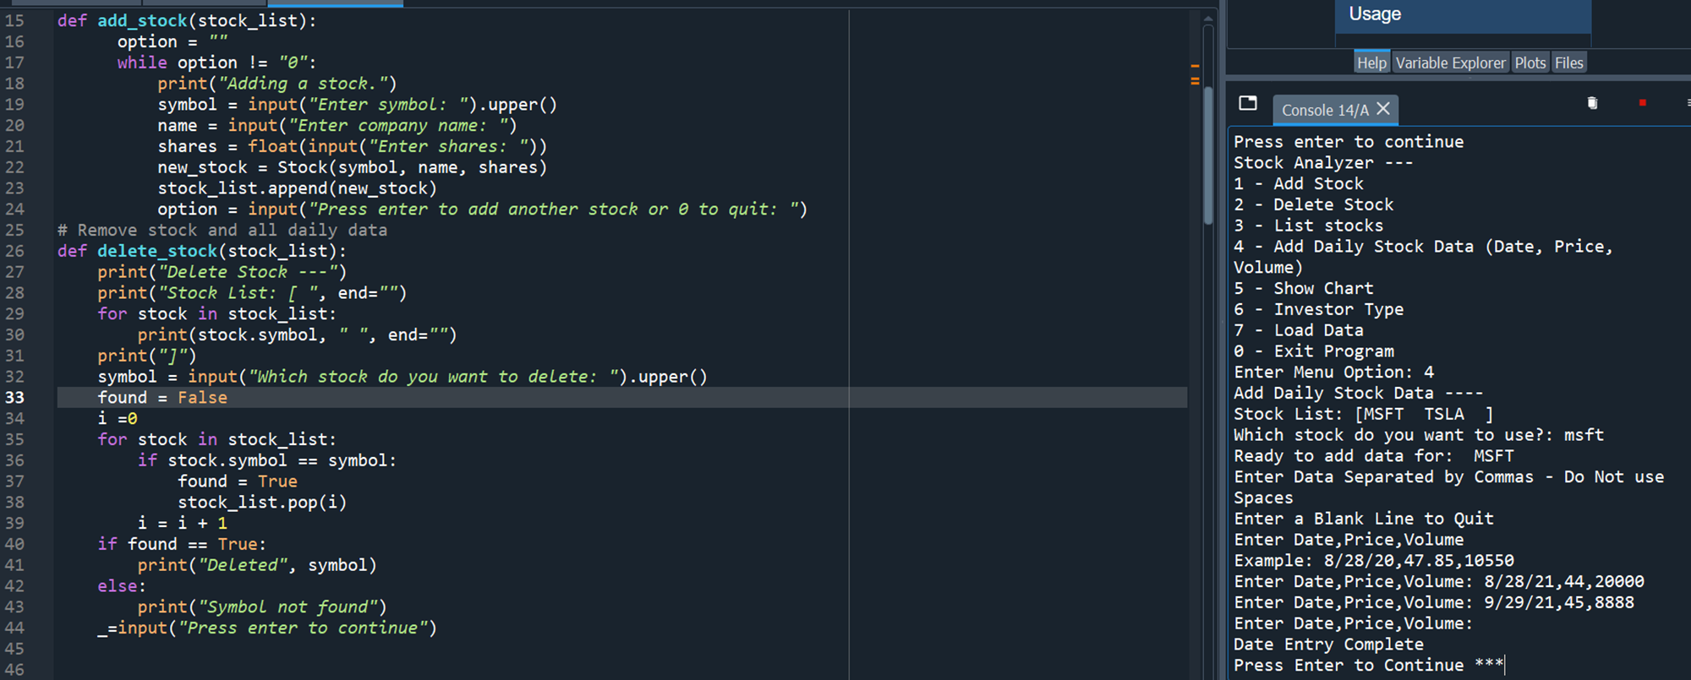
Daily Data
Screen shot of my working Stock program.

Slide 13

Inheritance Summary Report
Objectives:
Implement inheritance in the stock program
Create three classes
Run Unit Test
Knowledge Gained:
These objectives contribute to a deeper understanding of object-oriented programming principles, including inheritance, class creation, and unit testing.

Slide 14
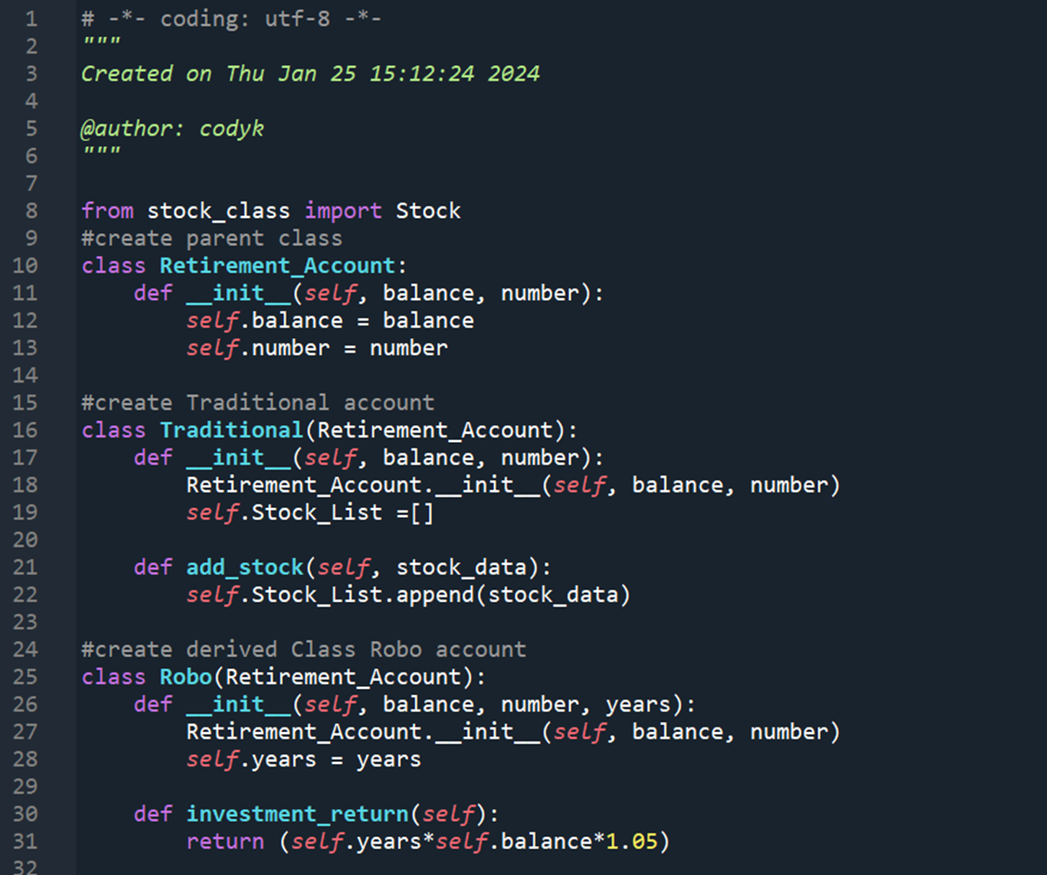
Inherited classes
Screen shot of my classes

Slide 15
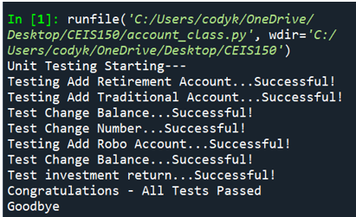
Unit Tests
Screen shot of my unit tests successfully completed

Slide 16
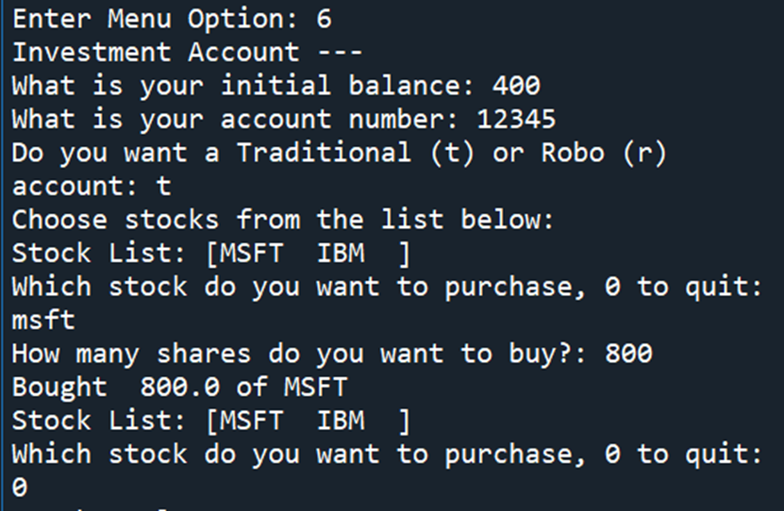
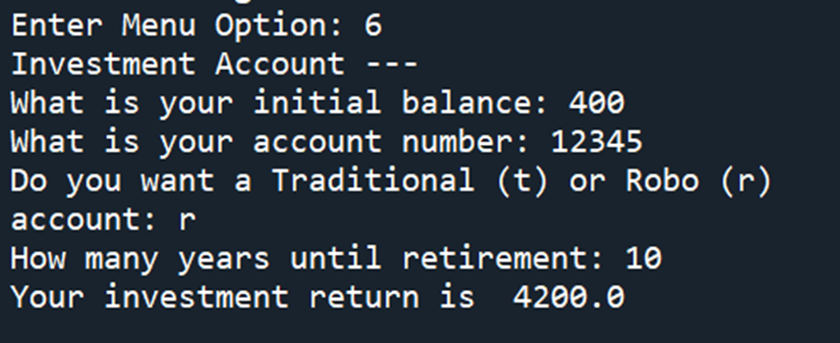
Stock Menu Program
Screen shot of my classes in the main program

Slide 17

Creating a Chart
Objectives:
Use the pyplot class in the matplotlib library to create a simple stock chart.
Knowledge Gained:
This objective contributes to knowledge in data visualization, specifically using the Matplotlib library and its pyplot class for creating informative and visually appealing stock charts. Additionally, it provides practical experience in interpreting and presenting financial data through visualizations.

Slide 18
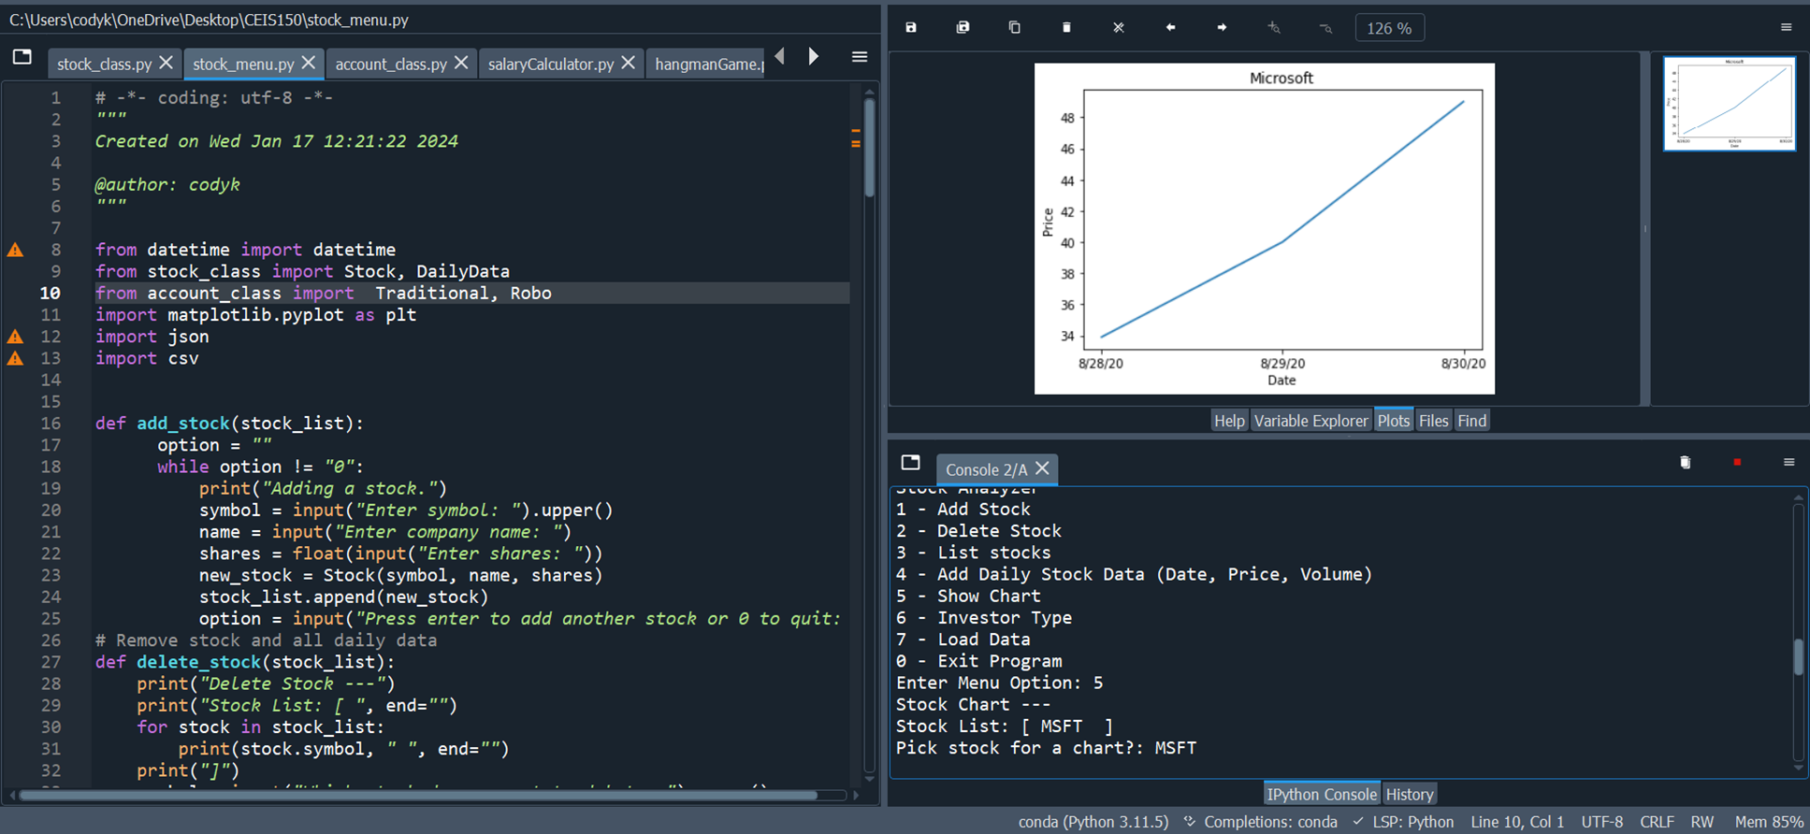
Chart

Slide 19
Loading Data
Objectives:
Use the csv library to import data from Yahoo! Finance.
Read data from a file
Knowledge Gained:
These tasks provide knowledge and skills related to data retrieval from external sources, handling CSV files, and reading data from files in a programming context. This is essential for obtaining and working with real-world data, especially in financial or data analysis applications.

Slide 20
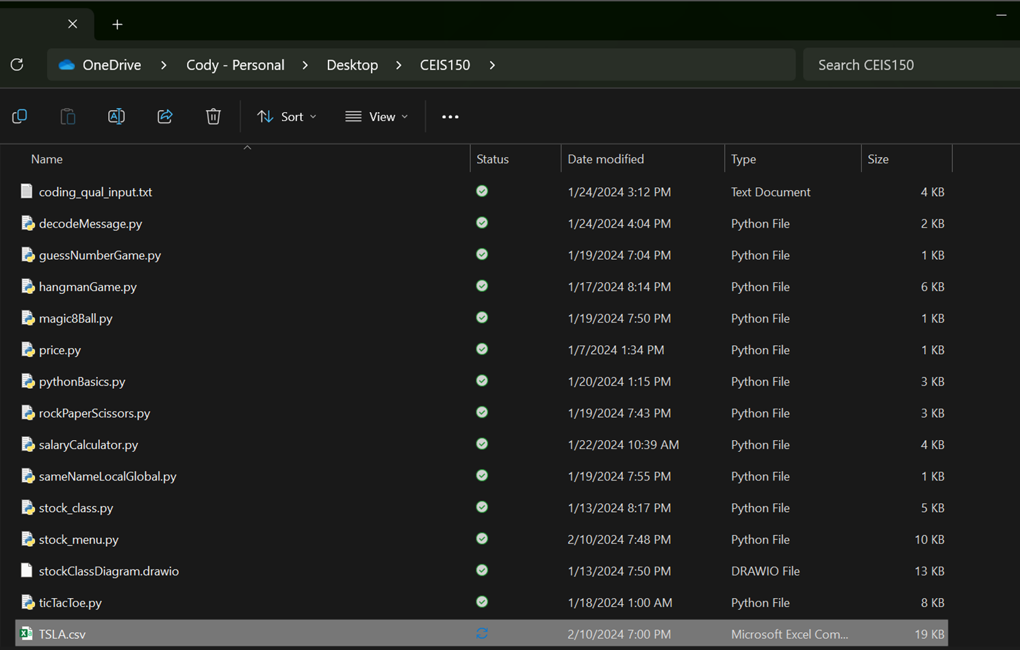
File
Screen shot of the file downloaded from Yahoo finance

Slide 21
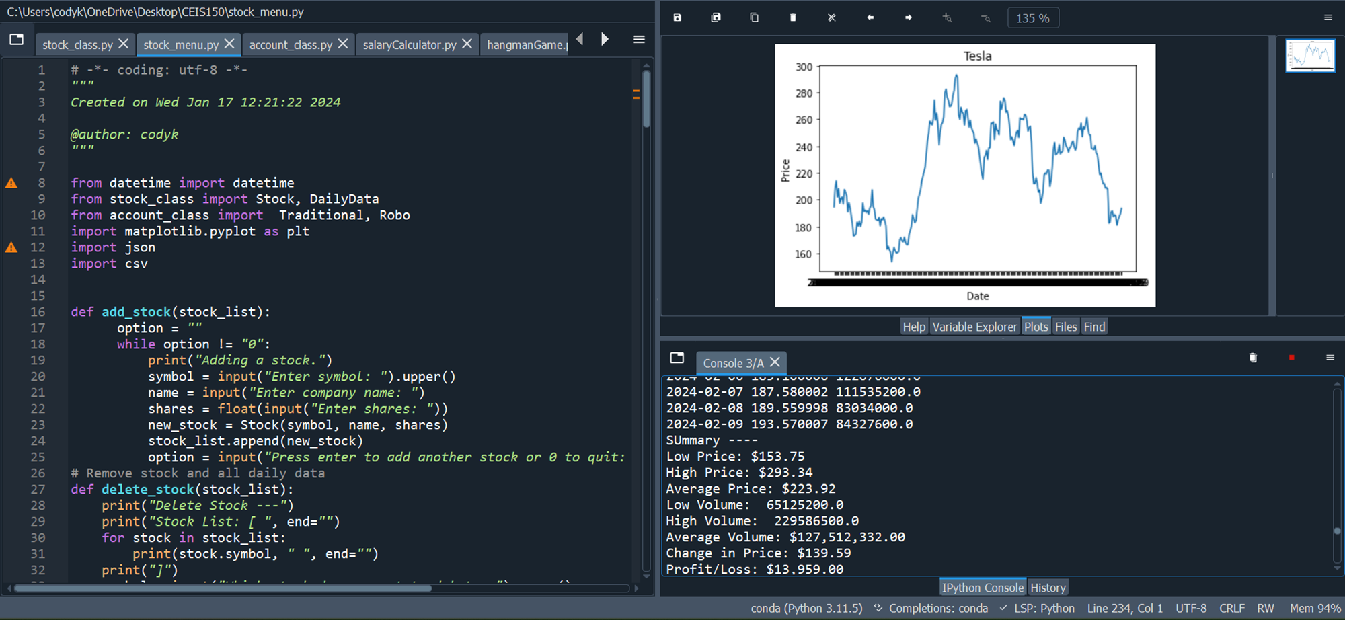
Importing data
Screenshot of the historical data import

Slide 22

GUI
Objectives:
Use tkinter to implement a graphical user interface
Knowledge Gained:
Using Tkinter to implement a graphical user interface provides knowledge in GUI development, event-driven programming, user interaction, and visual design within the context of Python applications. This skill set is crucial for creating user-friendly and visually appealing desktop applications.

Slide 23
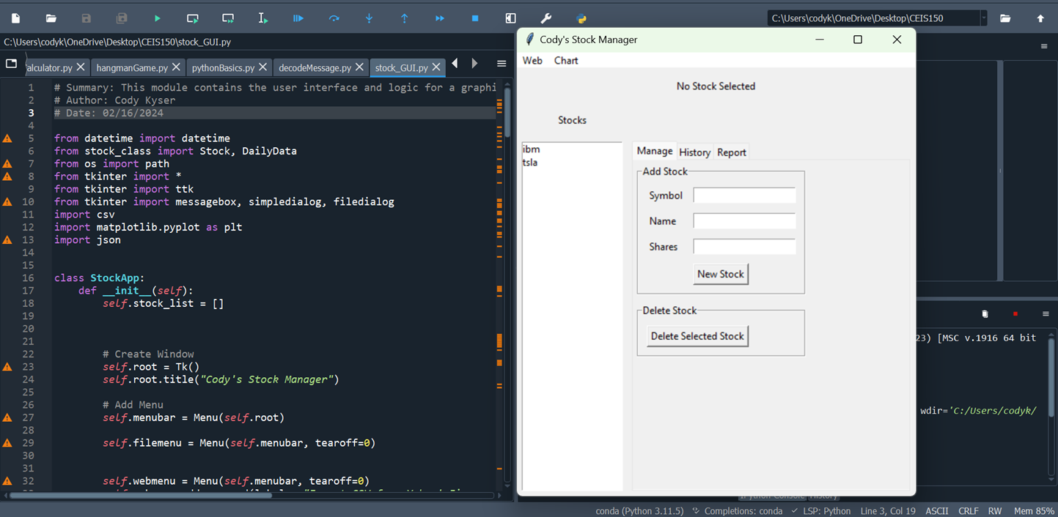
Stocks in GUI
Screen shot of my GUI working

Slide 24
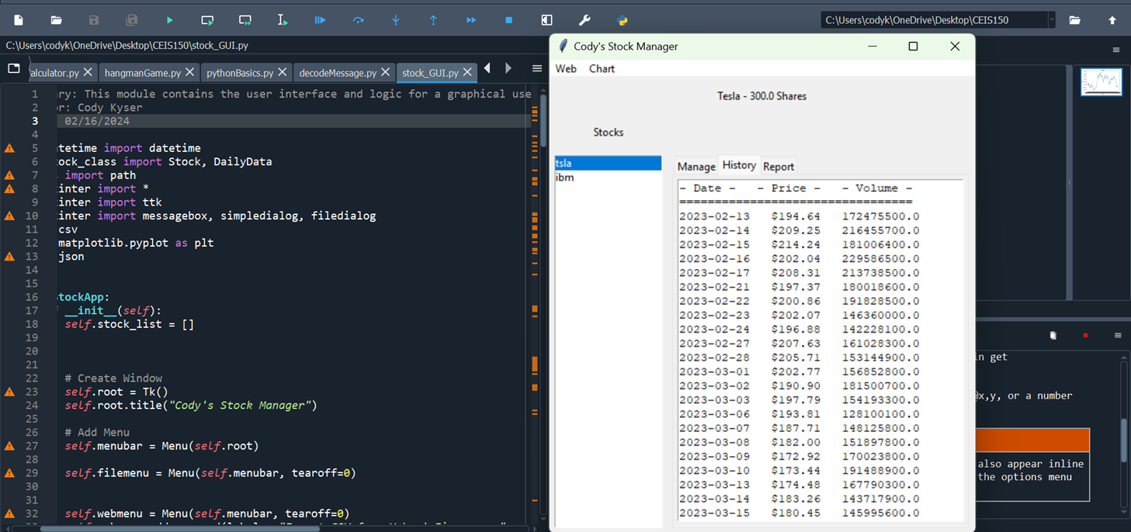
History Tab
Screen shot of my History tab with import working

Slide 25
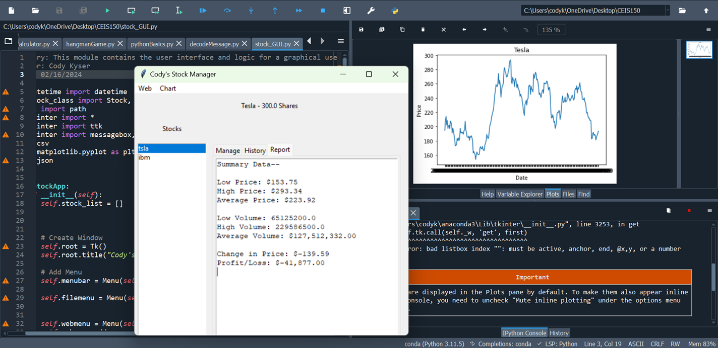
Report Complete
Screen shot of my Report tab

Slide 26

Career Skills Developed
Object-Oriented Programming (OOP)
Software Design and Architecture
User Interface (UI) Design
Data Handling and Analysis
Testing and Debugging
Overall, these skills collectively contribute to a well-rounded skill set that aligns with the demands of a career in software development, data analysis, or related fields. This project not only provided technical expertise but also emphasized collaboration, problem-solving, and a commitment to ongoing professional development.

Slide 27
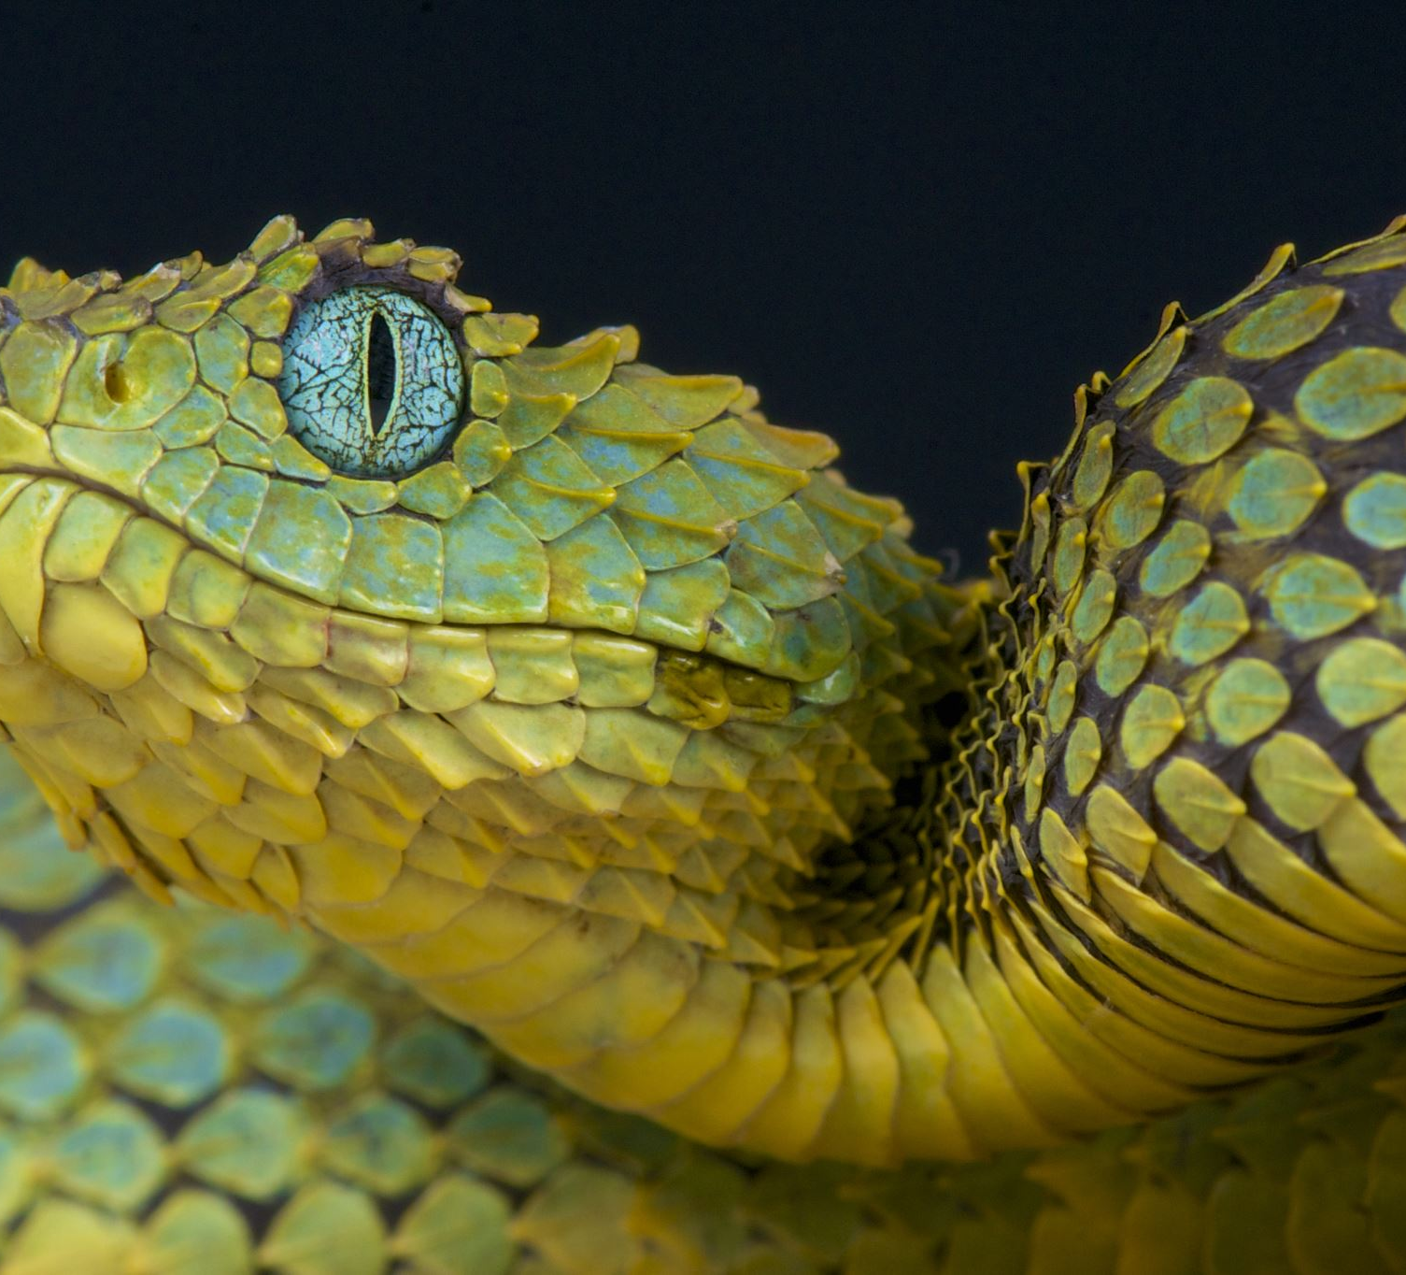
Conclusion
This project has provided me with the experience of creating applications in Python
I used object-oriented techniques to develop a stock tracking application
By processing the historical stock data, profit/loss reports were generated
This program used Python libraries to create charts and graphs to display stock data.
Overall, this was a fun and informative project, requiring intermediate Python programming knowledge and application.

