Slide 1

CEIS110 Programming with Data
Cody Kyser

Slide 2
Introduction
Data is proliferating at an exponential rate
Utilizing a cloud-centric system, this project acquires data related to temperature and humidity.
Subsequently, the collected data undergoes analysis through programming and data analytics.

Slide 3
Software Inventory
Before developing this program with data project, all software must be downloaded
Software needed includes Excel and Python

Slide 4
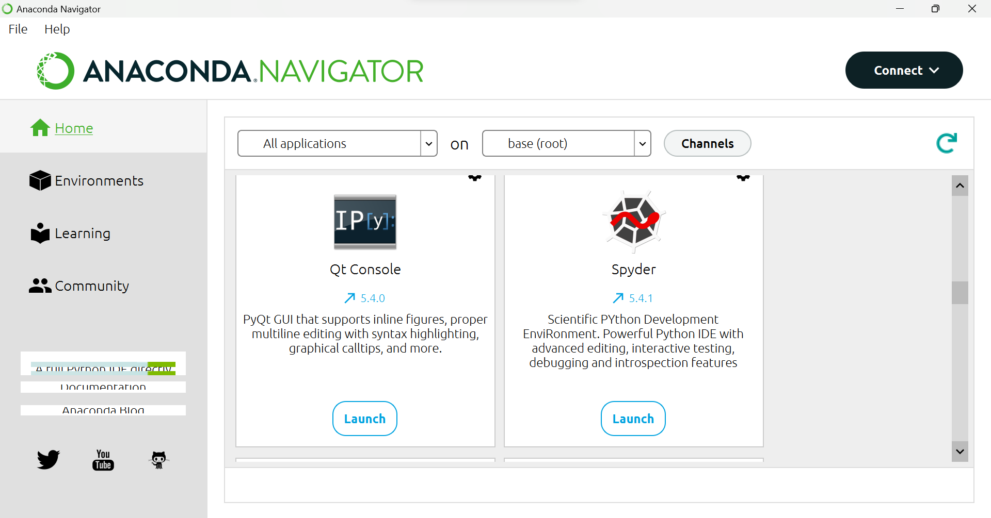
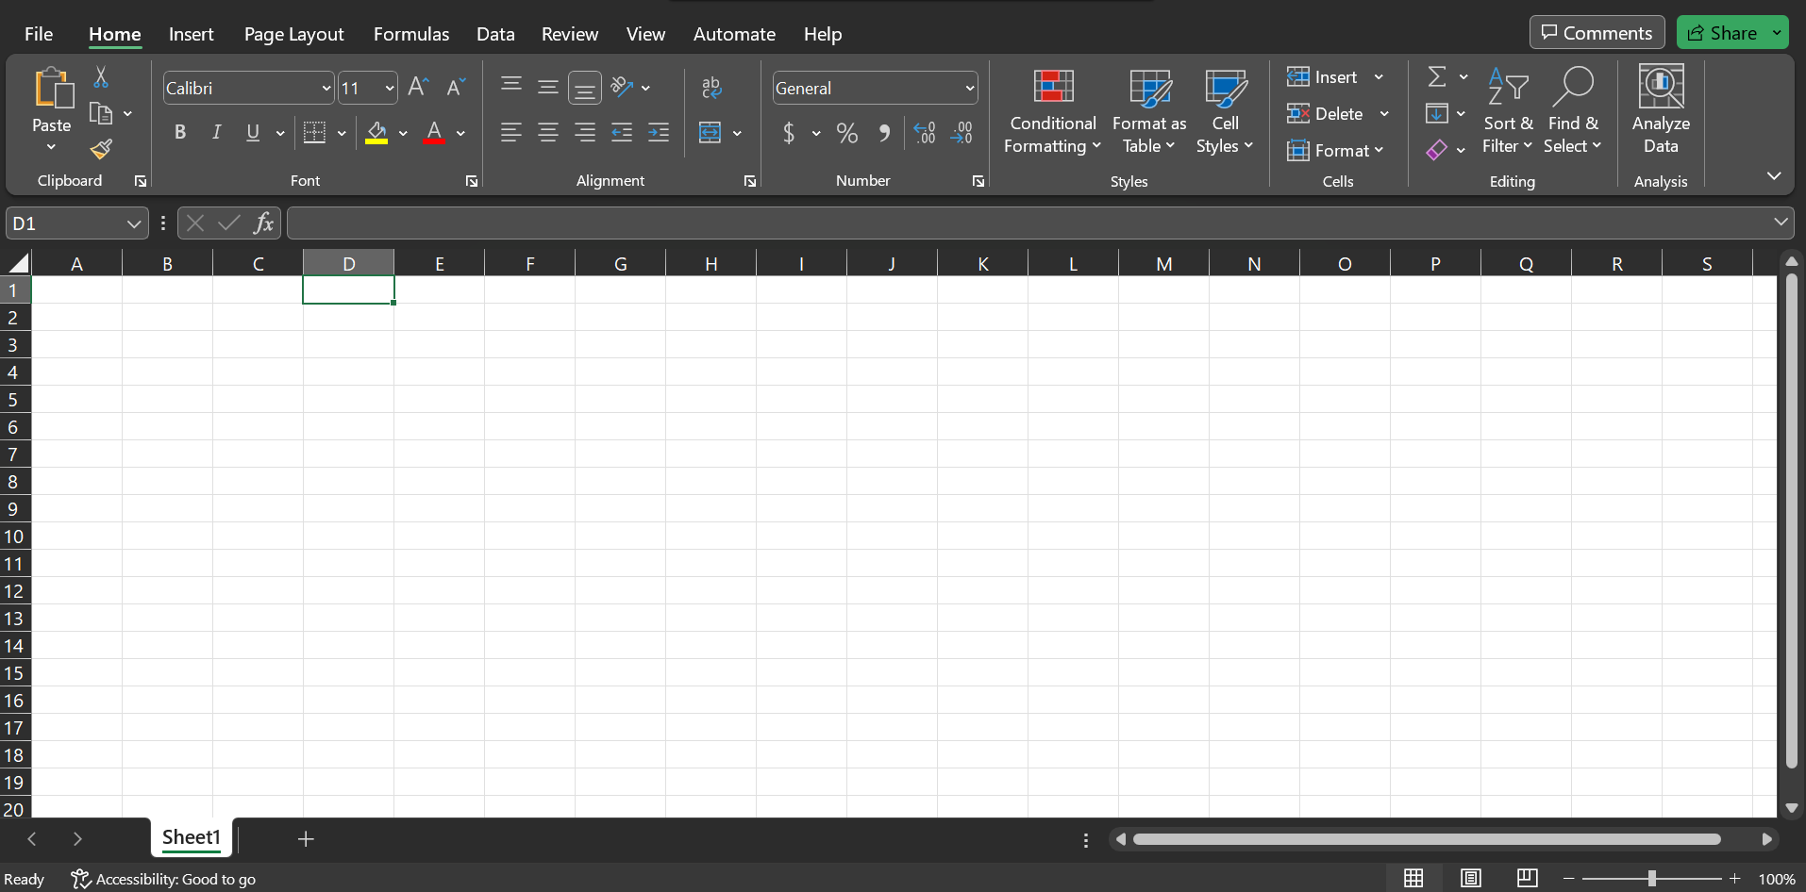
Software
The software needed for this project
includes:
Anaconda Navigator with Spyder
Microsoft Excel

Slide 5

Planning and Design
Following the completion of the software inventory for this project, a strategy was formulated for the temperature data initiative.
In order to blueprint the project's structure, a flowchart was produced.
The essential stages of comprehending the developmental process encompass project planning and design.

Slide 6

What are Flowcharts?
Graphical depictions or workflows known as flowcharts are utilized, and the generated flowchart visually portrays both the progression and outcomes of this software development endeavor.
Numerous companies adopt flowcharts as straightforward narratives.

Slide 7
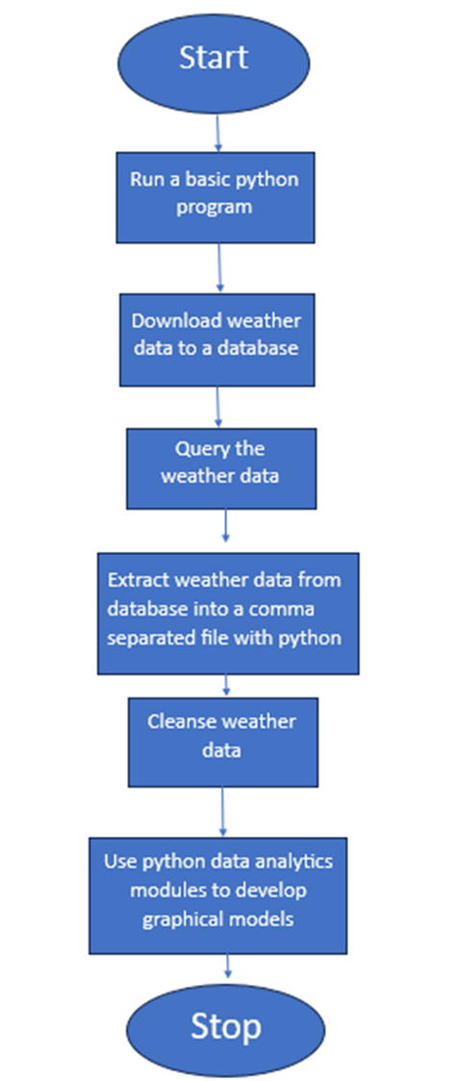
Flowchart
Install Python
Download weather data from database into a comma separated file with python
Cleanse weather data
Extract weather data from database into a comma separated file with Python
Use Python data analytics modules to develop graphical models

Slide 8
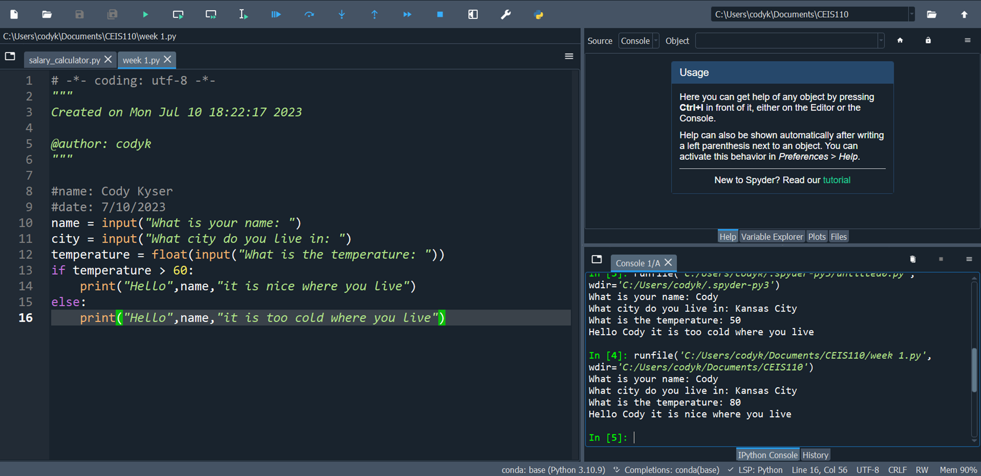
Introduction to Python
Python stands as a widely favored programming language employed across business, web development, data analytics, and scientific analysis.
This particular program showcases a selection control structure implemented in Python.

Slide 9

Gathering Temperature and Humidity Data
Following the stages of planning and design, the code was created to retrieve a collection of weather observations.
Subsequently, this dataset was stored within a local database, organized into a table to facilitate subsequent analysis.

Slide 10
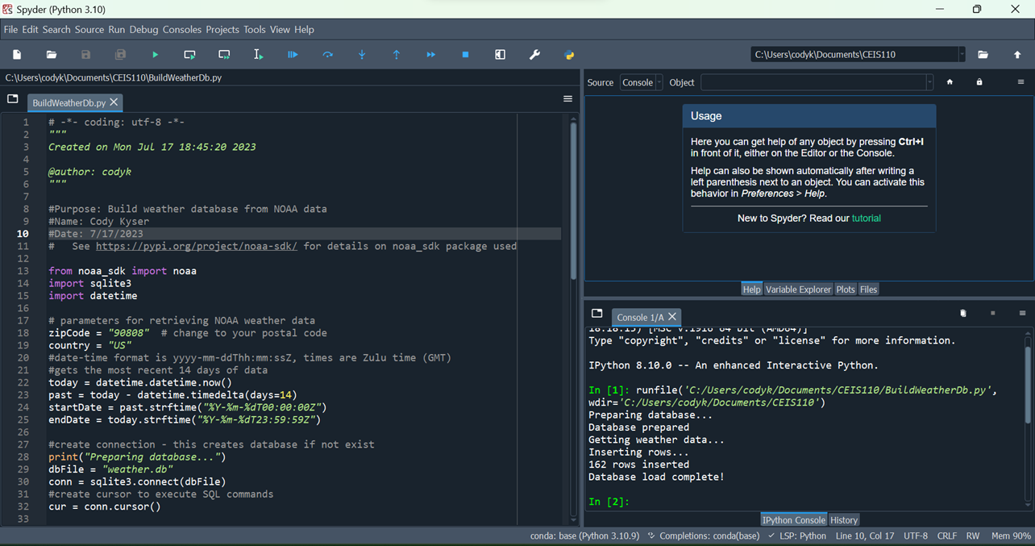
BuildWeatherDB.py Code (Screenshot)
Screenshot of code in Spyder
The code will create a table named Observations with the fields: timestamp, windspeed, temperature, relativeHumidity, windDirection, barometricPressure, visibility, and textDescription
The database will be named weather.db and stored in the same directory as the Python code

Slide 11
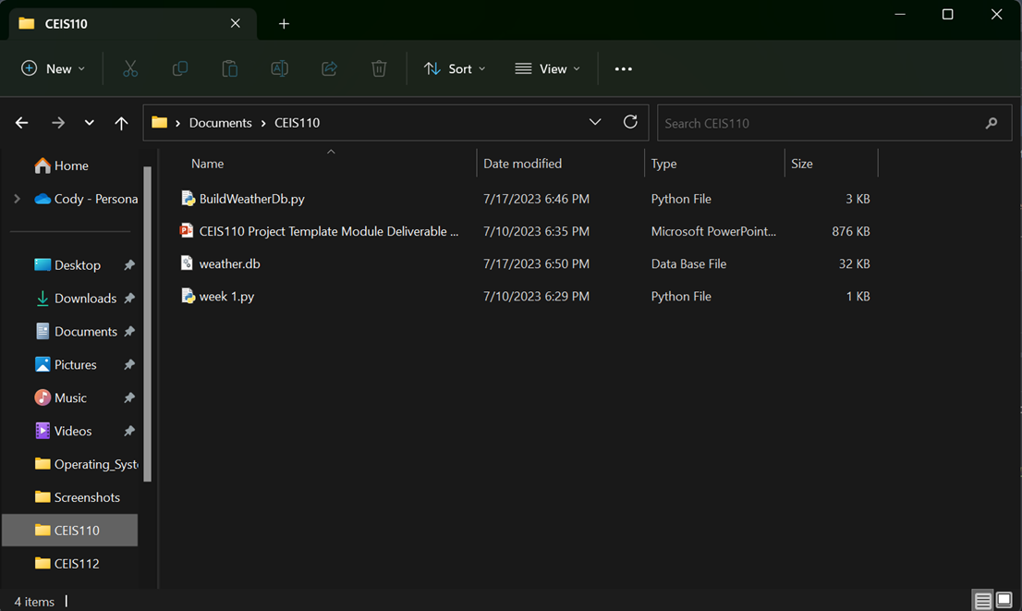
Weather.db File (Screenshot)
Screenshot of Windows Explorer showing database file Weather.db was created

Slide 12
Querying the Database
Structured Query Language (SQL) serves as a programming language employed in tasks involving relational databases.
The database was queried and the results were viewed using SQL.

Slide 13
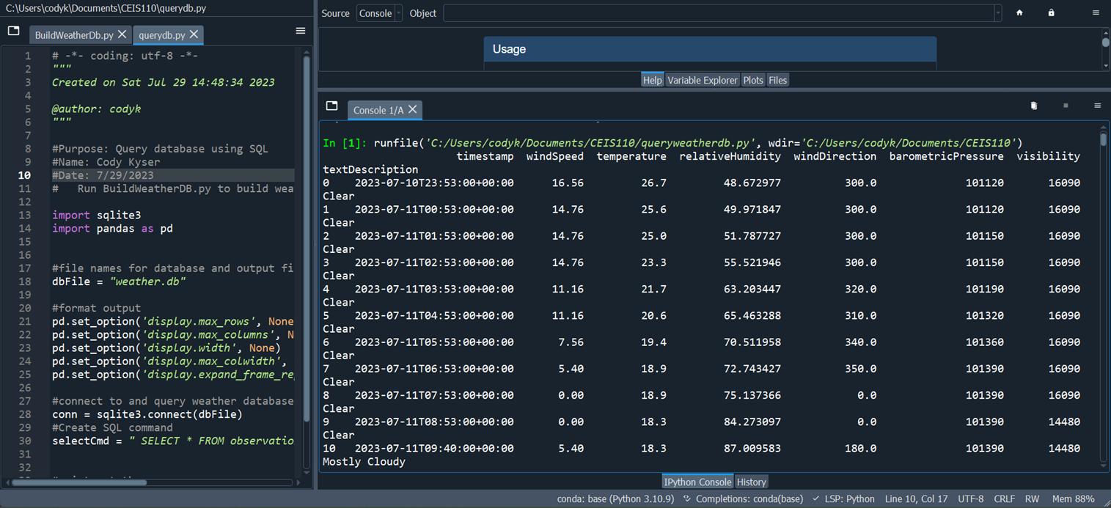
Query to retrieve all columns and all rows (Screenshot)
The SQL command “select * from observations” was executed to retrieve all rows and columns from the observations table

Slide 14
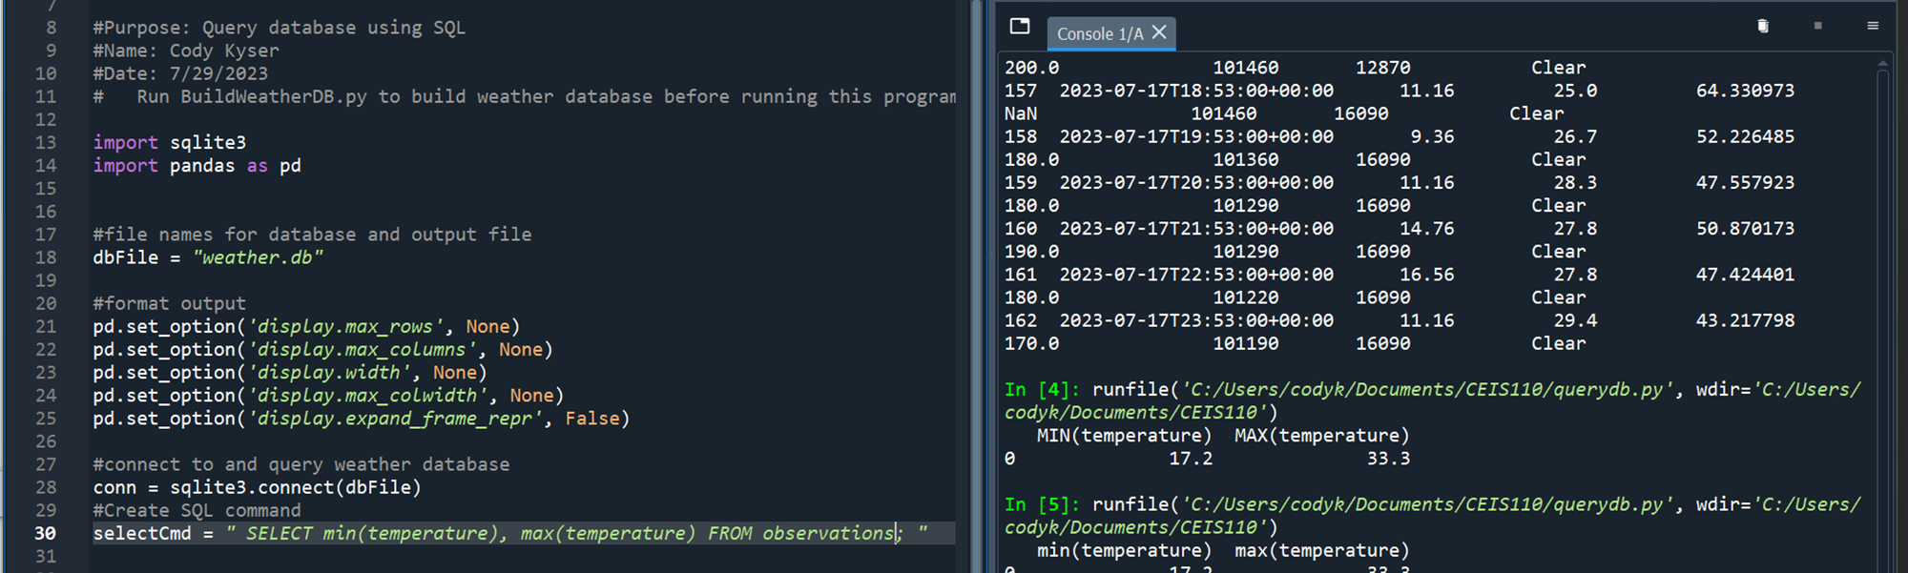
Query to retrieve lowest and highest temperatures (Screenshot)
The min and max temperatures were retrieved. These temperatures are captured based on the Celsius scale

Slide 15
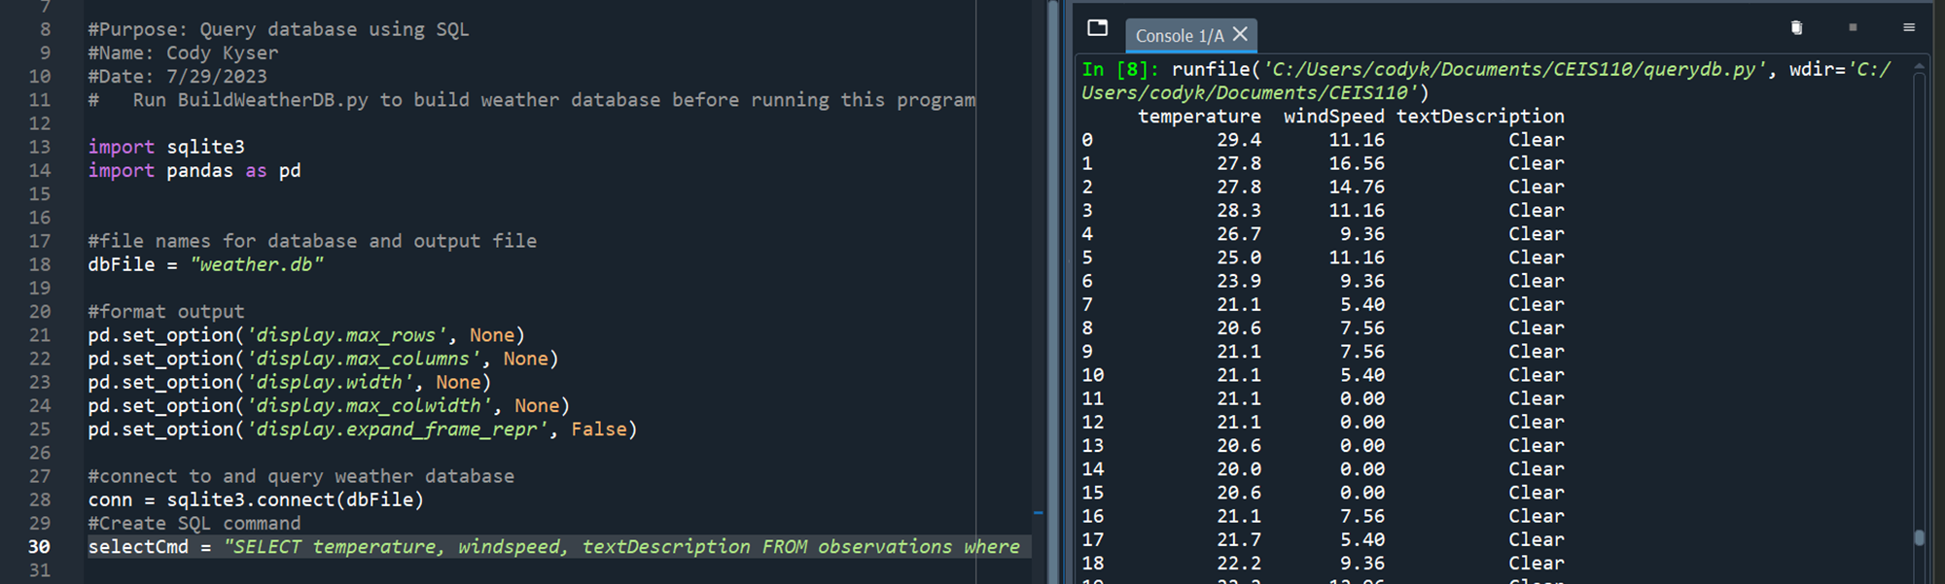
Query to retrieve the data when the weather is clear (Screenshot)
Another query was performed to retrieve the temperature, windspeed, and textdescription when the weather is clear

Slide 16

Data Cleansing
Data generated by machines might contain errors or unnecessary information. During the data cleansing process, software can automatically reformat it to align with the requirements of other programs.
A Python script is employed to read the output data from the initial Python program, subsequently storing it in a CSV file that is compatible with Excel.
Frequently, data requires the removal of erroneous or absent values within a dataset. This process ensures data completeness, validity, and standardization.

Slide 17
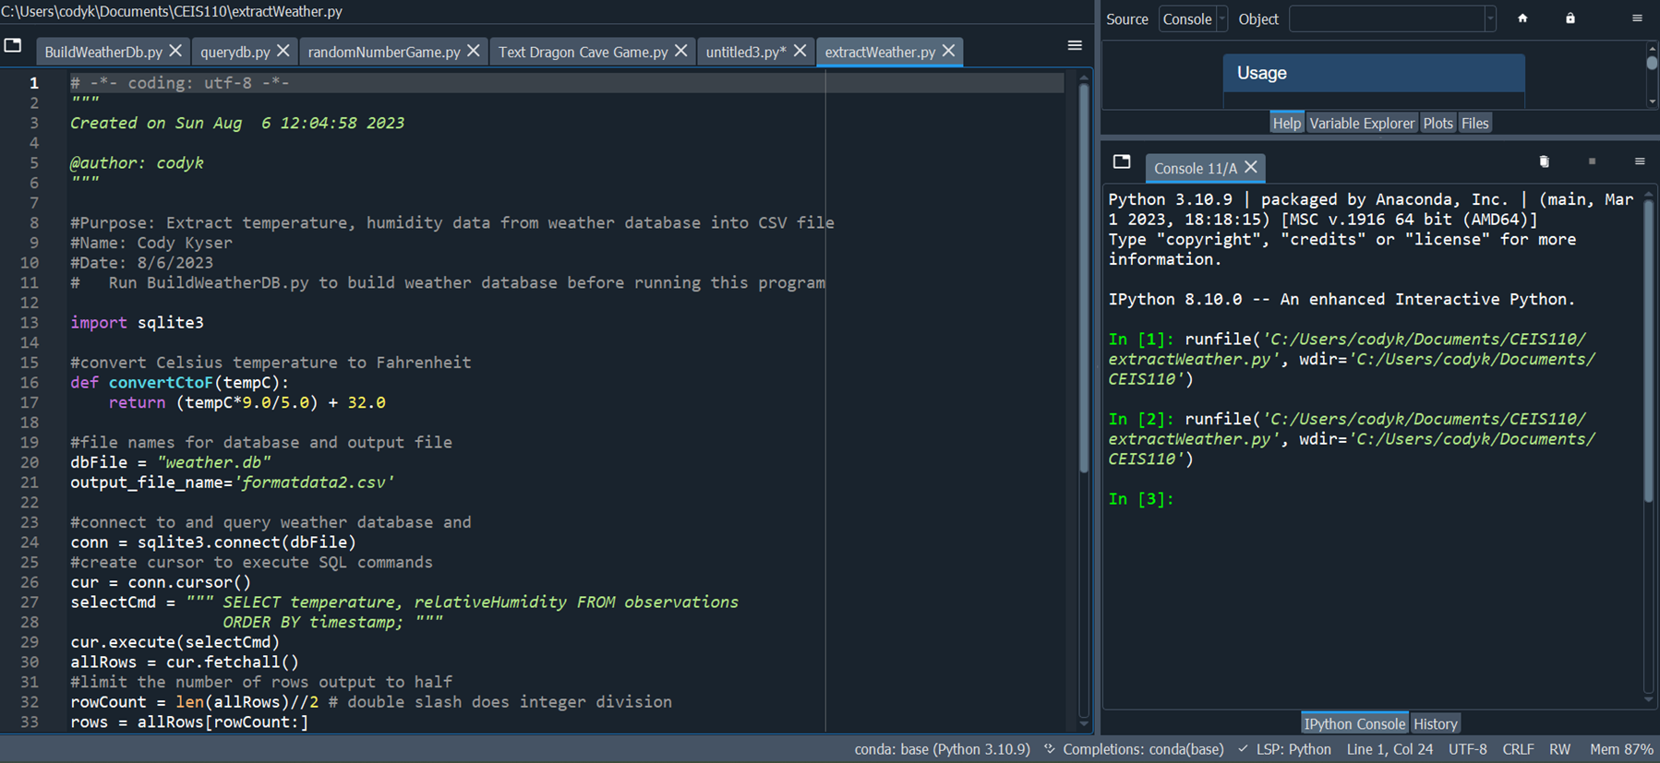
Extracting Temperature and Humidity using Python code
The weather.db database may contain null or missing values. The code used retrieves only the temperature and humidity values and write them to a comma separated values (CSV) file. Two files are created – a formatdata.csv and a formatdata2.csv that each contain half of the rows. Missing or invalid values are not written to the file.

Slide 18
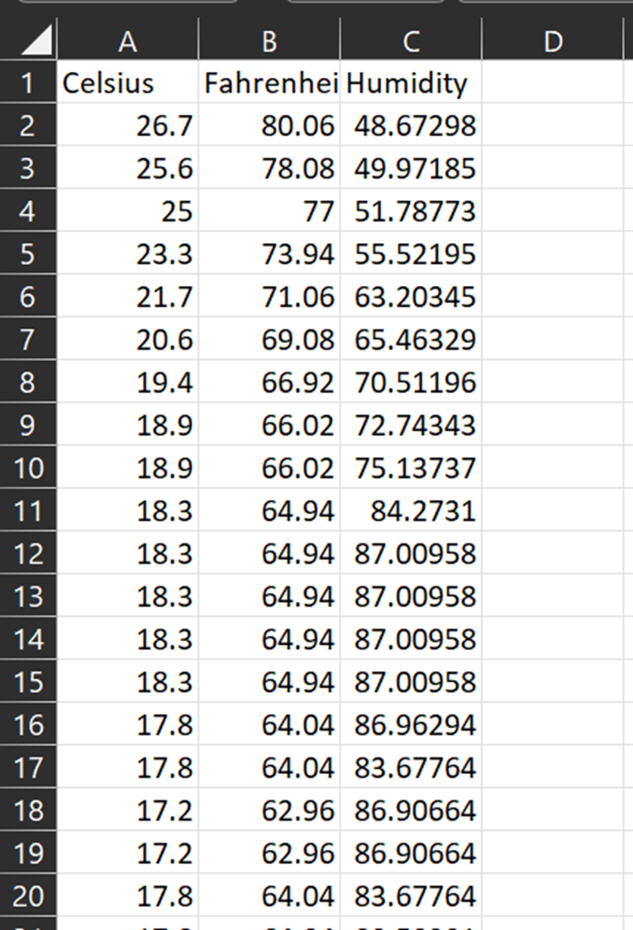
Data Formatted in an Excel Spreadsheet
The Python program created a formatdata.csv file
This file contains 3 columns: Celsius, Fahrenheit, and Humidity
Statistics can be performed on this spreadsheet

Slide 19
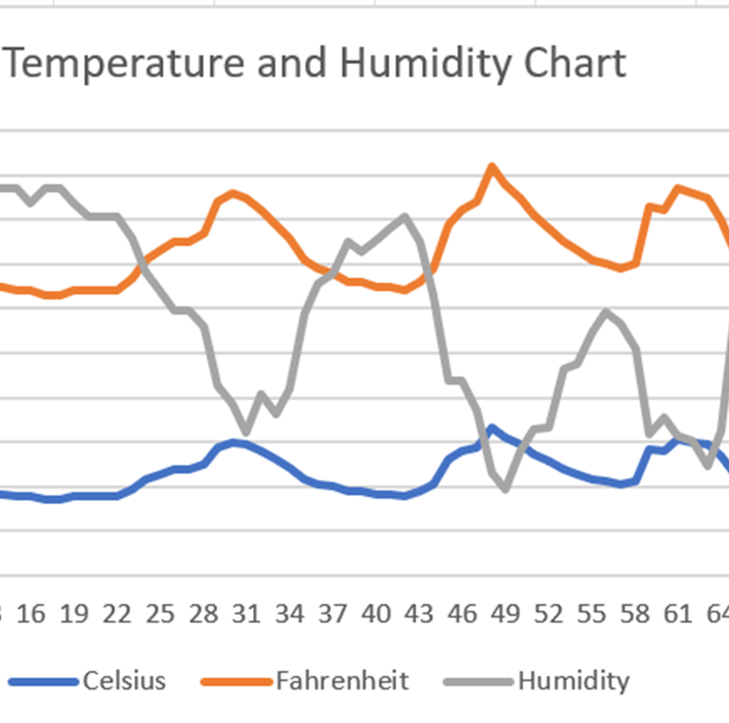
Data Visualization
A line chart was developed in Excel showing the Temperature and Humidity over Period 1

Slide 20

Data Analytics
Utilizing Python's data analytics modules, individuals can craft visual representations like charts and graphs to portray data.
Furthermore, these modules facilitate the manipulation of datasets, enabling their transformation into tabular formats.
Included within the Anaconda framework, these data analytics modules offer comprehensive capabilities.
Numerous plots were generated to explore humidity and temperature trends.
Subsequently, data analysis led to a predictive inference.

Slide 21
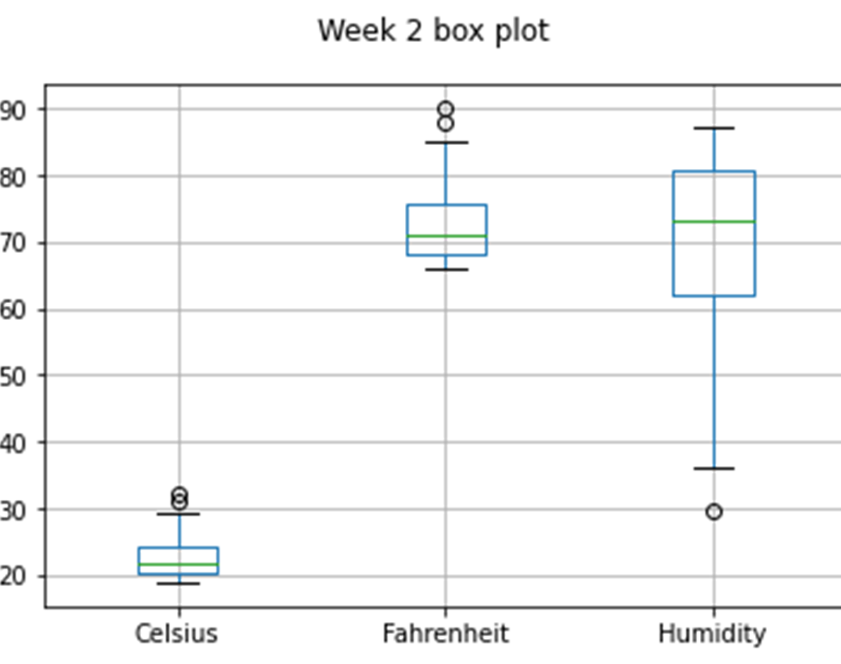
Week 2 Box Plot
#Purpose: Create box plot for week 2 data
#Name: Cody Kyser
#Date: 8/13/2023
import pandas as pd
import matplotlib.pyplot as plt
df2 = pd.read_csv("formatdata2.csv")
df2.boxplot(); plt.suptitle('Week 2 box plot')
plt.show()
print(df2.info())
print(df2.describe())
print("The median is ",df2.median())

Slide 22
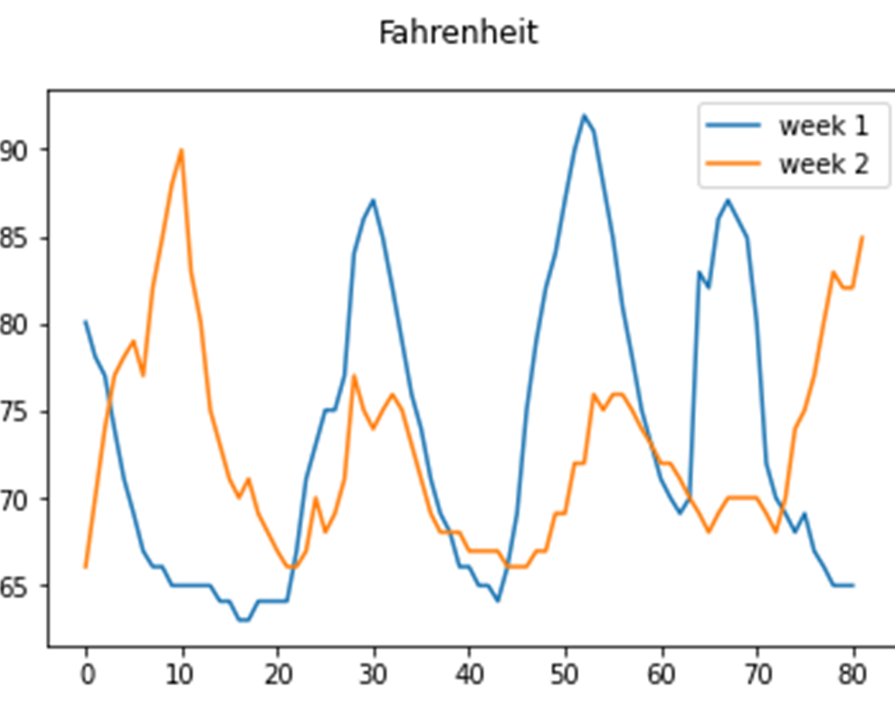
Fahrenheit Line Graph
#Purpose: Create Fahrenheit plot comparing period 1 and period 2 (week 1 and week 2)
#Name: Cody Kyser
#Date: 8/13/2023
import pandas as pd
import matplotlib.pyplot as plt
df1 = pd.read_csv("formatdata1.csv") #baseline data is period 1 (older)
df2 = pd.read_csv("formatdata2.csv") #data for period 2 (more recent)
plt.figure(); df1.Fahrenheit.plot(label = 'week 1 '); df2.Fahrenheit.plot(label = 'week 2'); plt.legend(loc='best'); plt.suptitle('Fahrenheit')
plt.show()

Slide 23
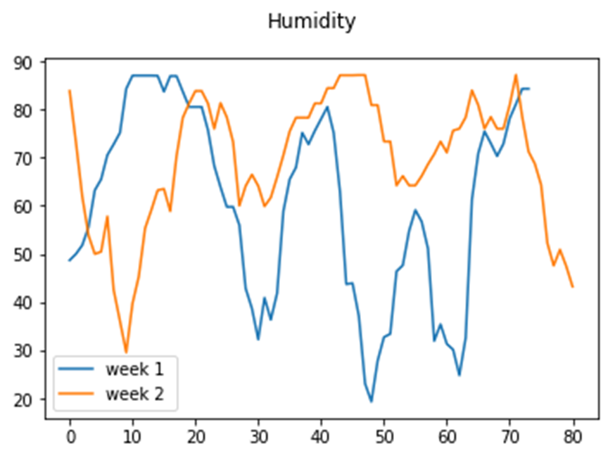
Analysis
The next step in analysis is developing a question and reviewing the data to answer the question. A chart can be used to look at the data
My question: What is the highest, lowest, and average humidity over the two weeks of data?
I created a line graph with data from both weeks
The results are as follows:
Min = 29.538214
Mean = 69.272479
Max = 87.166374

Slide 24
Code
The code to create the Humidity line graph is as follows:
#Purpose: Create Humidity plot comparing period 1 and period 2 (week 1 and week 2)
#Name: Cody Kyser
#Date: 8/13/2023
import pandas as pd
import matplotlib.pyplot as plt
df1 = pd.read_csv("humidity1.csv") #baseline data is period 1 (older)
df2 = pd.read_csv("humidity2.csv") #data for period 2 (more recent)
plt.figure(); df1.Humidity.plot(label = 'week 1 '); df2.Humidity.plot(label = 'week 2'); plt.legend(loc='best'); plt.suptitle('Humidity')
plt.show()
print(df2.info())
print(df2.describe())
print("The median is ",df2.median())

Slide 25
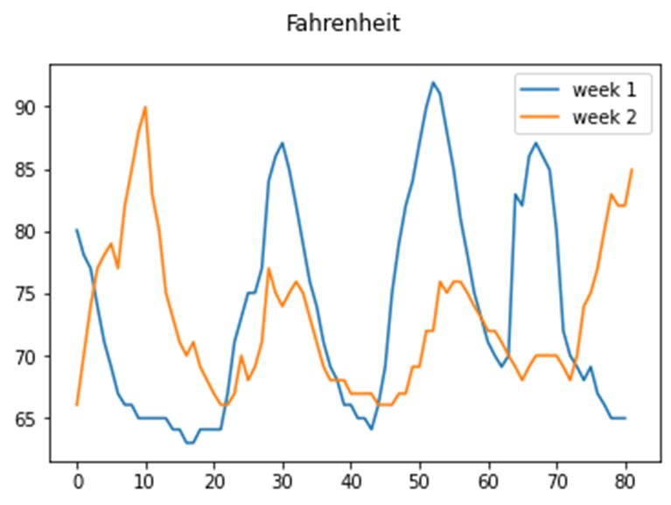

Prediction
As temperature increases, relative humidity decreases. Based on the data, I predict that the next few days after week two the relative humidity will continue to decrease as the temperature stays in the mid to upper 80’s.

Slide 26
Challenges
Making sure the data is cleansed before creating the graphs
Making sure the weather.db file is in the same directory as the Python program
Resolving code issues

Slide 27
Career Skills
Several career skills are gained in this project:
Effective communication
Proficiency in database development
Python programming skills
Identifying and resolving code issues as well as data cleansing
Analyzing and interpreting charts and graphs to formulate data predictions

Slide 28
Conclusion
The essential concepts of data-oriented programming were explored in this project, wherein data obtained from a cloud service was leveraged for conducting data analytics tasks.
Constructing this project offered a practical, experiential chance to apply the subject matter covered throughout the course.

