Slide 1
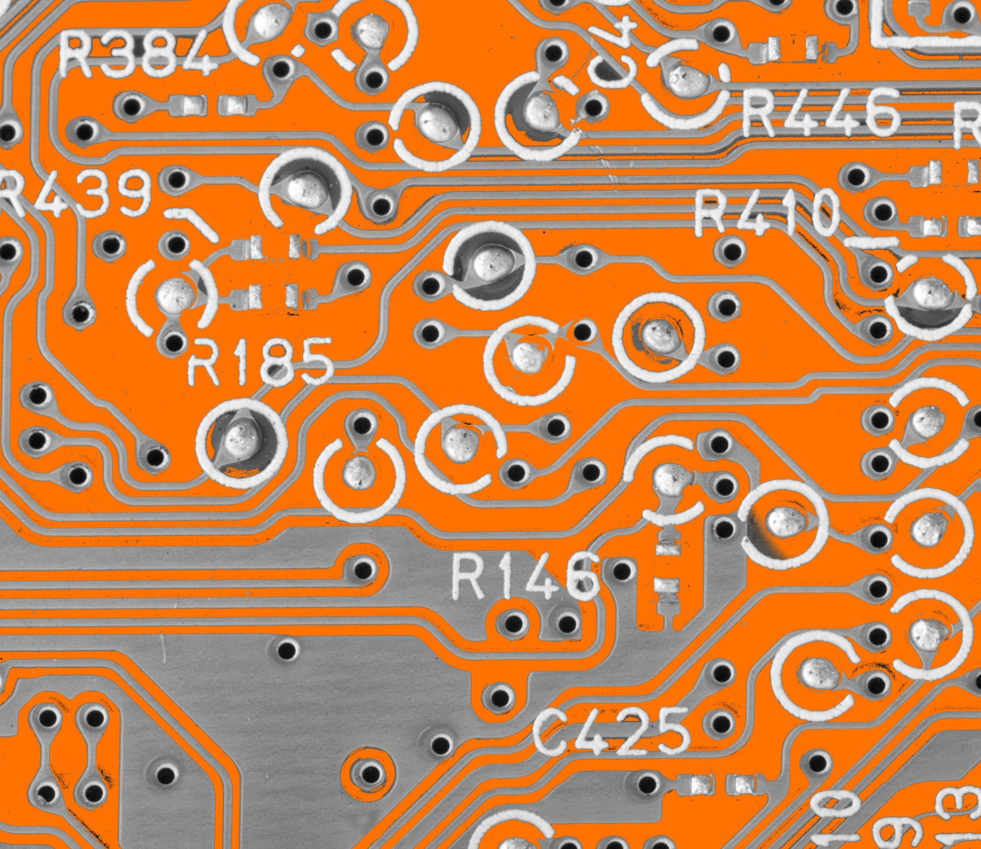
Creating a Multiple Traffic Light Controller with a Cross Walk and an Emergency Buzzer with SMART sensor Cody Kyser
CEIS 114 Final Project Component

Slide 2

INTRODUCTION
By utilizing Arduino circuits and components, I was able to successfully create a multi-stoplight circuit. This circuit included a push button, buzzer, motion sensor, and LCD display for a pedestrian crosswalk. Finally, the last component was to integrate an emergency signal to complete the traffic intersection circuit.

Slide 3
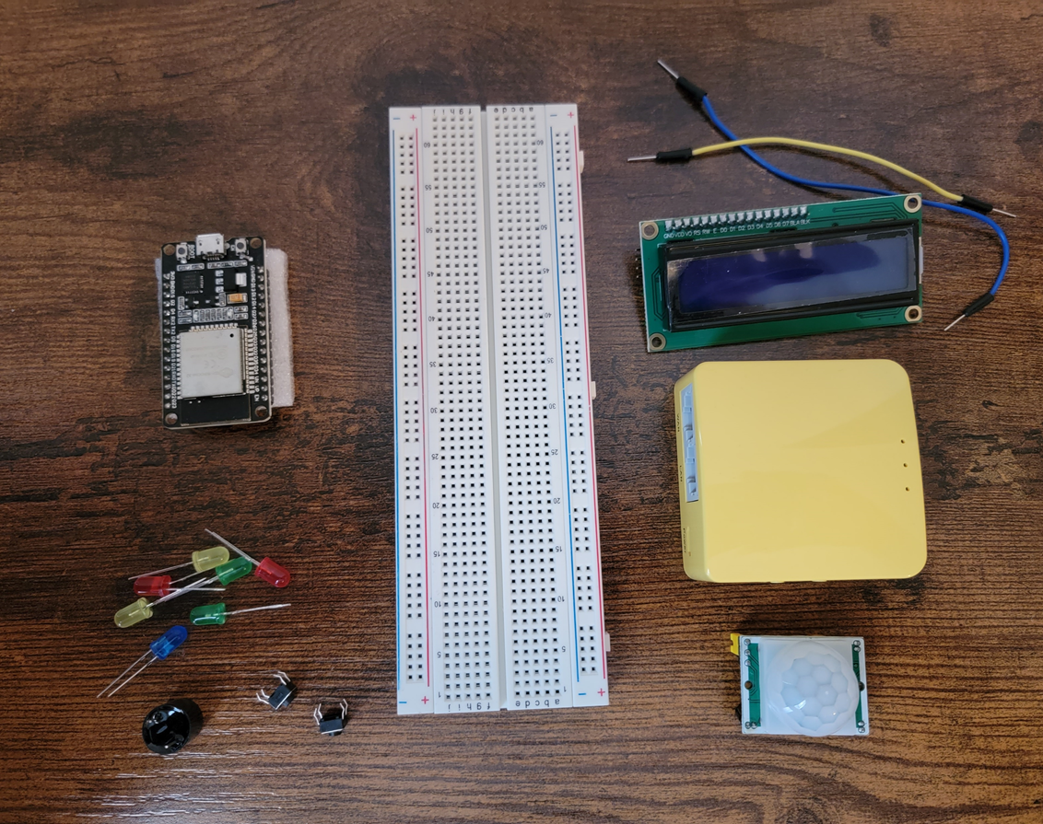
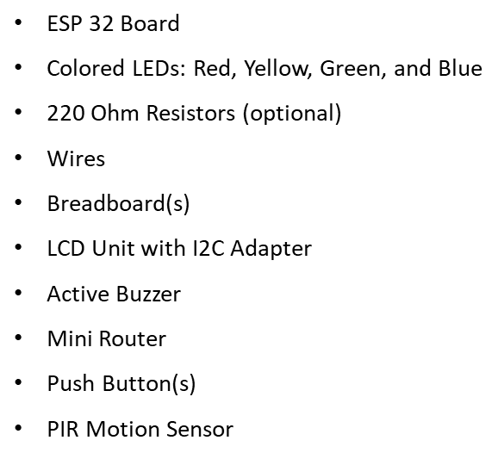
Resources needed to build a smart traffic controller.

Slide 4
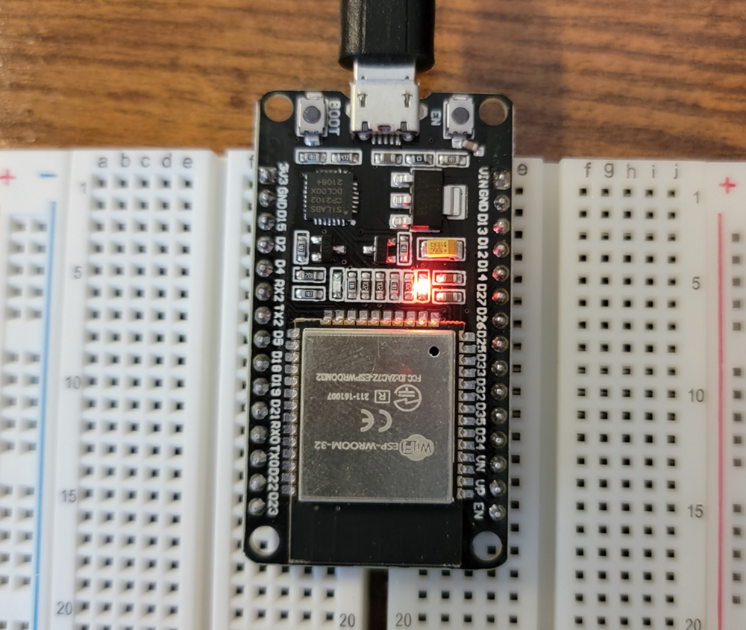
ESP32 (Picture)
Microcontroller mounted and powered ON

Slide 5
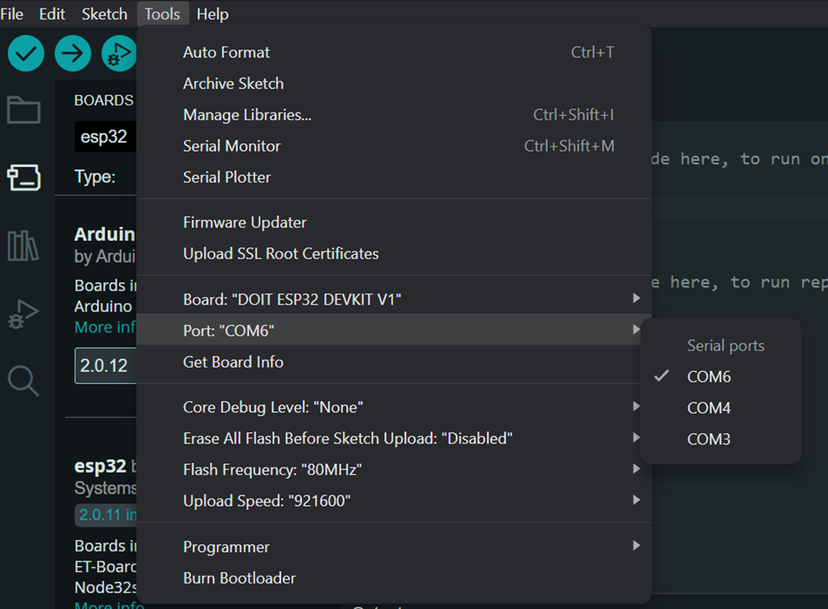
Installation of Arduino IDE
Screenshot of Arduino IDE with Port selected from Tools menu.

Slide 6
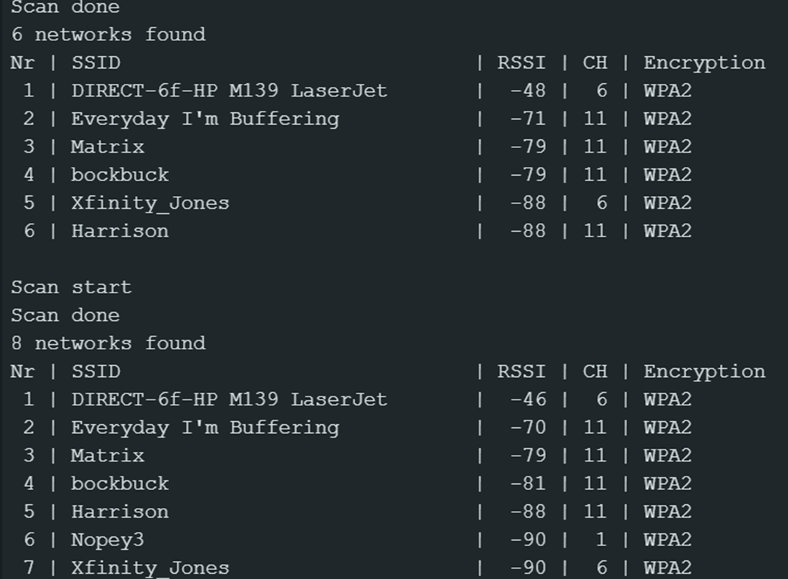
ESP32 WIFI SCAN
Screenshot of Serial Monitor in Arduino IDE showing the available networks

Slide 7

CREATING A BASIC TRAFFIC CONTROLLER

Slide 8
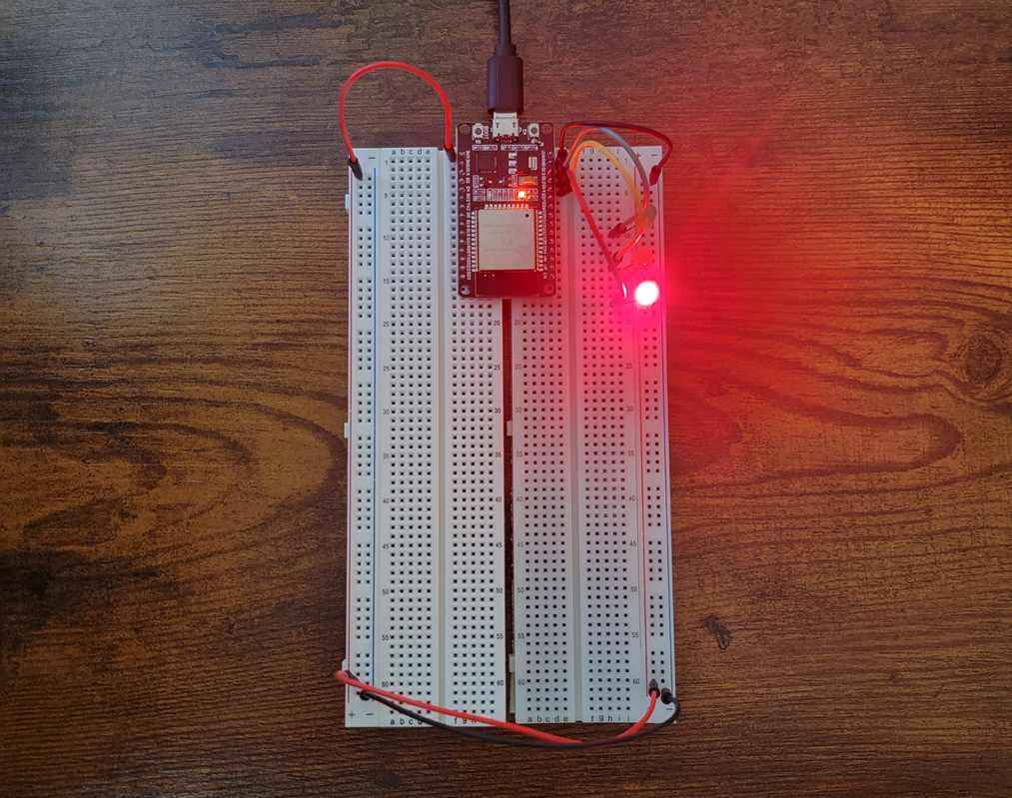
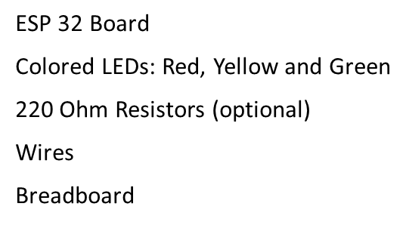
PICTURE OF CIRCUIT WITH WORKING LEDs

Slide 9
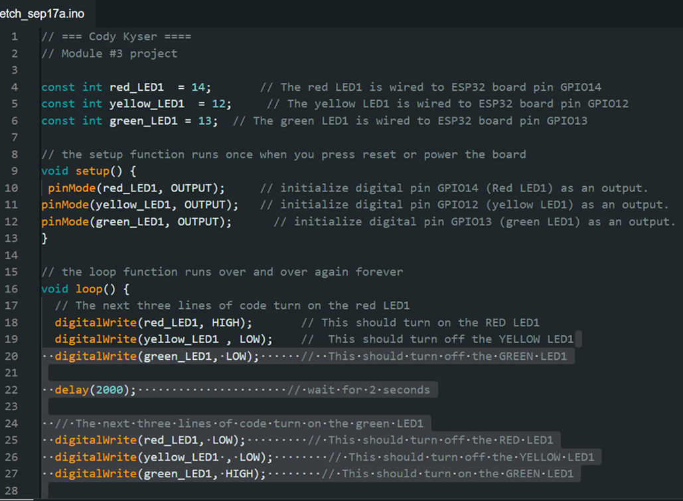
Arduino IDE CODE
Screenshot of code in Arduino IDE showing my name in the comment.

Slide 10

CREATING MULTIPLE TRAFFIC LIGHTS

Slide 11
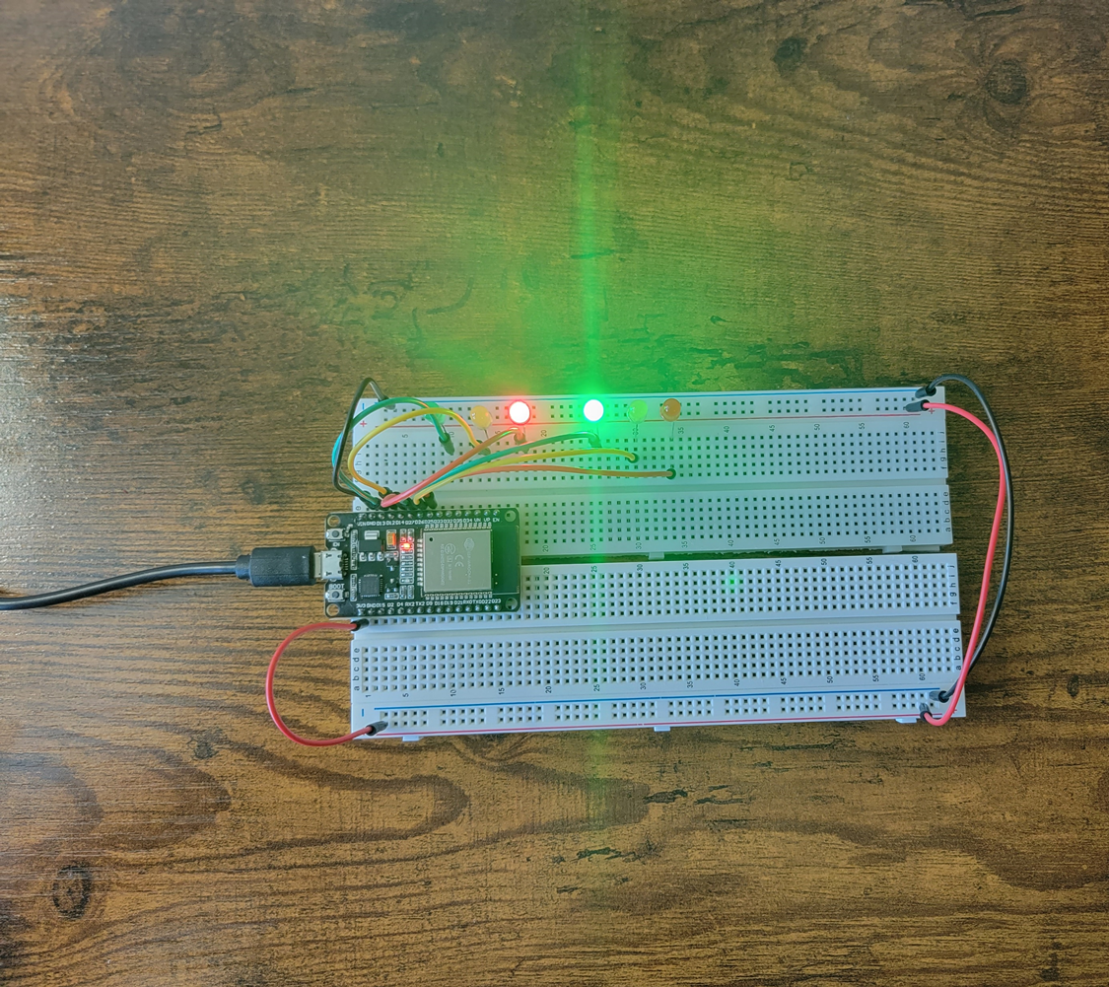
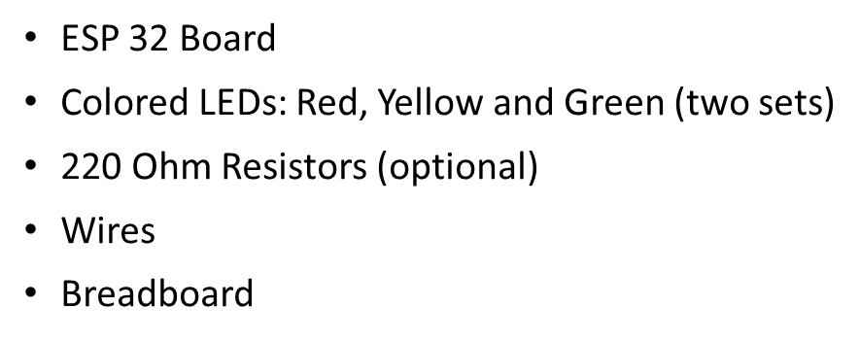
PICTURE OF CIRCUIT WITH WORKING LEDs

Slide 12
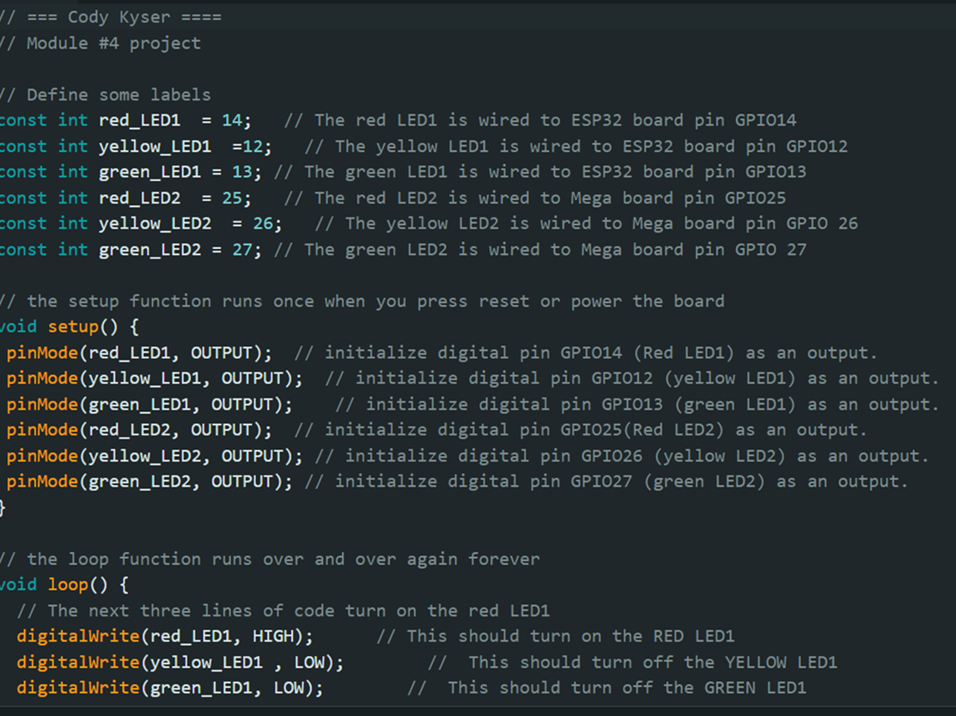
Screenshot of code in Arduino IDE
Screenshot of code in Arduino IDE for two traffic lights showing my name in the comment.

Slide 13
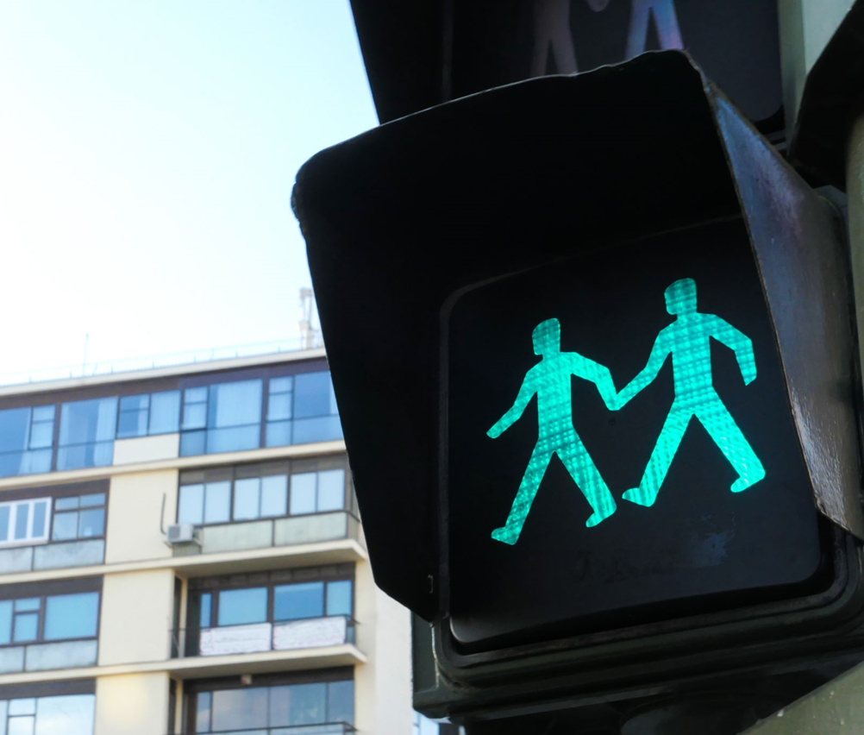
ADDING A CROSSWALK BUTTON

Slide 14
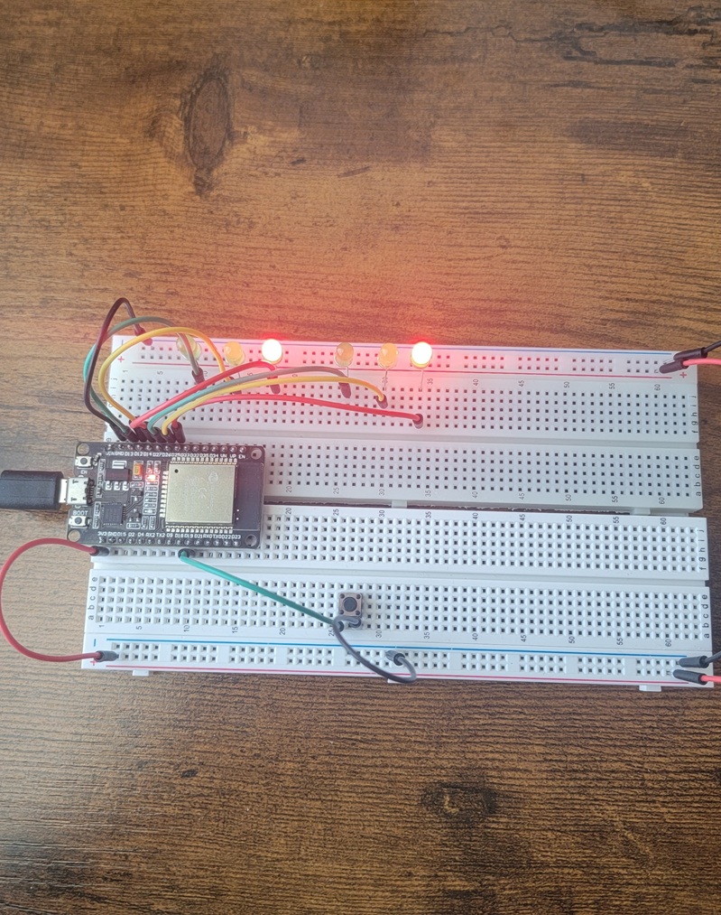
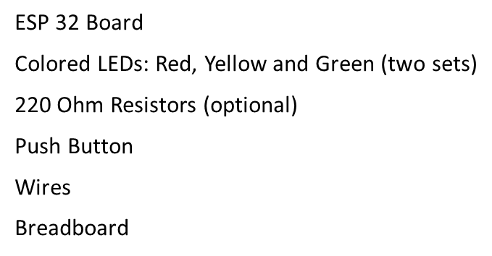
Picture of Circuit with Working LEDs

Slide 15
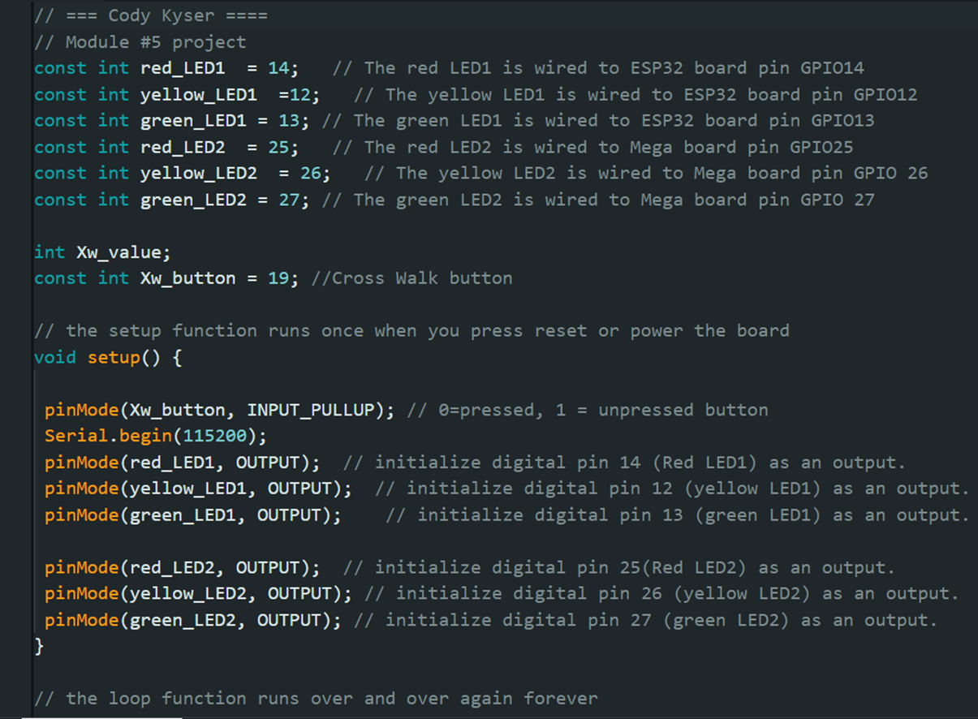
Screenshot of code in Arduino IDE
Screenshot of code in Arduino IDE showing my name in the comment

Slide 16
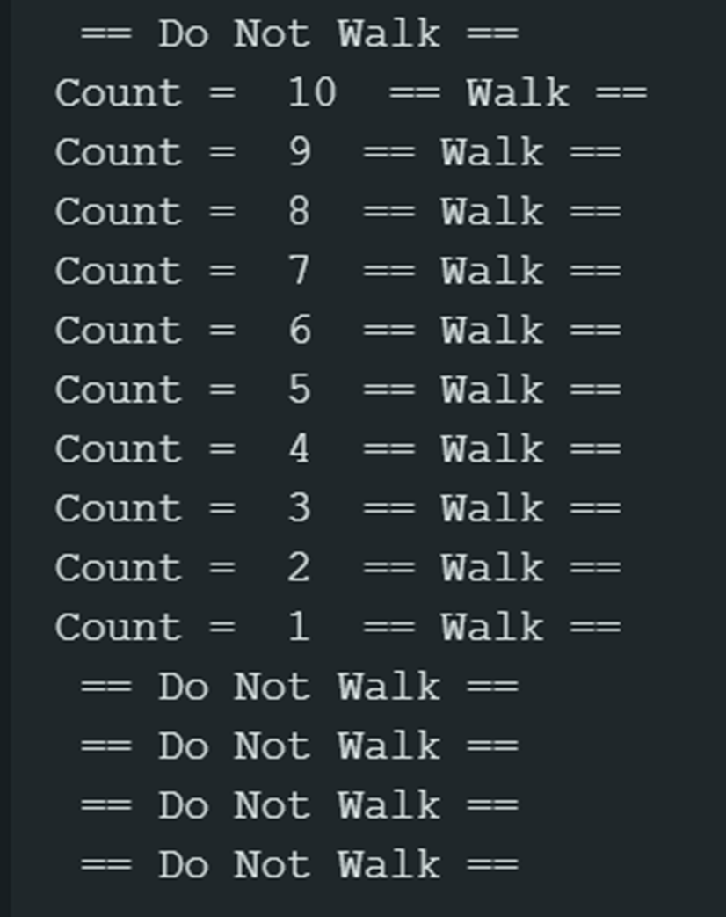
Screenshot of Serial Monitor in Arduino IDE
Screenshot of output in Serial Monitor

Slide 17

ADDING A BUZZER AND LCD DISPLAY

Slide 18
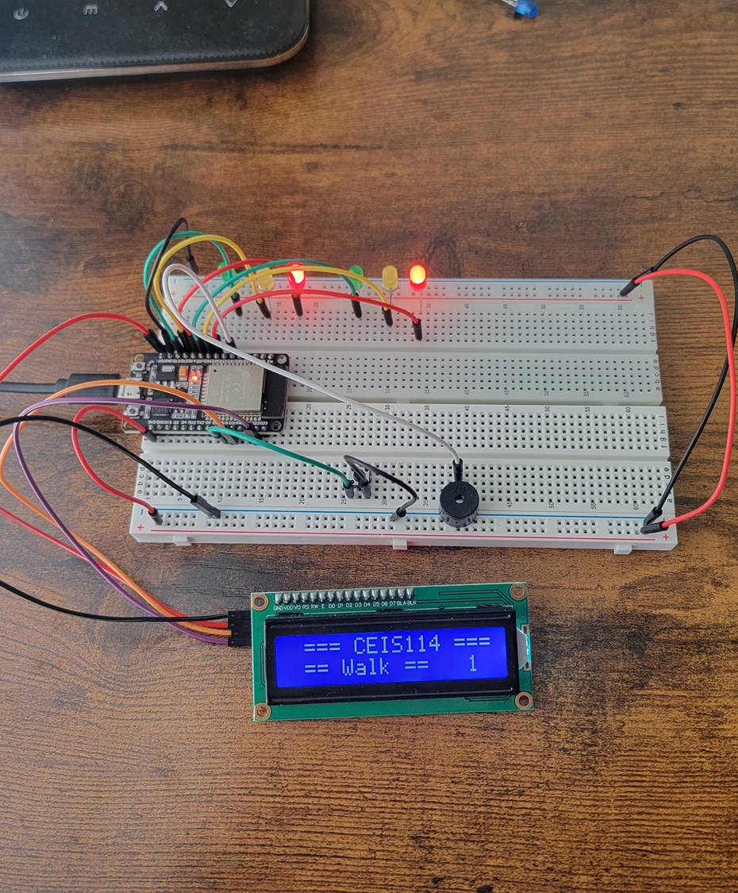
Picture of Circuit with Working LEDs and LCD Display
ESP 32 Board
Colored LEDs: Red, Yellow and Green (two sets)
220 Ohm Resistors (optional)
Push Button
LCD Unit with Message Display
Wires
Breadboard

Slide 19
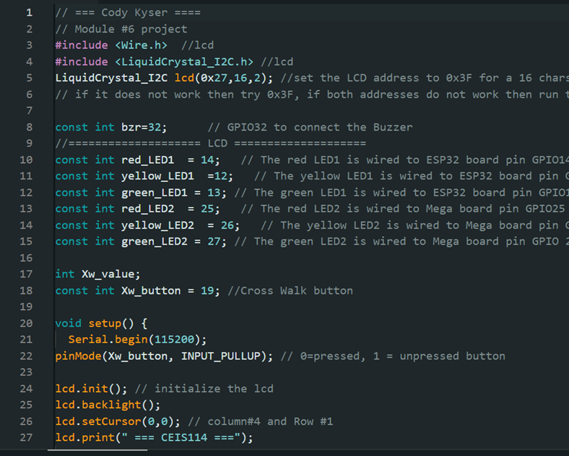
Screenshot of code in Arduino IDE
Screenshot of code in Arduino IDE showing my name in the comment

Slide 20
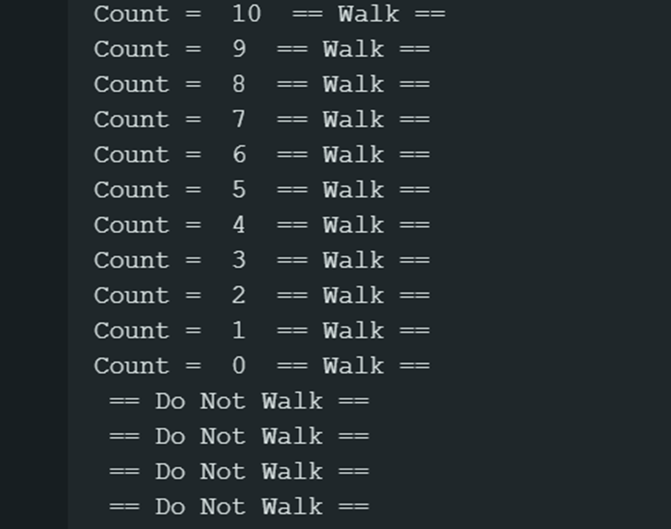
Screenshot of Serial Monitor in Arduino IDE
Screenshot of output in Serial Monitor

Slide 21
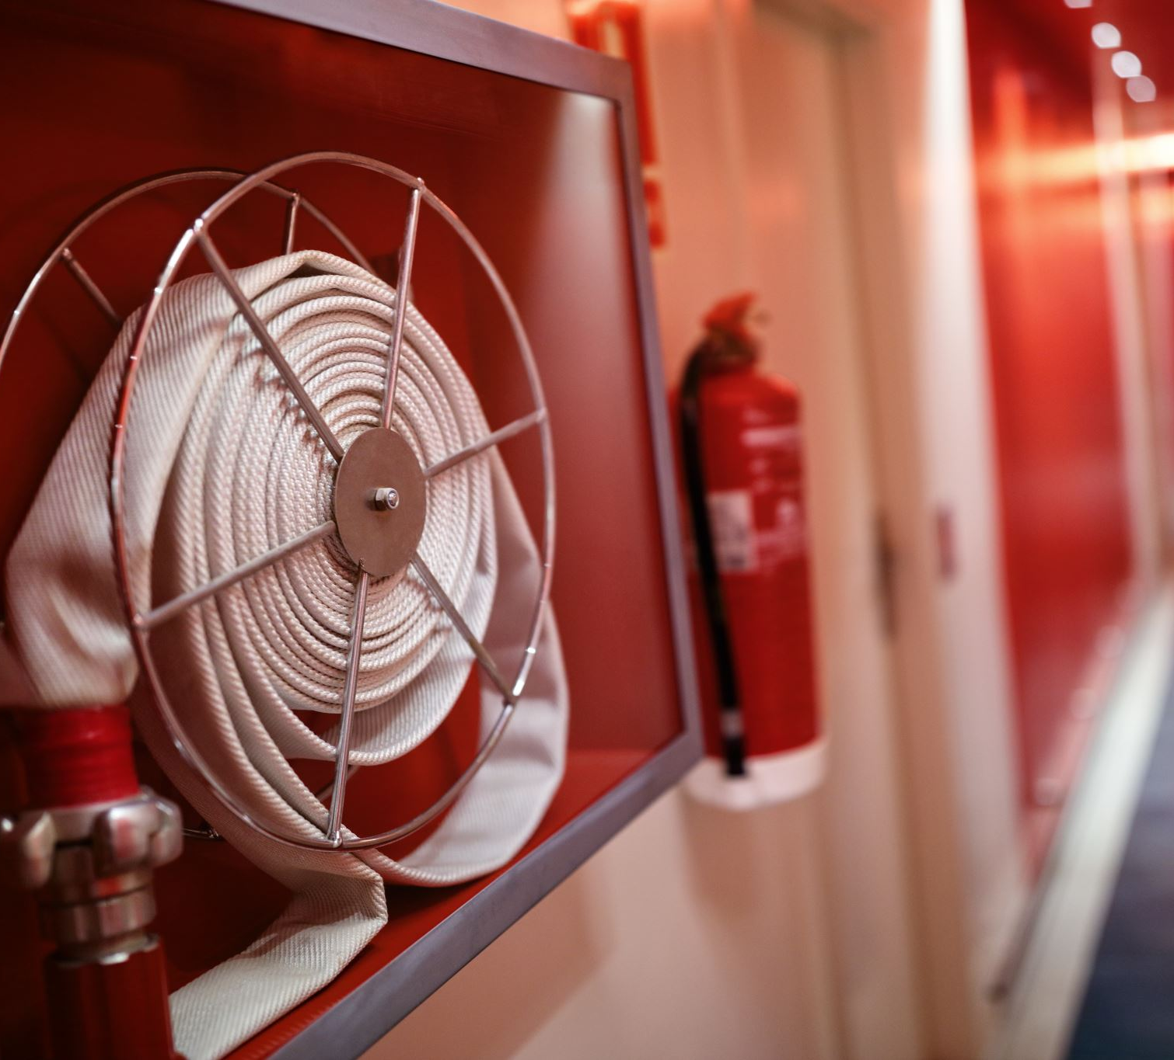
ADDING EMERGENCY CONTROL AND MOTION SENSOR

Slide 22
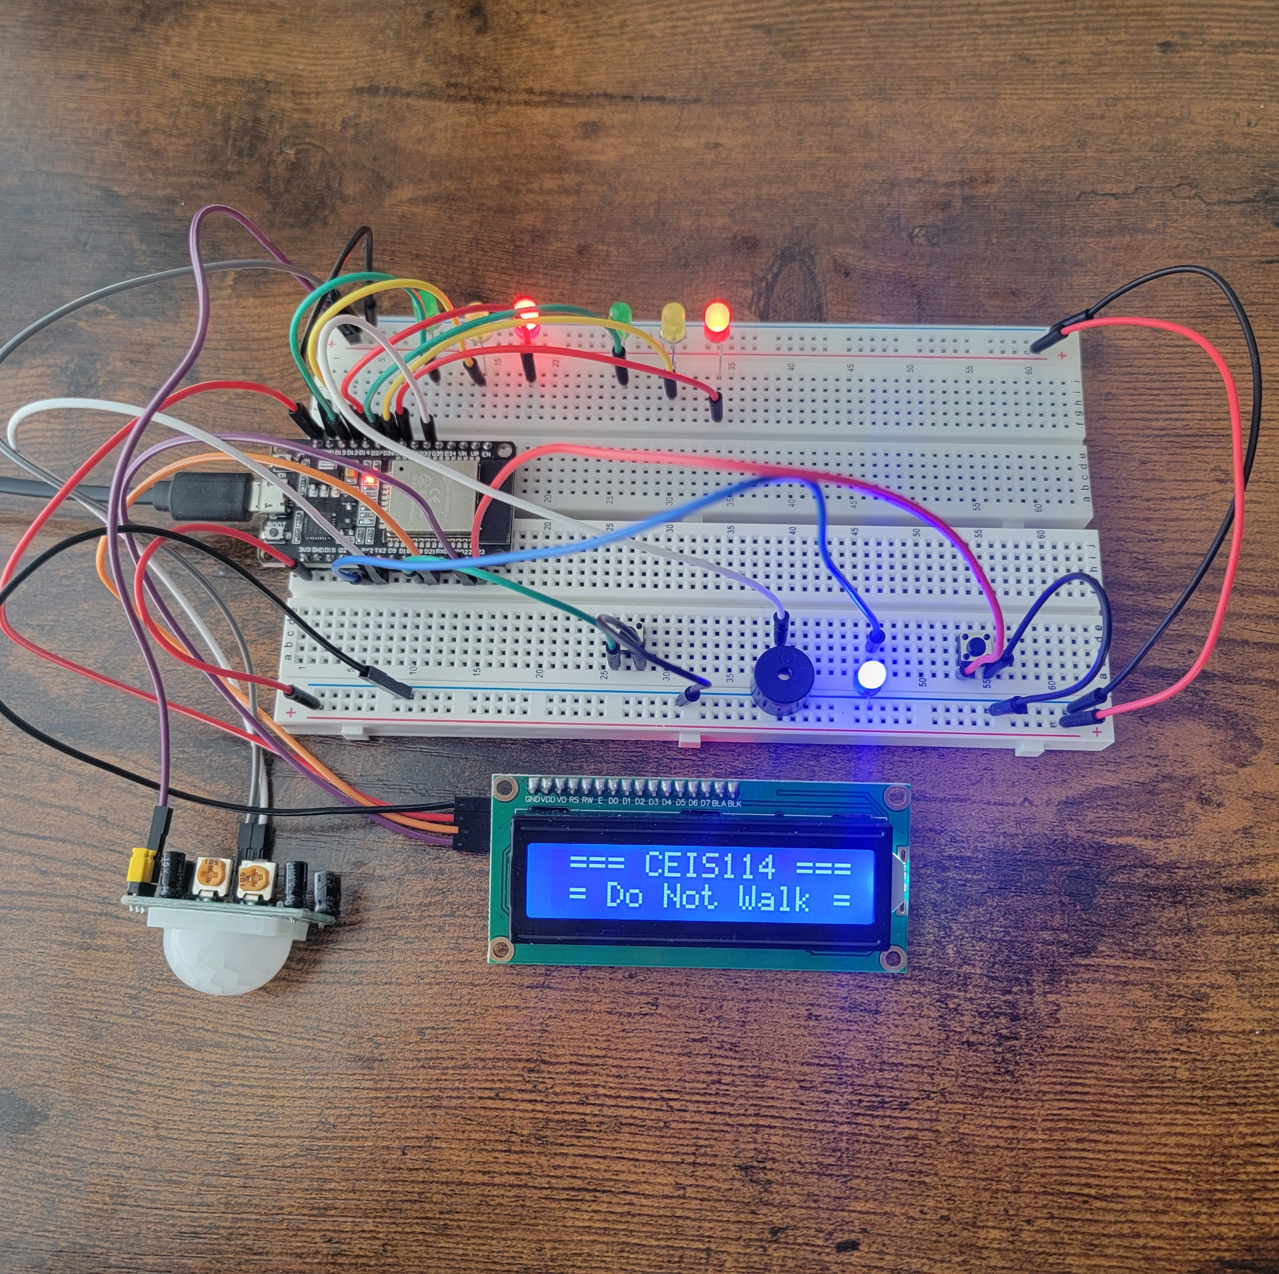
Screenshot of circuit with working LEDs and LCD display (Building/Operation)
ESP 32 Board
Colored LEDs: Red, Yellow and Green (two sets)
One Blue LED – Emergency Light
220 Ohm Resistors (optional)
Push Button
LCD Unit
Buzzer
Wires
Breadboard

Slide 23
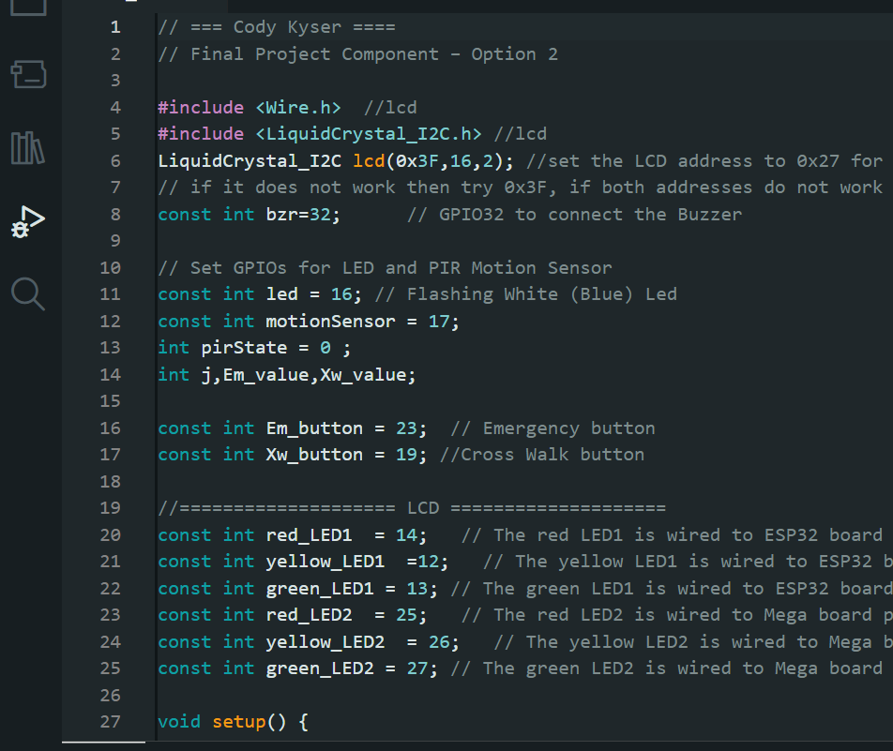
Screenshot of code in Arduino IDE (Testing)
Screenshot of code in Arduino IDE showing my name in the comment

Slide 24
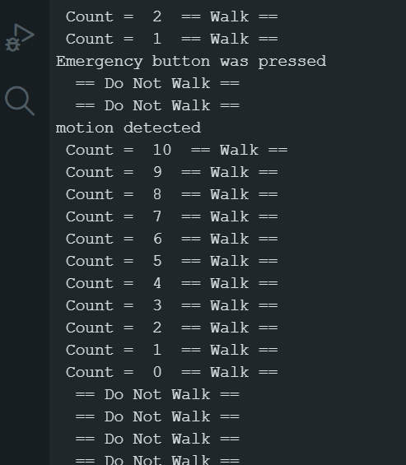
Screenshot of Serial Monitor in Arduino IDE (Testing)
Screenshot of output in Serial Monitor

Slide 25

CAREER SKILLS OBTAINED
Programming and Software Development
Embedded Systems Development
Electronics and Circuit Design
Hardware Integration
Systems Integration
Problem-Solving and Debugging
Project Management
Safety Considerations
Testing and Quality Assurance

Slide 26
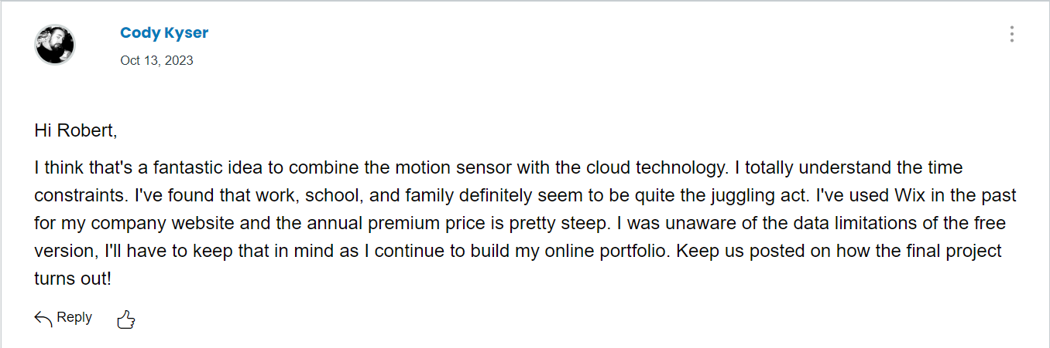
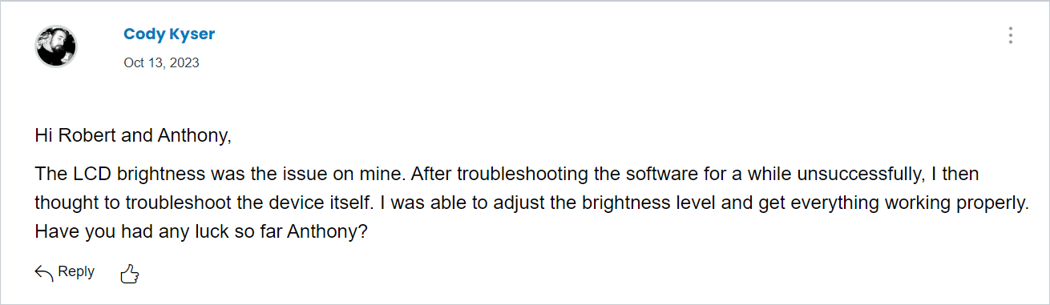
TEAMWORK
Share- I was able to provide feedback to multiple peers on this project. I have attached screenshot of a couple responses to other students posts.
Reflect- Although I did not receive much feedback, another student agreed that the motion sensor was a great addition to our final project.
Review- While there were two options for the final project, it appears the majority went with adding the motion sensor. Per my attachments, one interesting idea was to combine both projects into one, utilizing both motion sensor technology with cloud technology.

Slide 27

CHALLENGES
Some of the challenges I faced for this project included making sure the led lights were inserted properly and troubleshooting loose wiring connectivity issues to prevent flickering LEDs. Downloading and integrating the library for the LED display took a bit of troubleshooting as well before the screen displayed the messages to the pedestrians.

Slide 28

CONCLUSION
In conclusion, projects like this multi-traffic light system have helped me gain a hands-on understanding of these skills. This information is valuable for careers involving software development, embedded systems, electronic engineering, as well as other related fields. This project showcased problem-solving abilities and a practical application of theoretical knowledge.

