Slide 1

NET411 Final Project
Cody Kyser
June 27, 2025

Slide 2

Introduction
This final project for NETW411: Information Security and Mobile Devices presents a summary of the key concepts and skills explored throughout this course. The focus has been on understanding mobile platforms, identifying potential vulnerabilities, and applying defensive techniques using real-world tools and scenarios.
Examined mobile device architecture and cellular network communication
Analyzed mobile app behavior using Android emulation tools
Explored common security threats and real-world vulnerabilities
Conducted reverse engineering of Android applications
Performed network traffic analysis and threat detection

Slide 3

Project Overview
This course project provided hands-on experience with mobile device security using Android emulator tools. It focused on identifying, analyzing, and mitigating security risks in mobile environments.
Utilized an Android emulator to simulate mobile environments
Explored APK file structures and performed basic reverse engineering
Captured and analyzed network traffic between mobile apps and external devices
Identified insecure coding practices and data leakage
Applied countermeasures to address discovered vulnerabilities

Slide 4

Android Emulator

Slide 5
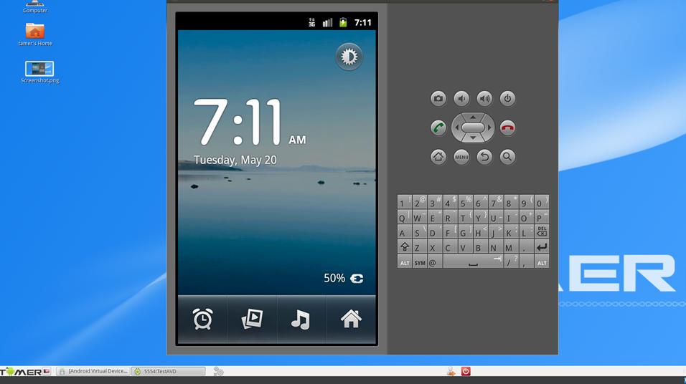
Accessing the Android Emulator
This screenshot shows the Android emulator phone screen with its apps.

Slide 6
What is Android SDK? What is it used for?
Answer:
The Android Software Development Kit (SDK) is a developer’s toolbox for creating Android applications. It works on multiple operating systems to create, test, and debug Android Apps.
These tools include:
Android SDK Build tool
Android Emulator
Android SDK Platform-tools
Android SDK Tools.
The purpose of this SDK is to simulate a virtual Android device on your computer for testing new applications before they are launched. Every time Google releases an update for Android there is a new SDK version made available so developers can access the latest features.
References:
1. https://www.geeksforgeeks.org/android-sdk-and-its-components/#
2. https://developer.android.com/tools

Slide 7

Mobile Remote Shell

Slide 8
What does the com.android.phone process represent?
Answer:
This com.android.phone process is a core system component in Android responsible for handling functions such as SIM management, voice calls, mobile network connections, data service, and is closely tied to the phone’s dialer app.
If this process crashes or causes errors, it represent a problem with the phone’s dialer app or system. This can be caused by software glitches, firmware bugs, installed applications, or a bad SIM card.
Mitigation steps include removing recently installed apps, clearing app cache, resetting all setting, updating software, replacing the SIM card, and finally, a factory reset.
References:
1. https://howtorecover.me/error-comandroidphone-app-manual-how-fix-it
2. https://r2.community.samsung.com/t5/Galaxy-A/com-android-phone-has-stopped/td-p/16122571

Slide 9
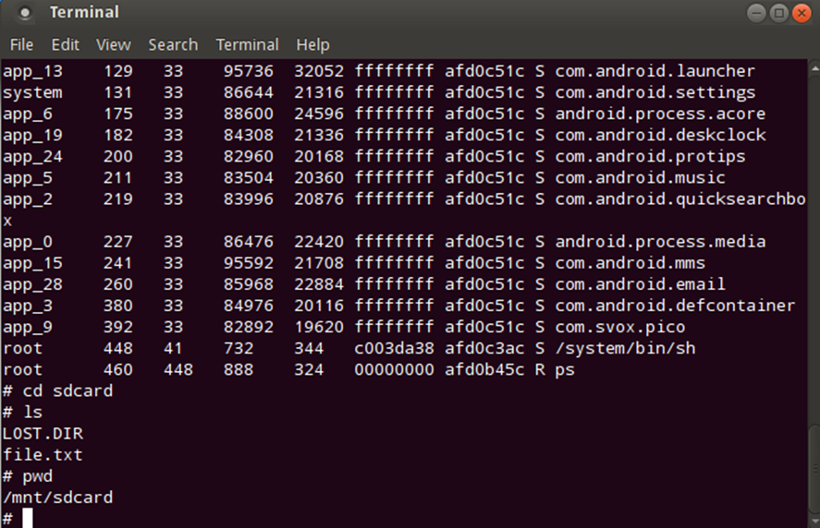
Using Mobile Remote Shell
This screenshot shows that the file.txt file is present in the target directory.

Slide 10
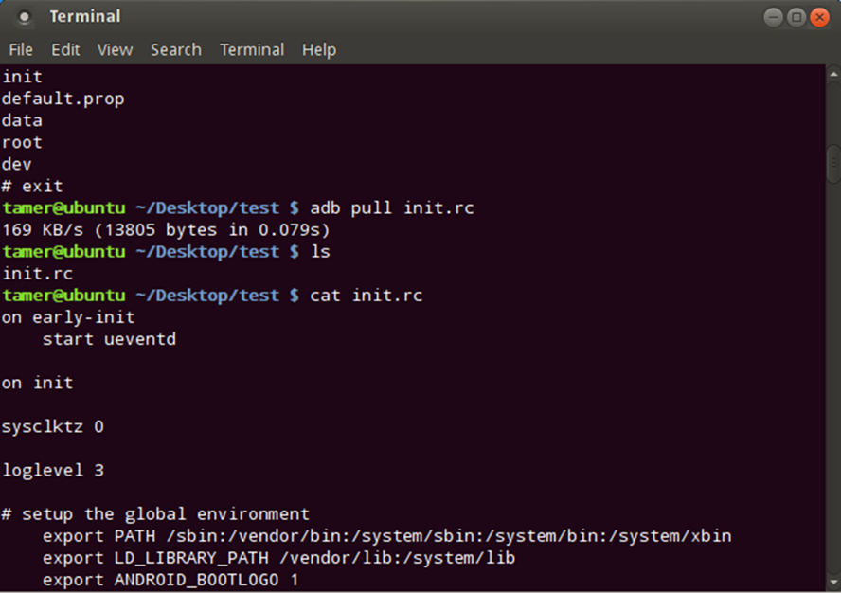
Using Mobile Remote Shell
This screenshot shows 1) the abd pull command and 2) the copied over file in the target directory.

Slide 11
Examine the content of init.rc file on local machine by using the nano init.rc command. Explain the purpose of the file.
Answer:
The init.rc file is a configuration script used by the Android init process. This defines how Android initializes and configures system services, mounts filesystems like SD cards, sets permissions, and launches daemons to control the flow of early system setup.
There are two init.rc files located in:
./system/core/rootdir/init.rc
./bootable/recovery/etc/init.rc
The first file is used for normal startup.
The second file is used when flashing software or to enter recovery mode.
References:
1.
https://dev.to/larsonzhong/android-system-init-process-startup-and-init-rc-full-analysis-22hi
2.
https://android.googlesource.com/platform/system/core/+/master/init/README.md

Slide 12
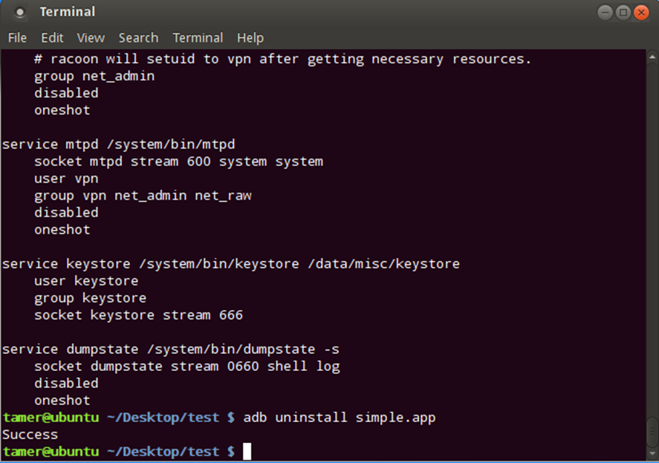
Using Mobile Remote Shell
This screenshot shows the command line adb steps for app deletion.

Slide 13

Android App Development

Slide 14
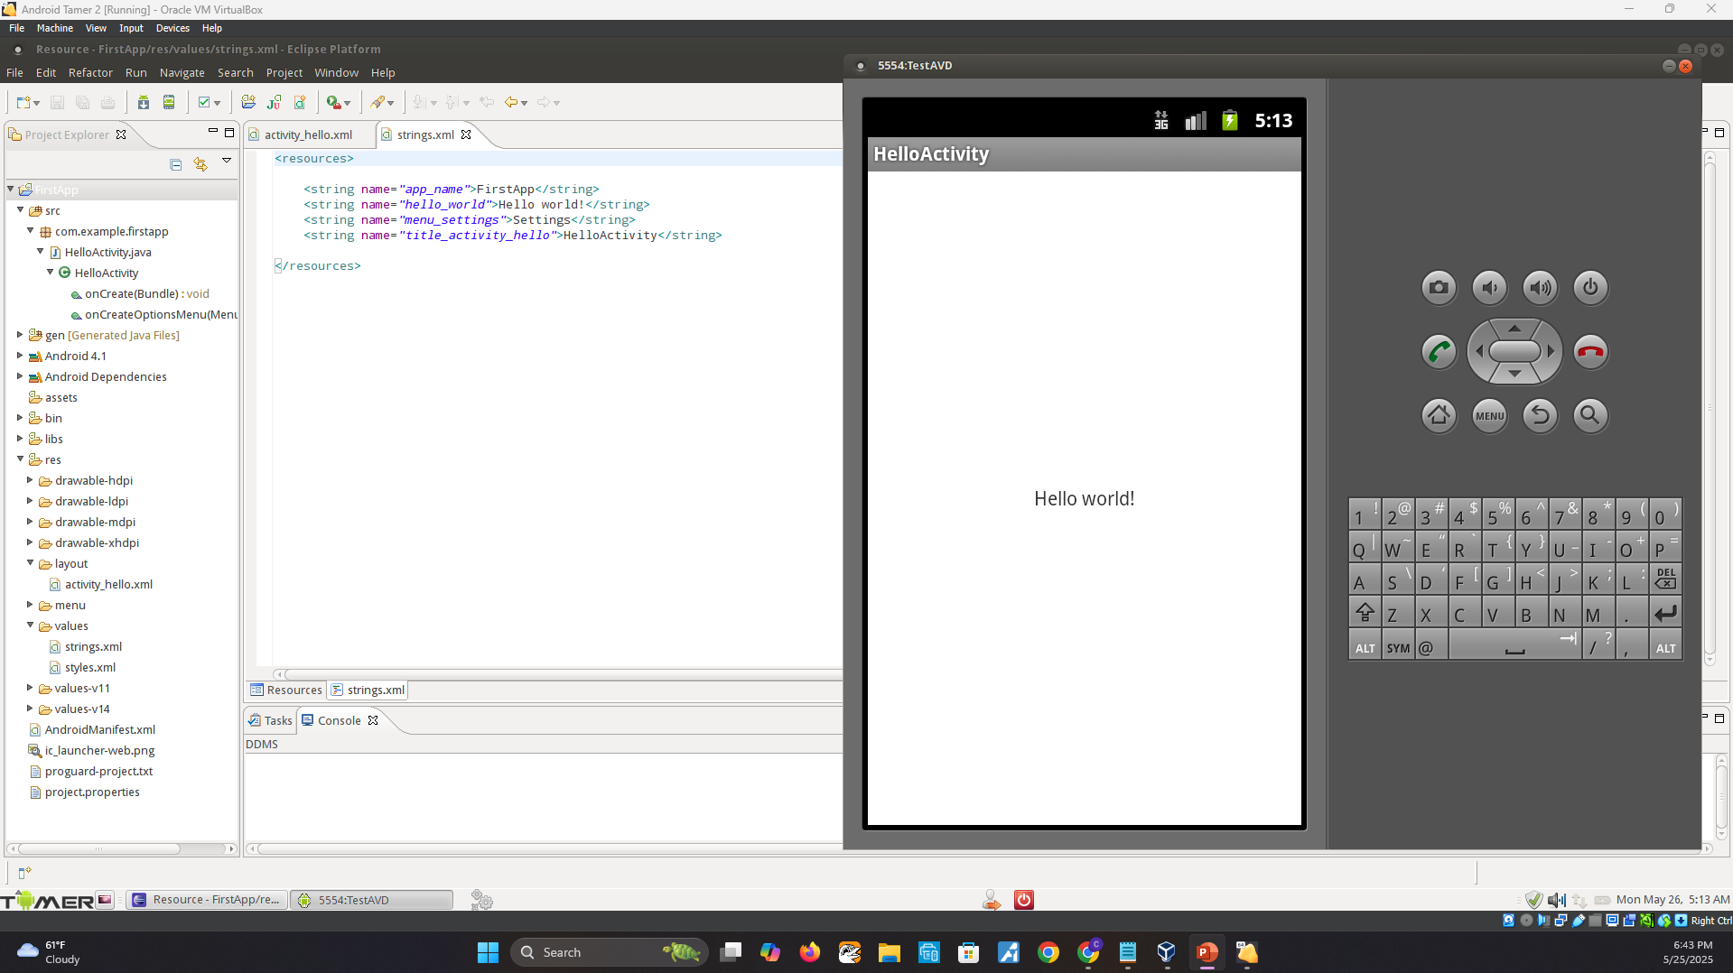
Using the Eclipse IDE
This screenshot shows the phone screen with the “Hello world!” message.

Slide 15
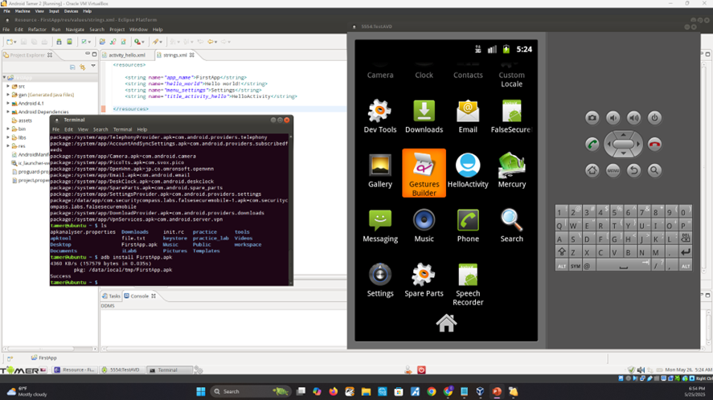
Creating Android Package File
This screenshot shows the phone screen with the new FirstApp app installed.

Slide 16
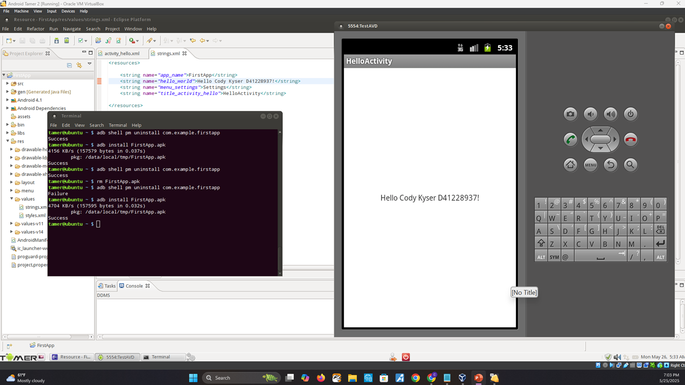
Editing the Application Output

Slide 17

Reverse Engineering

Slide 18
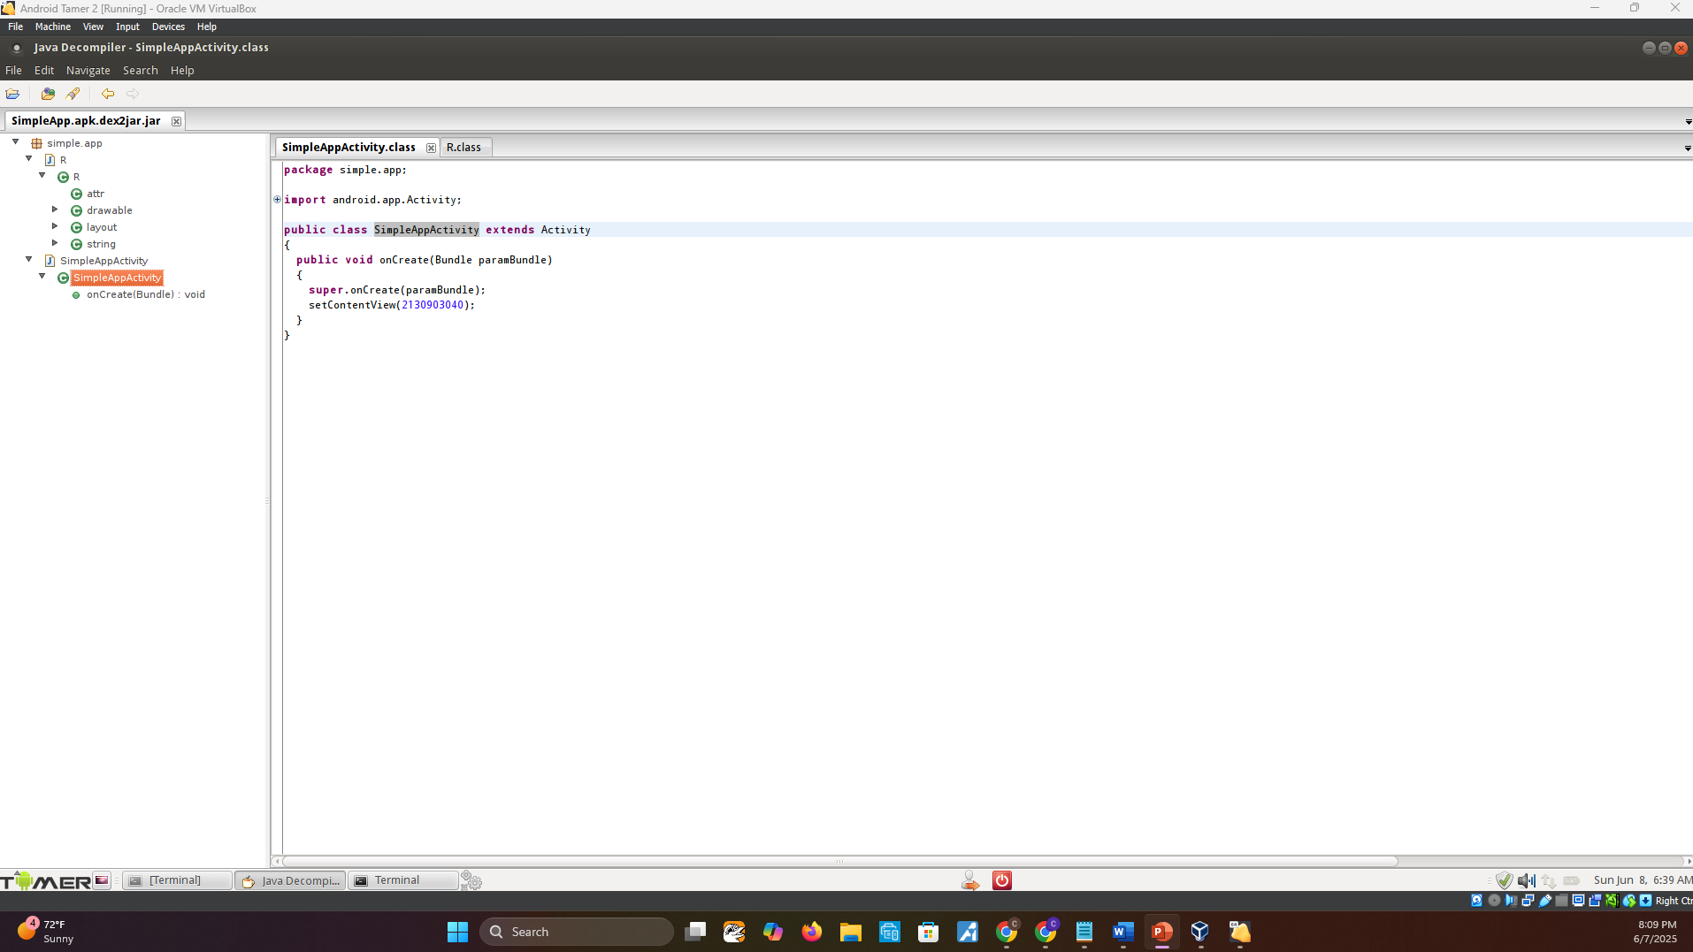
Reverse Engineering the SimpleApp App
This screenshot shows the Java Decompile tool window with SimpleApp source code.

Slide 19
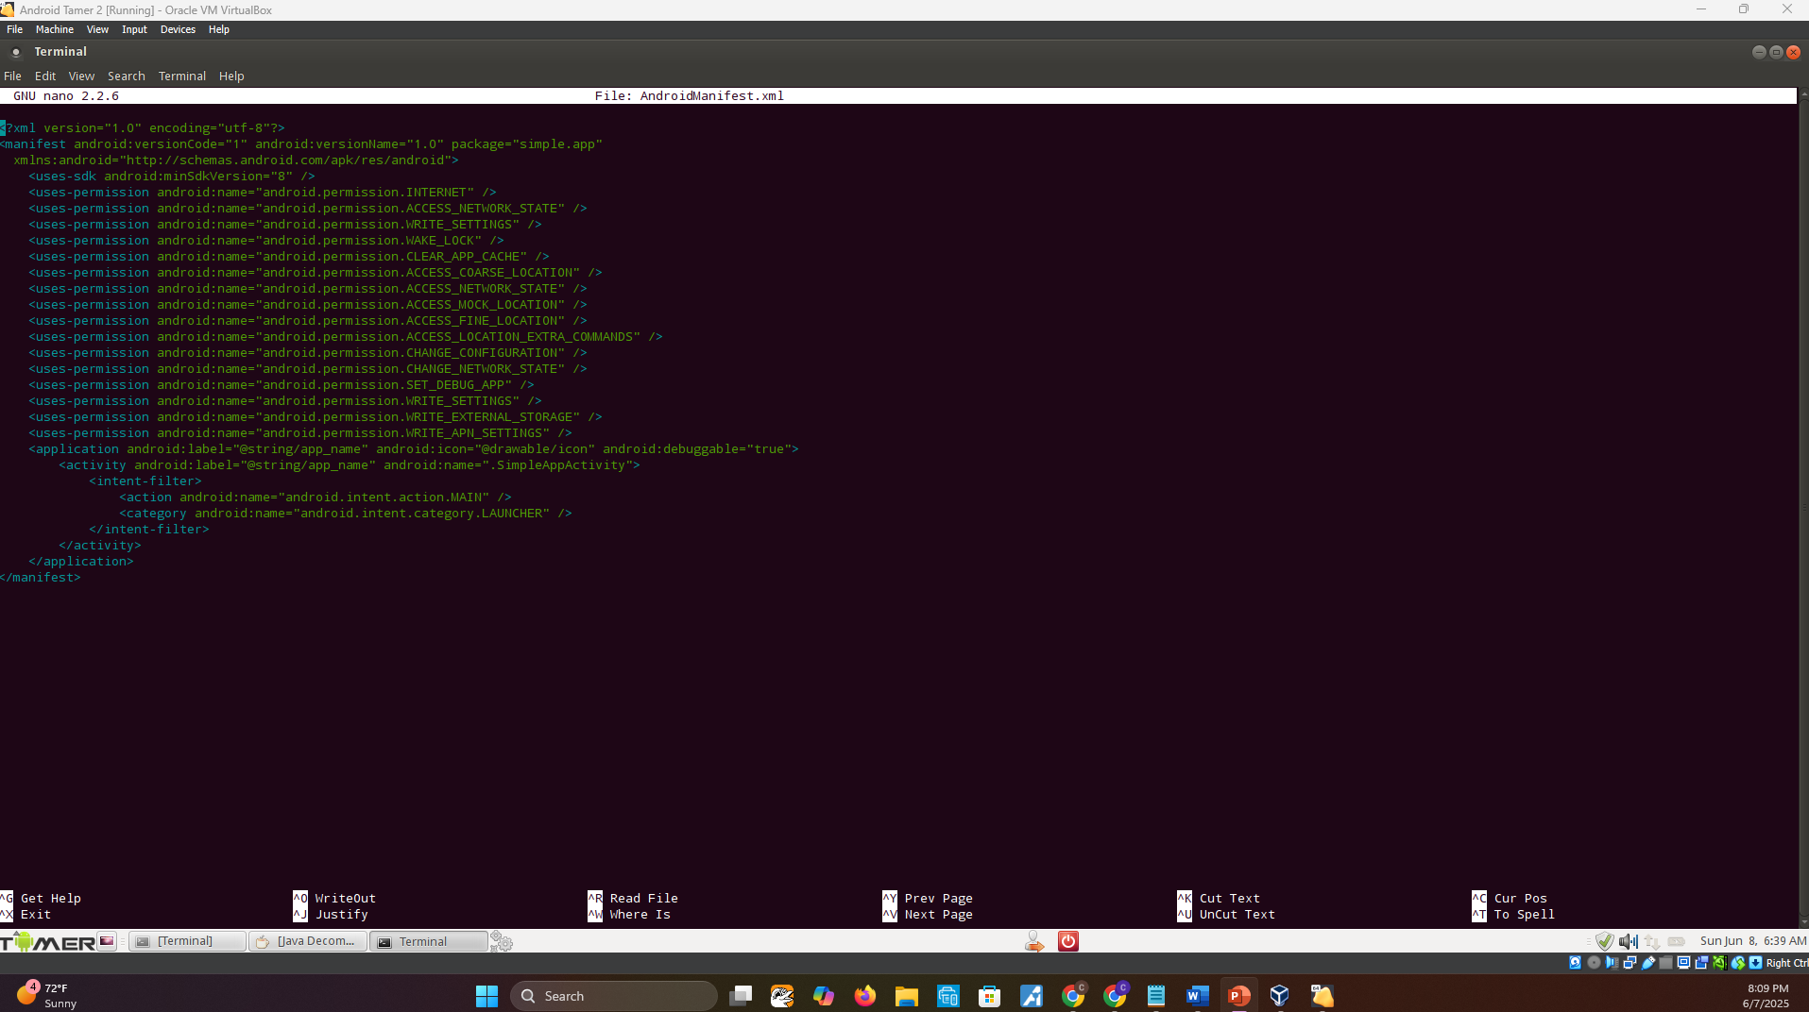
Reverse Engineering the SimpleApp App
This screenshot shows the content of the AndroidManifest.xml file.

Slide 20
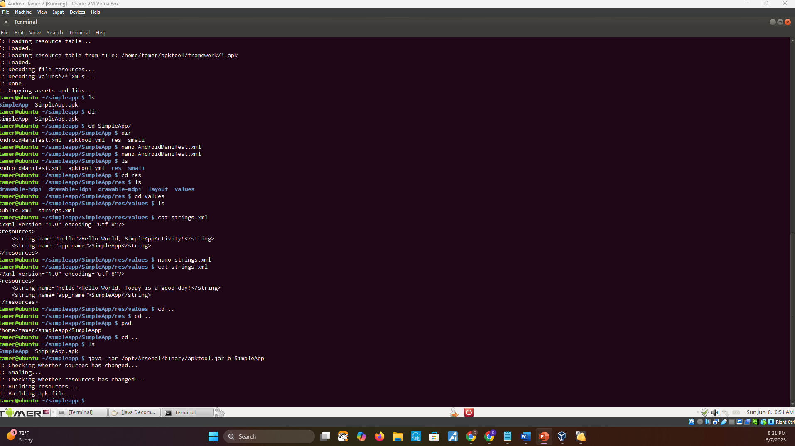
Reverse Engineering the SimpleApp App
This screenshot shows the recompiling process using apktool.

Slide 21

Web Traffic Analysis

Slide 22
Research Burp Suite online.
In the screenshot shown in Step 3, what does it mean when you select “Yes” to confirm the “Are you sure that you want to listen on all interfaces” message?
Answer:
Burp Suite’s proxy will listen on all network interfaces, not just the default loopback (127.0.0.1). This allows external systems on the network to use Burp as their Proxy allowing their HTTP/HTTPS traffic to be inspected
References:
1. https://portswigger.net/web-security
2. https://www.geeksforgeeks.org/ethical-hacking/how-to-setup-burp-suite-for-bug-bounty-or-web-application-penetration-testing/

Slide 23
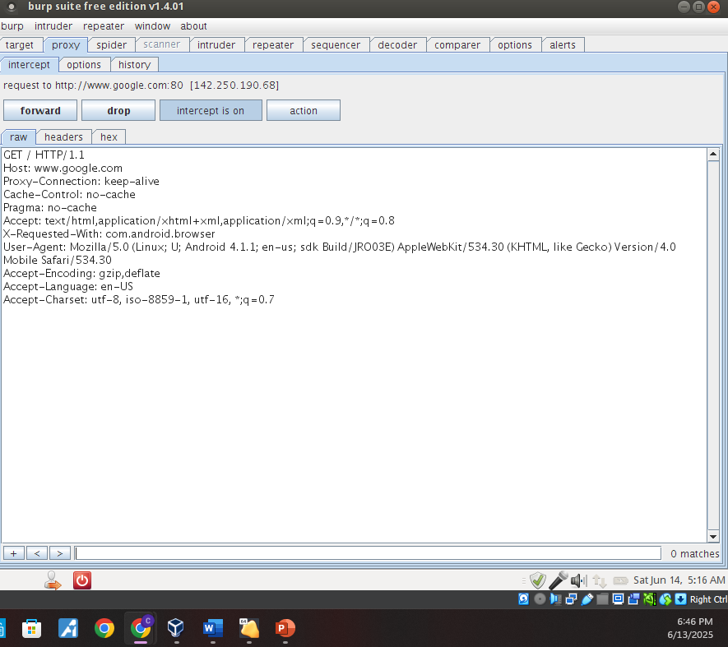
Using Burp Suite to Analyze Web Traffic
This screenshot shows the Burp Suite window with the Web header displayed.

Slide 24
Research the concept of “Web Headers.”
What is the role played by Web headers in a hacker’s attempt to mount a cyber attack?
Answer: Tools like Burp Suite or curl –I help hackers examines server headers for weaknesses. Attackers can inject malicious headers into requests to bypass security filters. Headers like User-Agent can be spoofed to look like real traffic. Attack Types include:
Session Hijacking
Cross-Site Scripting (XSS)
Clickjacking
Directory Traversal
Bypassing Authentication
Cross-Site Request Forgery (CSRF)
References:
https://www.geeksforgeeks.org/computer-networks/http-headers-x-xss-protection/
2. https://hackernoon.com/cybersecurity-essentials-practical-web-app-security- testing-tips-for-qa-engineers

Slide 25
Research the proxy software available for actual Android devices (not just an emulator).
Describe what it is and how it works.
Answer:
Every Proxy is a free, no-root proxy server app by Gorilla Software LLP and supports multiple protocols including HTTP, HTTPS, SOCKS4, and SOCKS5. This app works by converting your Android device into a proxy server so other devices like laptops can route traffic through it. Once set up, the app relays requests/responses as the middleman.
References:
https://play.google.com/store/apps/details?id=com.gorillasoftware.everyproxy&hl=en_US&pli=1
2. https://www.everyproxy.co.uk/

Slide 26

Challenges Faced
Throughout the project, several technical and conceptual challenges were encountered, which required troubleshooting and creative problem-solving.
Configuring and optimizing the Android emulator for analysis
Modifying network settings in Oracle VM to route traffic through a proxy
Extracting and decompiling APK files without corruption
Capturing accurate network traffic

Slide 27
Career Skills Gained
This project strengthened a range of technical and analytical skills directly applicable to careers in cybersecurity, mobile forensics, and penetration testing.
Mobile device analysis using Android emulator
Reverse engineering APKs and inspecting app behavior
Network traffic capture and proxy configuration
Identifying mobile-specific vulnerabilities and exploits
Troubleshooting VM, proxy, and tool compatibility issues
Strengthening analytical thinking and security mindset

Slide 28
Conclusion
The NETW411 course and final project provided valuable insight into the unique security challenges of mobile devices. By combining theoretical knowledge with hands-on labs, I developed a practical understanding of mobile threat landscapes and defensive techniques.
Gained real-world experience in mobile app and network analysis
Improved technical proficiency in reverse engineering and traffic inspection
Learned how to identify, assess, and mitigate mobile vulnerabilities
Reinforced the importance of proactive security
Prepared to apply these skills in cybersecurity and mobile-focused roles

Slide 29

References
https://docs.oracle.com/en/virtualization/virtualbox/index.html
https://www.infosecinstitute.com/resources/application-security/android-tamer-walk/
https://developer.android.com/studio/debug/apk-analyzer
https://www.geeksforgeeks.org/computer-networks/what-is-reverse-engineering-technique-in-cybersecurity/

