Slide 1



CIS355A Final Project Presentation
Cody Kyser
CIS355A

Slide 2
Introduction
Java is a globally recognized, versatile programming language known for its reliability and platform independence
Java provides robust features for designing interactive and dynamic GUIs
Java simplifies handling file operations, such as reading, writing, and managing data efficiently
Java seamlessly integrates with databases, making it a preferred choice for developing enterprise-level applications
Java’s extensive library support and community resources empower developers to create innovative solutions
Java excels in building secure, scalable, and performance-drive applications across multiple domains

Slide 3
Design phase
A well-planned design phase saves time and reduces rework
Design documents allow clients to visualize the project
Wireframe diagrams provide a clear development target
UML Class diagrams outline the application’s structure
Simplifies communication between team members
Helps identify potential issues early in the process

Slide 4
Wireframe diagram
GUI Structure:
  The visual framework for user interaction.
Components Selection:
  Identification of buttons, textfields, dropdowns, and other interface elements.
Screen Layout Design:
  The arrangement of elements to ensure a user-friendly flow.
Navigation Flow:
  Defines how users move between screens and access features.
Visual Consistency:
  Ensures uniform styling and alignment across all screens.

Slide 5
UML Class diagram
Defining Core Classes:
  Identifying and designing the main classes that will form the building blocks of the application.
Object Relationships and Structures:
  Mapping the relationships and interactions between objects for clarity and efficiency.
Establishing the Application Framework:
  Outlining the overall architecture to ensure scalability and maintainability.
Attributes and Methods:
  Specifying the properties and functionalities of each class to fulfill project requirements.
Inheritance and Polymorphism:
  Utilizing object-oriented principles to promote code reuse and flexibility.

Slide 6
Simple gui application
Initial Steps in GUI Development:
  Began with creating a basic graphical user interface (GUI) application to understand foundational concepts.
Added Interactive Elements:
  Implemented labels, textfields, and other essential components to enhance user interaction.
Built the Main Application Frame:
  Designed and generated the framework to serve as the container for all GUI elements.
Optimized the Layout:
  Centered the application window to improve usability and professional appearance.
Explored Event Handling Basics:
  Introduced the functionality for user inputs by preparing the application to handle simple events.

Slide 7
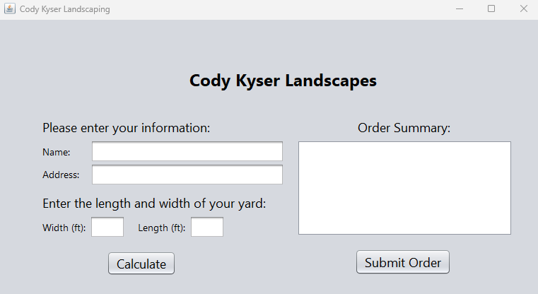
Simple gui
Labels:
  Used to display static text or instructions to guide the user on how to interact with the application.
Textfields:
  Provided input fields for users to enter data or information as required by the application.
Buttons:
  Included clickable elements to trigger specific actions or events.
Panels:
  Added containers to organize and group related components for a cleaner layout.
Basic Event Handling:
  Set up interactions for user inputs, such as responding to button clicks or data entry.

Slide 8
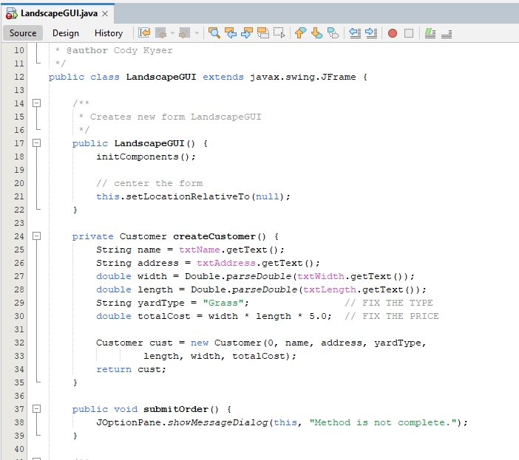
Event Code
Modular Code Structure:
  Organized the program into reusable methods to enhance readability and maintainability.
Platform Independence:
  Leveraged Java’s “write once, run anywhere” capability to ensure the application works seamlessly across different systems.
User Input Handling:
  Captured user data through text fields to allow dynamic and interactive functionality.
Data Processing:
  Processed input data within the application to execute desired tasks or calculations.
Output Display:
  Showed the results or responses to user input directly on the GUI for a seamless user experience.
Error Handling:
  Added basic input validation to manage unexpected or invalid user input.
Event-Driven Programming:
  Enabled Gui components to trigger specific methods upon user interaction, such as button clicks or text field updates.

Slide 9
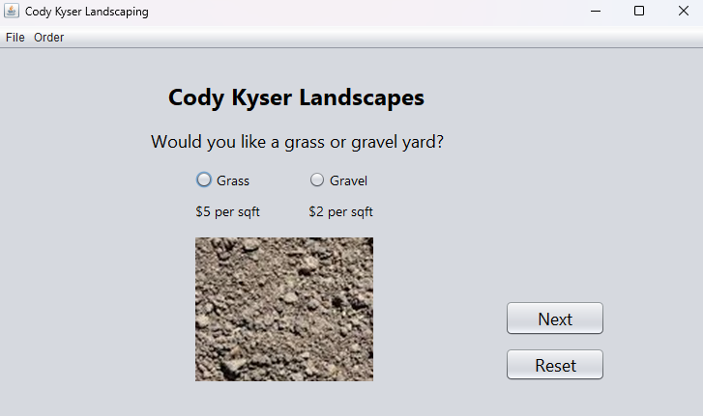
Advanced gui
Enhanced Functionality:
  Interactive features to improve usability and user engagement.
Radio Buttons for Yard Selection:
  Allows users to choose between “Grass” or “Gravel” for yard type.
Dynamic Photo Display:
  User’s selection updates the displayed photo.
Integrated Cost Calculations:
  Cost per square foot updates based on the user’s selection.

Slide 10
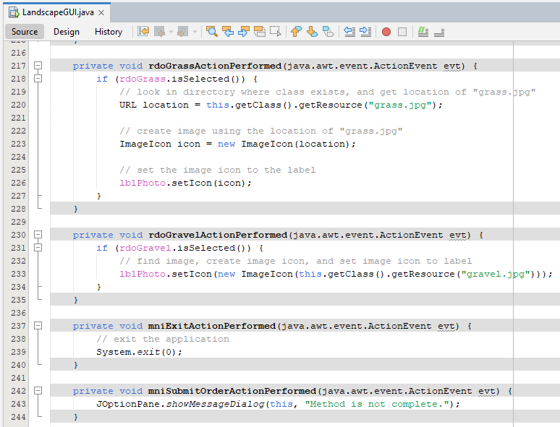
Event code
Dynamic Image Updates:
  Grass or Gravel options update lblPhoto with grass.jpg or gravel.jpg.
Application Control:
  Exit closes the application using System.exit(0).
  Order Submission displays placeholder message for future order submission functionality.
Event-Driven Design:
  Enhances interactivity.

Slide 11
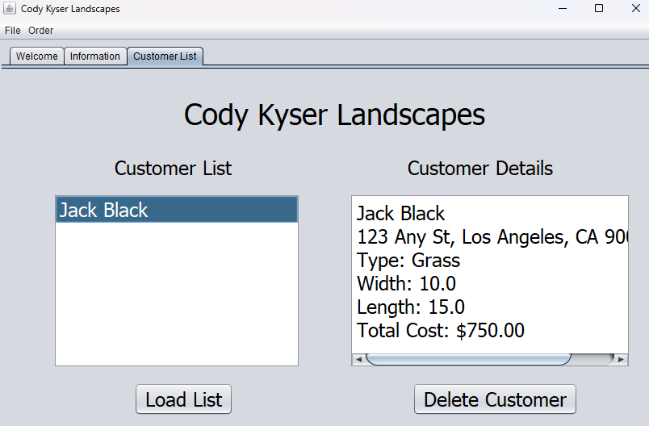
Object arrays
Customer List Tab:
  Displays customers stored in an object array and details for the selected customer.
Features:
  Load list populates the list from the array.
  Delete customer removes a customer and updates the list dynamically.
Integration:
  Builds on prior work by storing user inputs (name, address, dimensions) as object in the array.

Slide 12
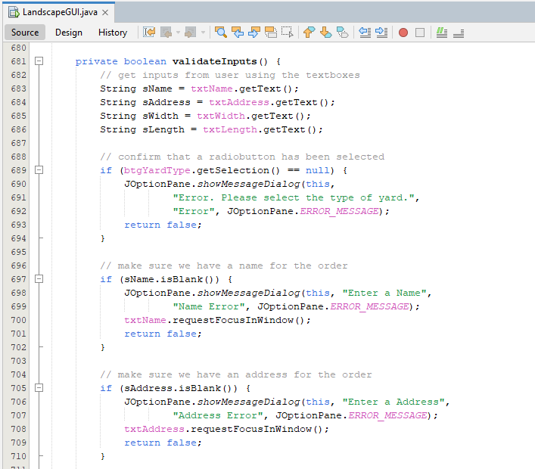
Event code
Input Validation:
  Checks user inputs from text fields and radio buttons before processing.
Validation Steps:
  Displays error messages and prompts user for inputs.
Error Handling:
  Uses JOptionPane to display specific error messages for incomplete or incorrect inputs, highlighting invalid fields.

Slide 13
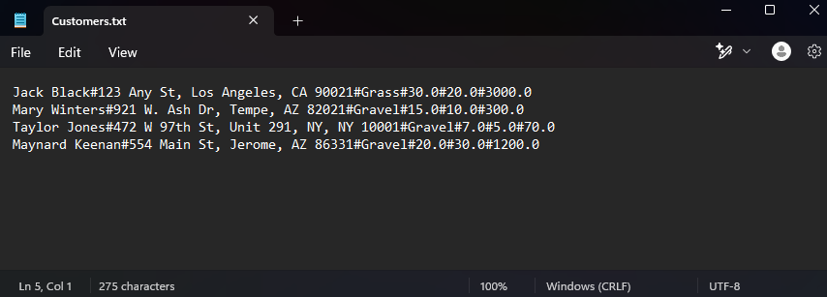
FILE io
Purpose:
  Utilize File I/O to save and load customer data for persistent storage.
File Format:
  Data is stored in a .txt file in a structured format using delimiters (#) to separate fields.
Functionality:
  Saves customer information in the order of creation.
  Reads the file to populate the customer list.
Key Features:
  Enables persistent storage for future use.
  Simplifies data retrieval and management within the application.

Slide 14
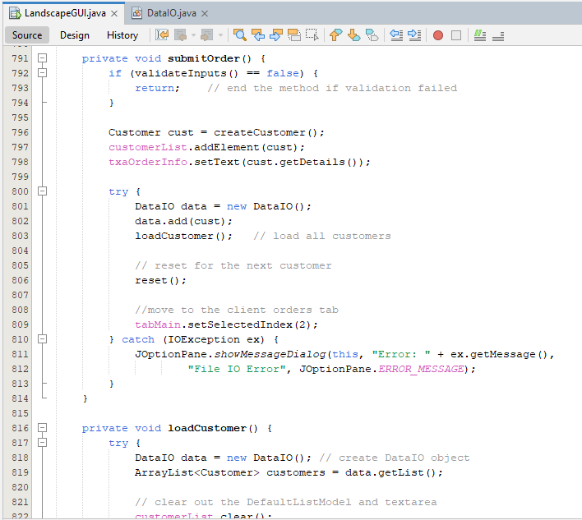
Event code
Submit Order ( submitOrder):
  Collects user inputs, creates a Customer object, and adds it to the list.
  Uses the DataIO class to save customer data to a file.
  Clears current input fields for the next customer.
Load Customer ( loadCustomer ):
  Retrieves customer data from file and displays it into the GUI.

Slide 15
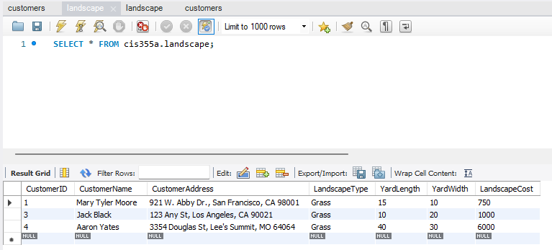
Database io
Purpose:
  Store customer details in the landscape table within the cis355a MySQL database.
Operations:
  Data is saved using parameterized INSERT queries.
  Verified with SELECT queries in SQL Workbench.
Key Features:
  Persistent, structured storage for customer data.
  Easily retrievable for updates or reposting.

Slide 16
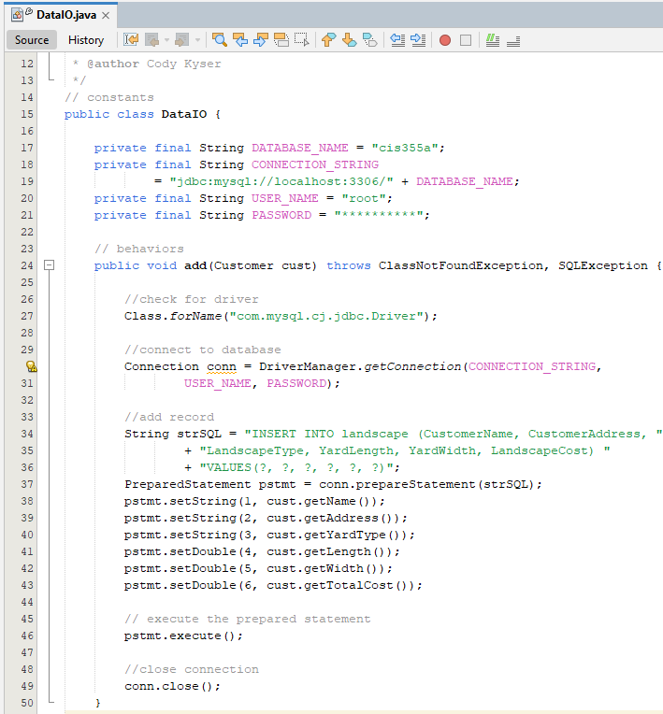
Event Code
Database Connection: ( cis355a )
  Uses MySQL JDBC Driver to connect to a local database.
  Connection details include database name, username, password, and connection string.
Key Method: ( add(Customer cust):
  Driver setup loads driver with Class.forName.
  Establishes a connection using DriverManager.getConnection.

Slide 17
Challenges
Code is Case Sensitive:
  Small typos in variable names or commands caused issues during implementation.
Debugging Errors:
  Some bugs required advanced debugging techniques and careful analysis to resolve.
Alignment and Layout:
  GUI alignment issues need trial and error for a polished appearance.
Database Connectivity:
  Establishing a stable connection and handling exceptions for database operations.
Input Validation:
  Ensuring proper error handling for invalid or incomplete user inputs required additional logic.

Slide 18
Career Skills
Designing GUI Applications:
  Developed user-friendly graphical interfaces in Java using Swing.
Class Design with UML:
  Learned to design and structure classes with UML diagrams for better modularity and scalability.
Three-Tier Development:
  Applied the three-tier architecture to separate the presentation, business logic, and data layers effectively.
Proficiency in Java Syntax:
  Strengthened understanding of Java syntax and object-oriented programming principles.
Advanced Debugging Techniques:
  Enhanced problem-solving skills by debugging complex issues in the application.
File and Database Integration:
  Gained experience with File I/O and database connectivity to manage persistent data.

Slide 19
Conclusion
Key Takeaways:
  Developed a comprehensive Java application integrating GUI, object-oriented programming, and database connectivity.
  Strengthened problem-solving and debugging skills through hands-on project challenges.
  Applied concepts like three-tier architecture, UML design, and input validation in a real-world context.
Skills Acquired:
  Gained proficiency in designing user interfaces, managing data storage, and implementing event-driven programming.
  Learned to handle File I/O and database integration effectively.
Future Applications:
  These skills lay a strong foundation for developing scalable, professional software solutions.
  Prepared to tackle more complex programming projects and enhance career readiness in software development.

