Slide 1

The Future is in the Clouds:
A Deep Dive into Cloud Computing

Slide 2
Welcome to the threshold of technological metamorphosis, where we delve into the expansive universe of cloud computing, a convergence of innovation and infrastructure with limitless potential. Our spotlight is on Microsoft Azure, a powerhouse within the realm of cloud solutions. More than just a platform, Azure serves as a catalyst for change, providing scalability, an extensive services portfolio, and a global presence that propels businesses to unprecedented heights.

Slide 3

Virtual Machine (VM) Instances

Slide 4
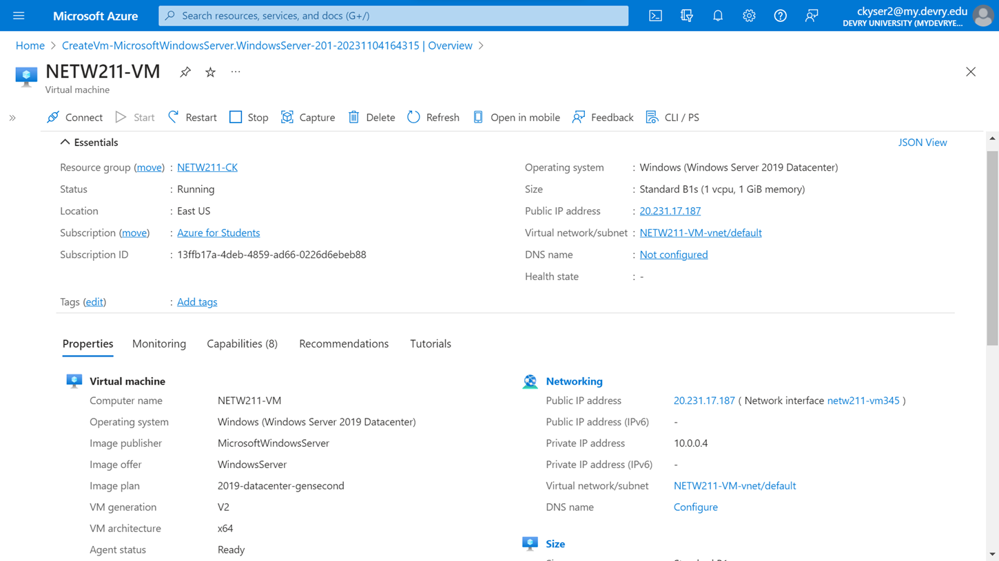
This screenshot shows the NETW211VM page with information such as the resource group name, subscription, public IP address, etc.
Deploying a VM in Azure

Slide 5
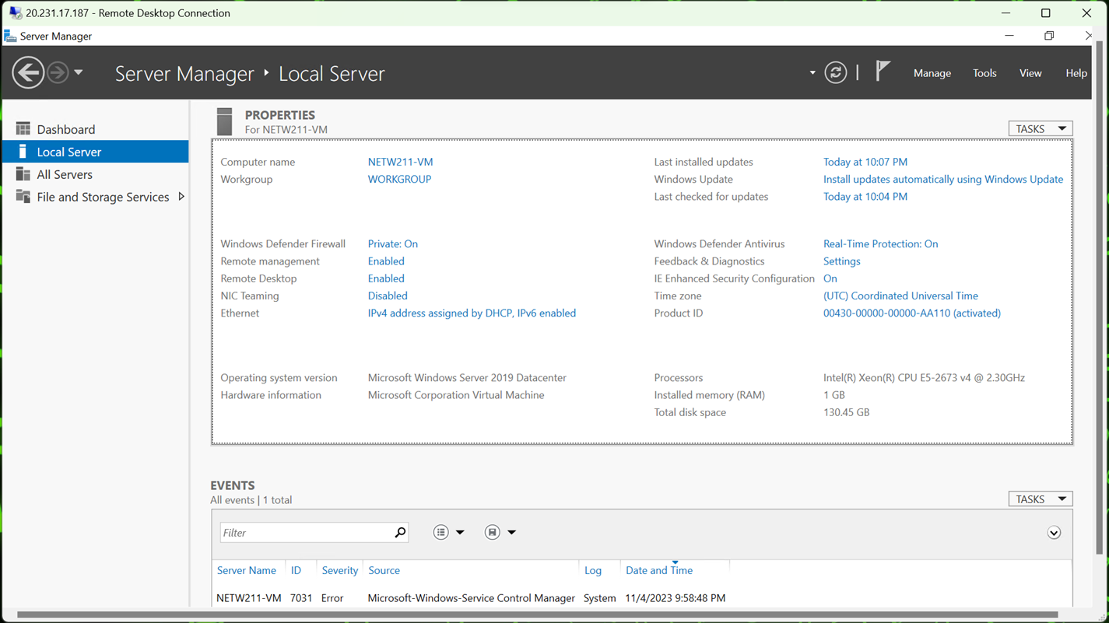
This screenshot shows the PROPERTIES for NETW211VM page, including the computer name, operating system version, hardware information, etc.
This screenshot also shows the EVENTS section with the Date and Time information.
Connecting to the VM

Slide 6
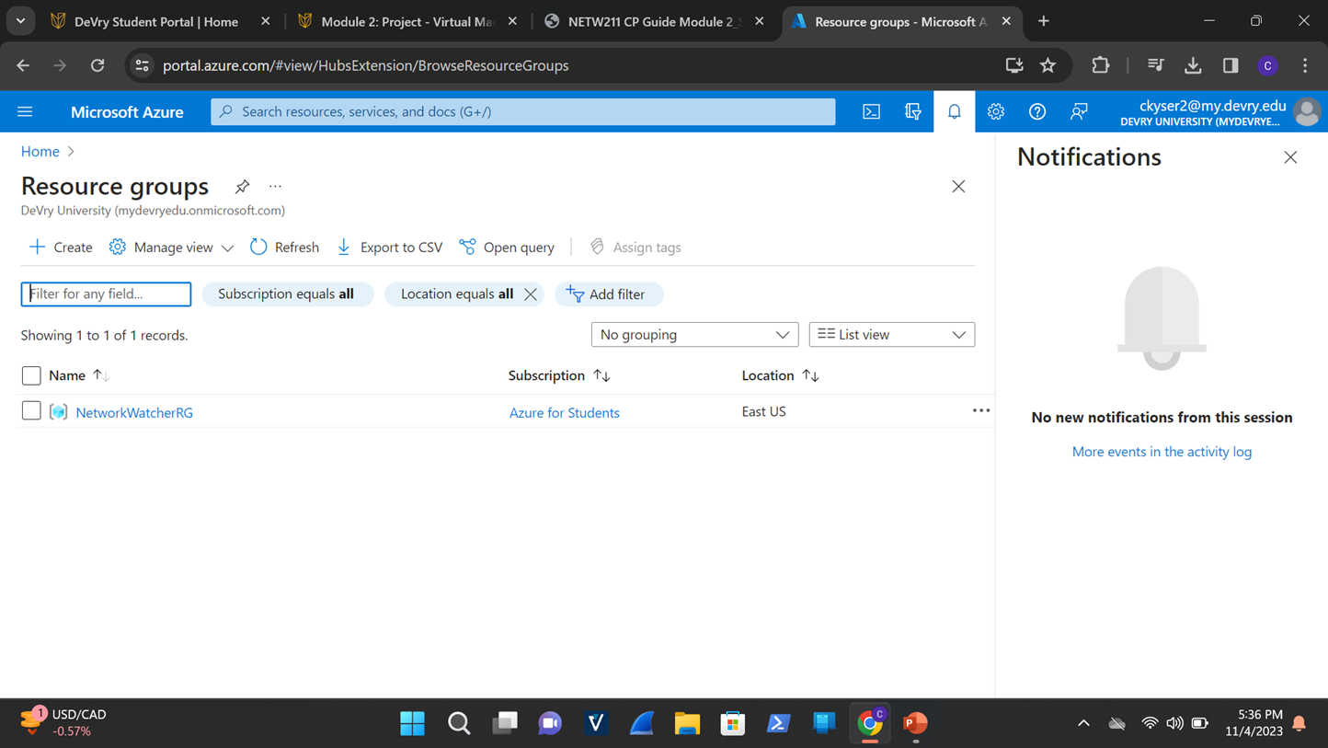
This screenshot shows the NETW211-ck Resource groups page, with the “No resources match your filters” message.
Deleting the VM

Slide 7

Azure VNet and Subnets
Azure VNet and Subnets

Slide 8
Creating a VNet with Two Subnets
1. With a /24 network prefix, how many usable IPv4 host addresses are there?
Answer: 254
2. Given the answer above, why is the number of available IP addresses for Subnet0 (10.0.0.0/24) or Subnet1 (10.0.1.0/24) is 251 when you create an Azure VNet?
Answer: Azure reserves the first subnet for the network address, the first three addresses of the subnet range, and the broadcast address for a total of 5 reserved out of 256, leaving 251 IP addresses available
References:
1. IP Subnet Calculator, https://www.calculator.net/ip-subnet-calculator.html
2. Azure Virtual Network frequently asked questions, https://docs.microsoft.com/en-us/azure/virtual-network/virtual-networks-faq

Slide 9
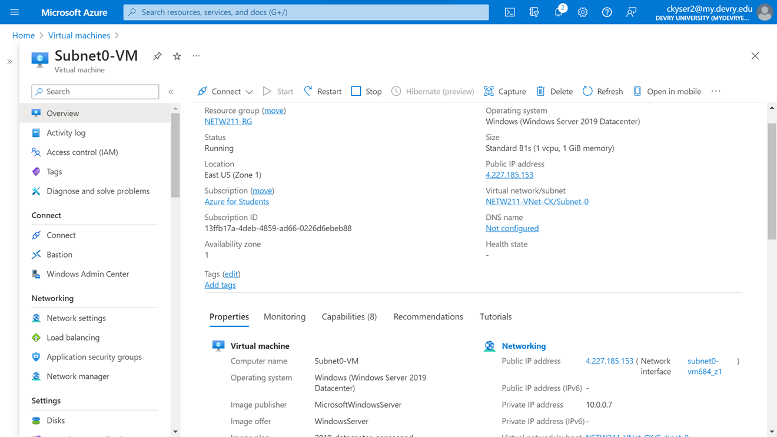
This screenshot includes the Properties section of the Subnet0-VM page, showing the networking and size information of the VM.
Deploying VMs into Subnets (1 of 3)

Slide 10
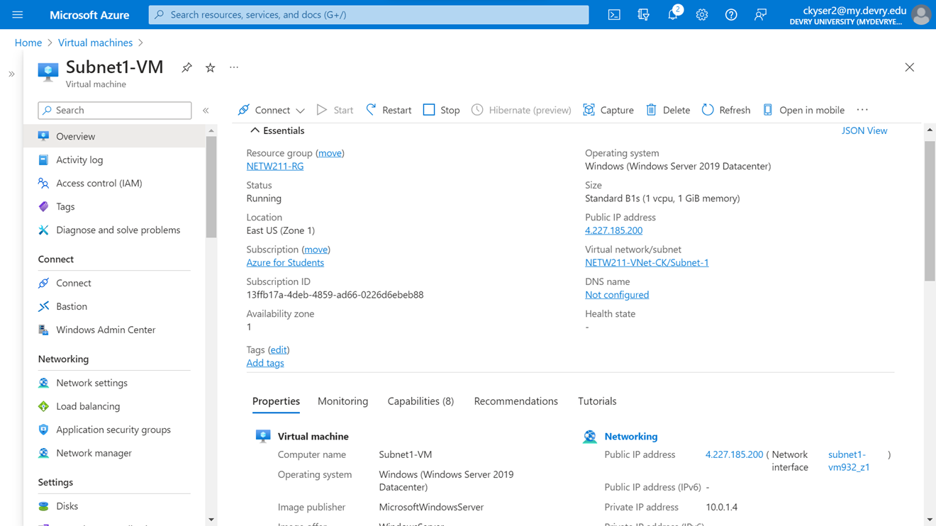
This screenshot includes the Properties section of the Subnet1-VM page, showing the networking and size information of the VM.
Deploying VMs into Subnets (2 of 3)

Slide 11
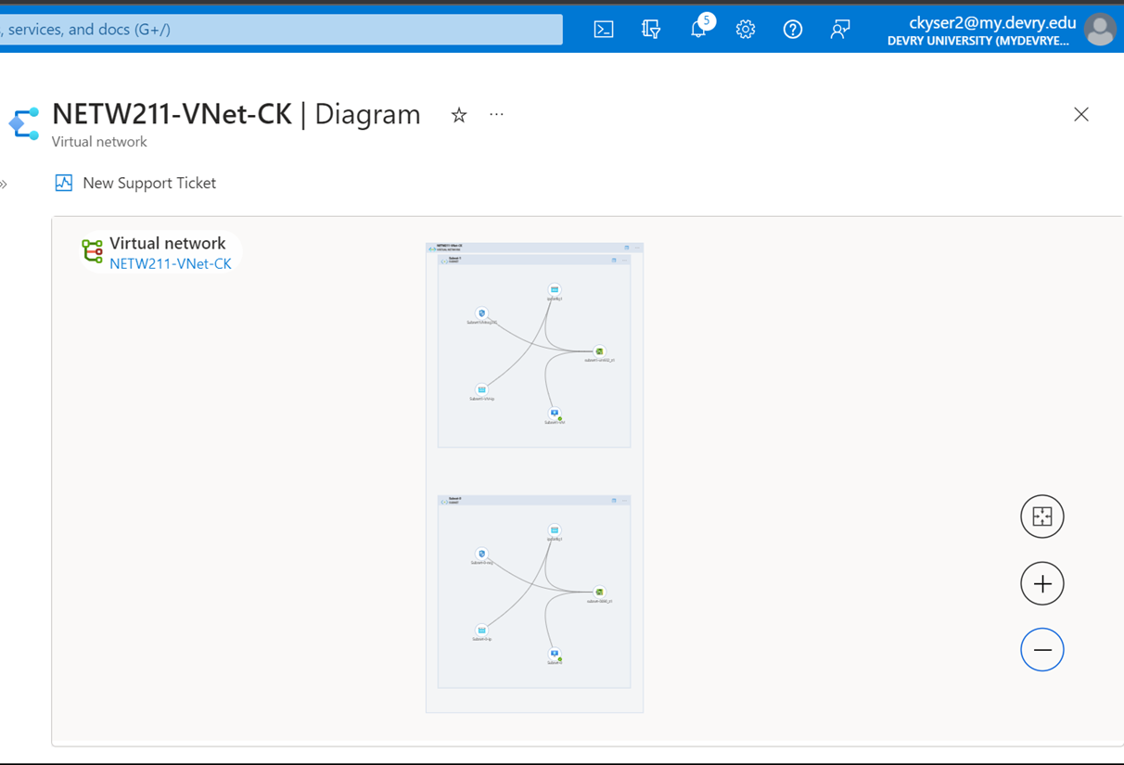
This screenshot shows the topology diagram of my VNet with two subnets (Subnet0 and Subnet1) and one VM in each subnet (Subnet0-VM and Subnet1-VM).
Deploying VMs into Subnets (3 of 3)

Slide 12
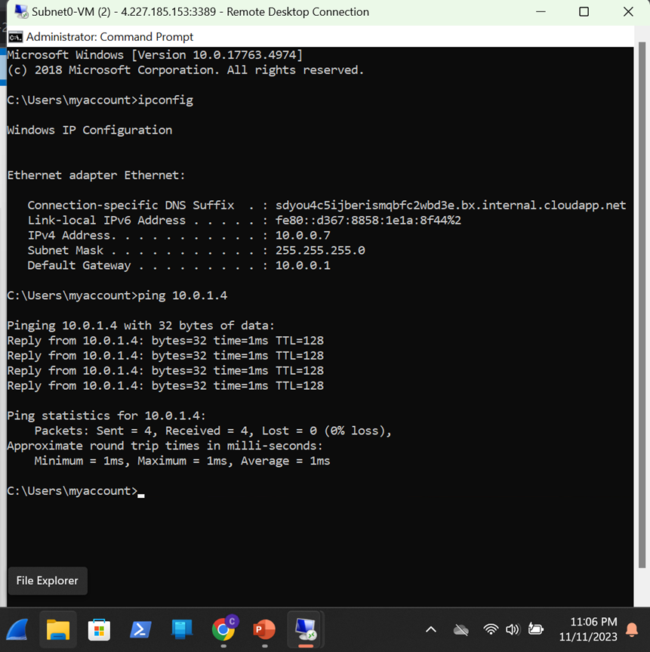
Verifying Connectivity between VMs
(1 of 2)
This screenshot shows the ipconfig and ping 10.0.1.4 results in the command prompt window of Subnet0-VM.

Slide 13
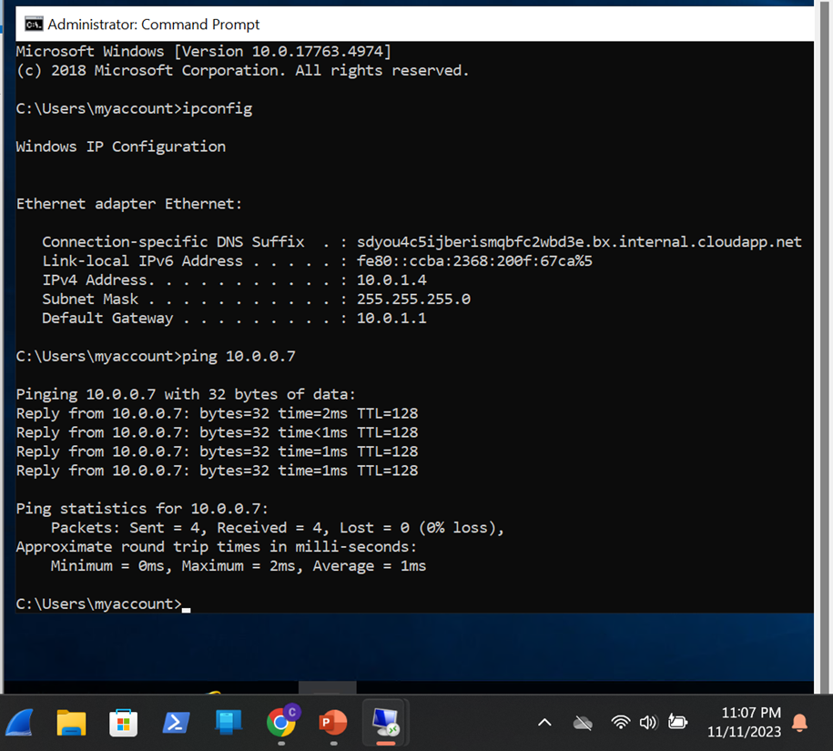
Verifying Connectivity between VMs
(2 of 2)
This screenshot shows the ipconfig and ping 10.0.0.7 results in the command prompt window of Subnet1-VM.

Slide 14

AZURE VM SECURITY

Slide 15
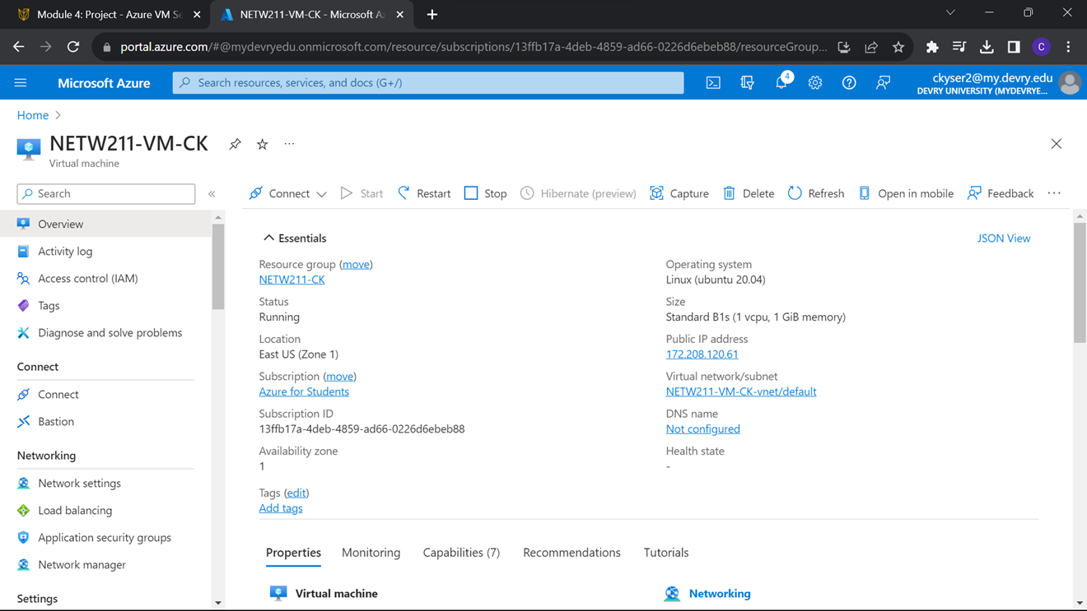
This screenshot shows the NETW211-VM-CK, with information such as the resource group name, subscription, public IP address, etc.
Launching a VM

Slide 16
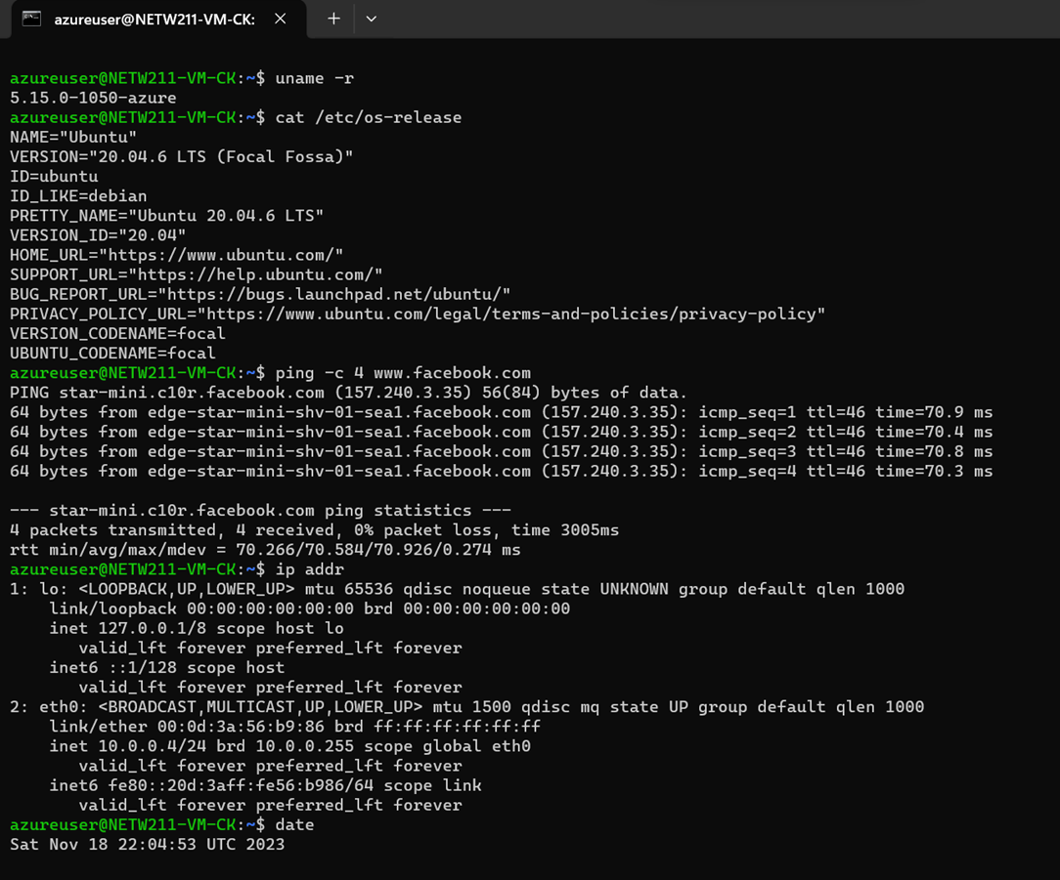
Connecting
to the VM
via SSH
This screenshot includes the azureuser@NETW211-CK showing the IPv4 address of the VM in the Azure cloud.

Slide 17
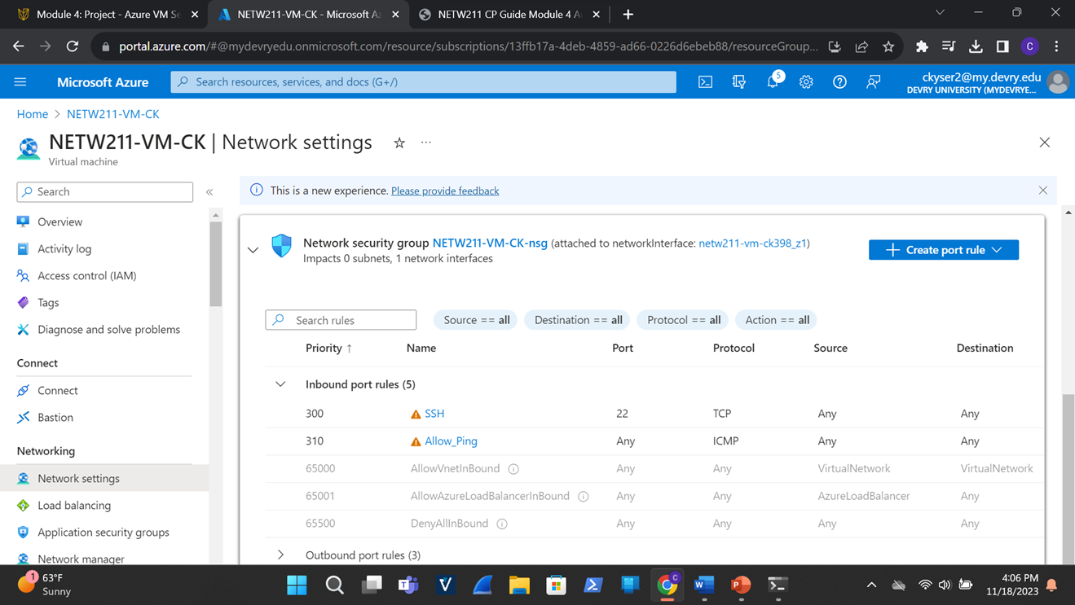
This screenshot shows the Inbound port rules section with the newly added Allow_Ping rule.
Configuring an NSG (1 of 2)

Slide 18
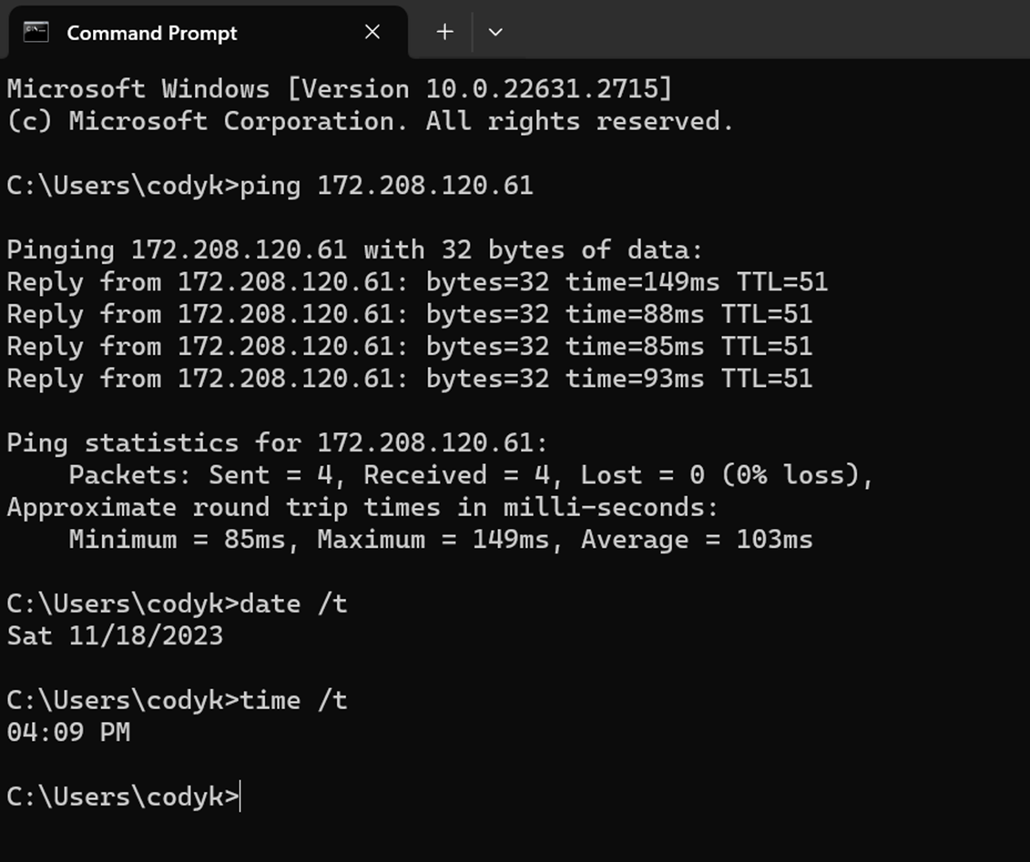
Configuring an NSG
(2 of 2)
This screenshot should show the successful ping result from your local computer to the VM in the Azure cloud.

Slide 19

CLOUD STORAGE

Slide 20
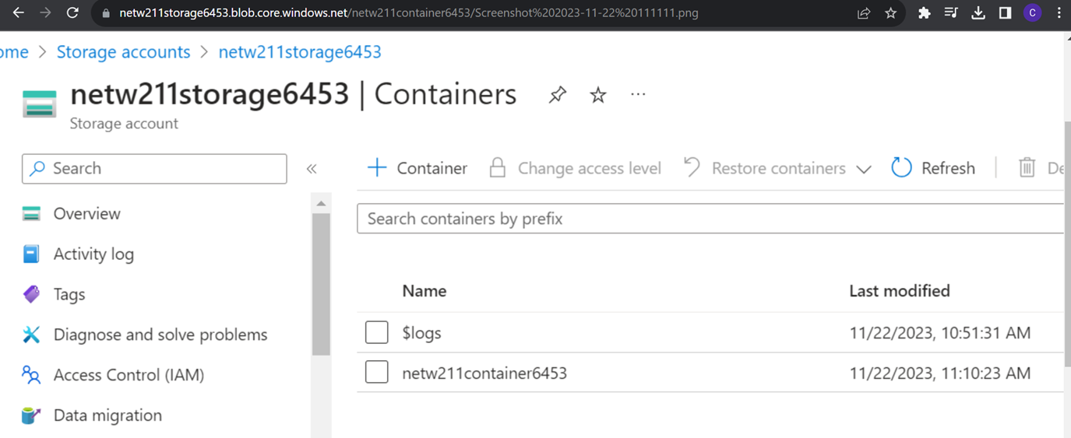
This screenshot shows the browser window with the image uploaded from my local computer and the URL on top of the window, as well as the last modified property of the uploaded image.
Uploading and Accessing a File

Slide 21
Creating Blob Snapshots (1 of 2)
1. What does the access tier setting do? What are the Azure blob storage access tiers?
Access tier settings define availability and cost of data storage. Azure blob storage offers four tiers.
Hot tier - An online tier optimized for storing data that is accessed or modified frequently. The hot tier has the highest storage costs, but the lowest access costs.
Cool tier - An online tier optimized for storing data that is infrequently accessed or modified. Data in the cool tier should be stored for a minimum of 30 days. The cool tier has lower storage costs and higher access costs compared to the hot tier.
Cold tier - An online tier optimized for storing data that is rarely accessed or modified, but still requires fast retrieval. Data in the cold tier should be stored for a minimum of 90 days. The cold tier has lower storage costs and higher access costs compared to the cool tier.
Archive tier - An offline tier optimized for storing data that is rarely accessed, and that has flexible latency requirements, on the order of hours. Data in the archive tier should be stored for a minimum of 180 days.
References:
Hot, Cool, and Archive access tiers for blob data, https://learn.microsoft.com/en-us/azure/storage/blobs/access-tiers-overview
2. Azure Blob Storage Access Tiers, https://devry.percipio.com/courses/c7ef0333-8560-403f-a004-9c5c843866b0/videos/2658bbe6-ee97-438b-a376-fbb079c3b3a0.

Slide 22
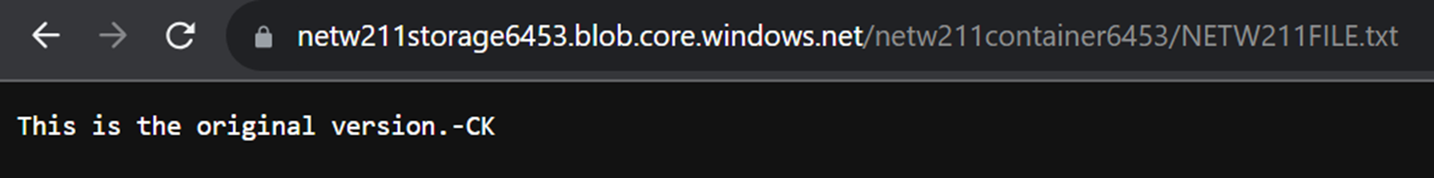
Creating Blob Snapshots (2 of 2)
This screenshot shows the browser window with the “This is the original version. –CK” message and the URL on top of the window.

Slide 23
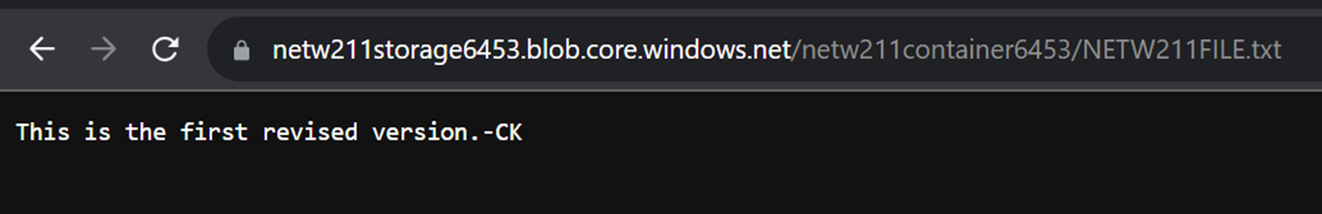
Enabling Blob Versioning
This screenshot shows the browser window with the “This is the first revised version. –CK” message and the URL on top of the window.

Slide 24

CLOUD MONITORING

Slide 25
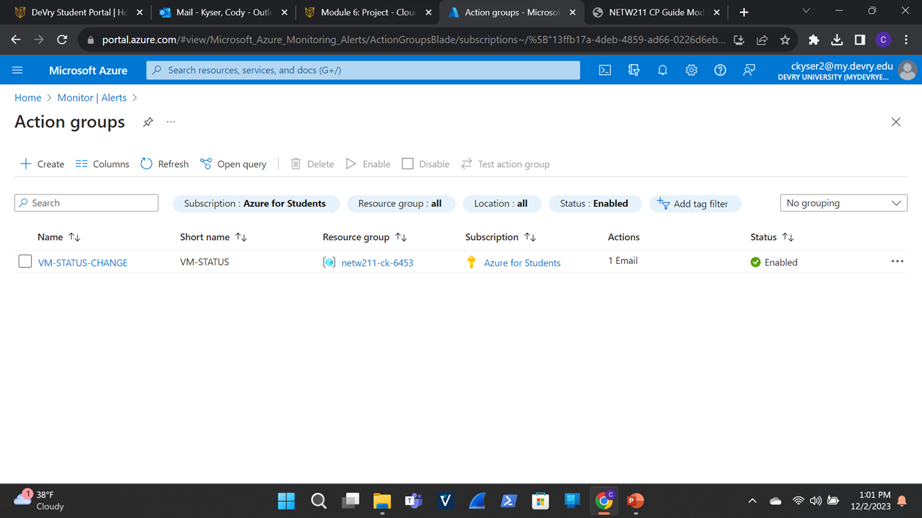
This screenshot shows the “VM-Status-Change” action group on the Manage actions page.
Setting up an Action Group and Notifications

Slide 26
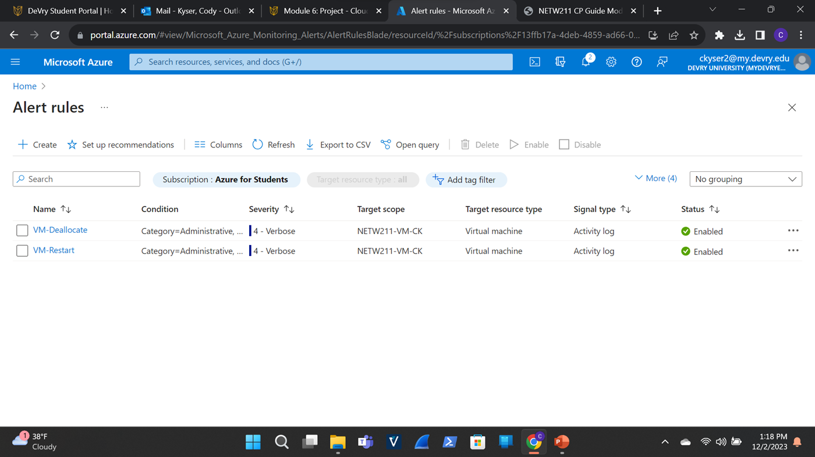
This screenshot shows the Alert rules window showing the VM-Deallocate and VM-Restart rules.
Setting up Alert Rules

Slide 27
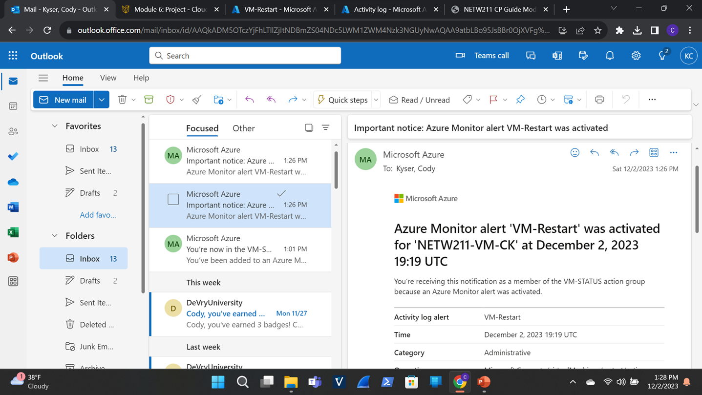
This screenshot shows the ‘VM-Restart’ was activated email message with the date and time of the alert.
Testing Alerts (1 of 2)

Slide 28
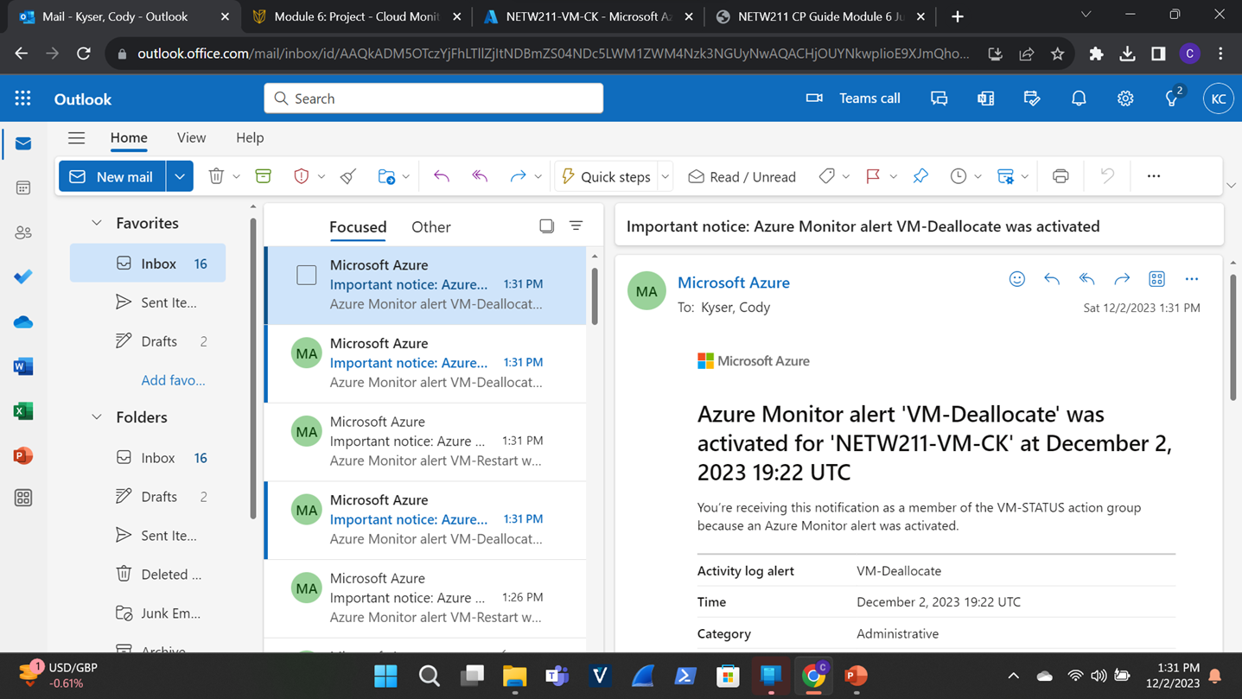
This screenshot shows the ‘VM-Deallocate’ was activated email message with the date and time of the alert.
Testing Alerts (2 of 2)

Slide 29
CHALLENGES
Implementing proper subnetting techniques for the virtual network
Ensuring the seamless deployment of the right virtual machine instance
Addressing intricacies in resource optimization and effective utilization
Fine-tuning configurations for optimal performance

Slide 30
CAREER SKILLS
Understanding how to design and architect solutions in the cloud
Knowledge of Azure Virtual Machines, Azure Storage, and Azure functions
Configuring and managing cloud-based networks and ensuring secure connectivity
Implementing and maintaining security measures to protect cloud resources
Scripting, infrastructure as code (IaC), and automation workflows.

Slide 31
In conclusion, from mastering cloud architecture to delving into automation, security, and data management, my toolkit is now enriched with sought-after capabilities. The cloud journey is continuous, and staying curious and engaged with this evolving digital landscape is key. Whether aspiring to be a cloud architect, a DevOps enthusiast, or a data specialist, the cloud offers boundless opportunities. I am now empowered with a diverse and empowering skill set in the digital landscape of cloud computing.

Slide 32
REFERENCES
Comptia Cloud+ Certification Exam Guide-Eric Vanderburg
Comptia Security+ Certification Exam Guide- WM. Arthur Conklin, PhD, & Gregory White, PhD
Comptia Network+ Certification Exam Guide- Mike Meyers, & Scott Jernigan

