Slide 1

Cybersecurity Strategies:
An Exploration of Security Measures in the Digital Landscape
Presented by: Cody Kyser

Slide 2
In today's dynamic digital environment, cybersecurity comprehension goes beyond being a mere skill—it's a vital imperative. In this presentation I will delve into the core principles, strategies, and practical applications of cybersecurity.
Together, let's navigate the complexities of the digital realm!

Slide 3

Asymmetric Key Encryption

Slide 4
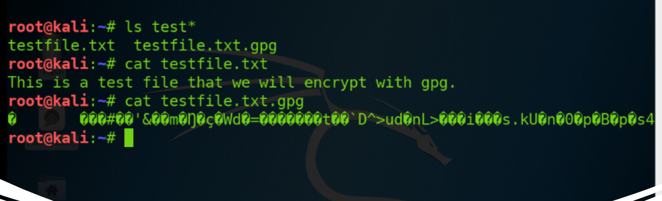
File Encryption
This screenshot shows the following:
Content of the plaintext file
Content of the encrypted file

Slide 5
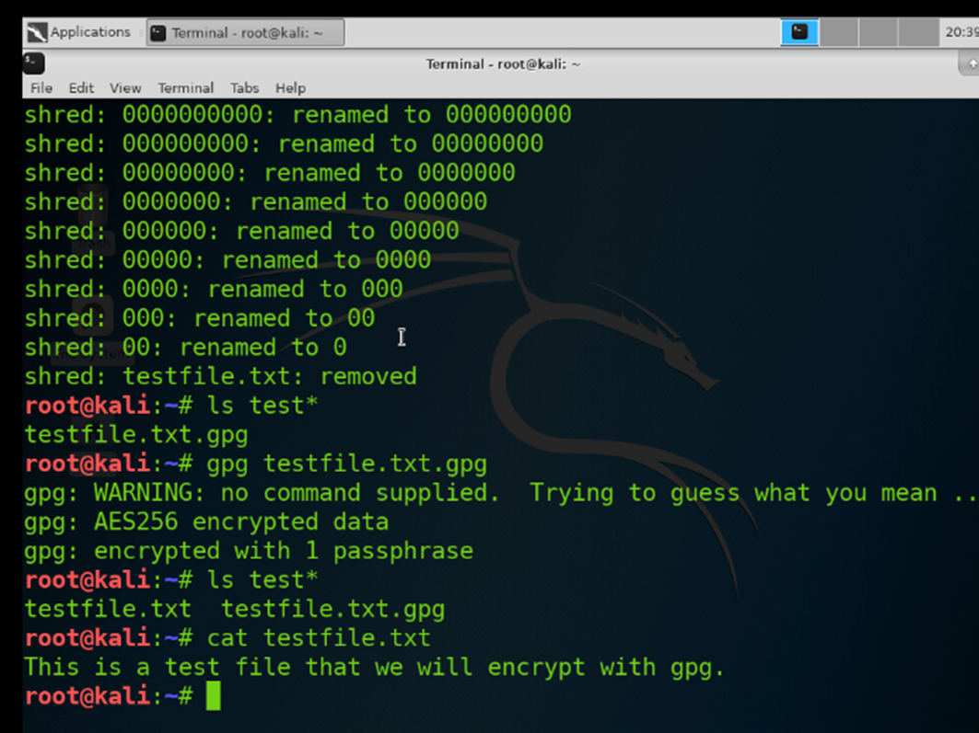
File Decryption
This screenshot shows the following:
The encrypted file being listed by itself
The decrypting process
Both the encrypted file and the original plaintext file being listed

Slide 6

Stateful Firewall

Slide 7

Question
What effect does the sudo iptables --policy INPUT DROP command have on the access to computing resources?
Answer
This command sets the default policy for incoming traffic on the INPUT chain to DROP unless specified by an explicit rule allowing it. After entering the command, nmap produced 0 results for open ports while prior to that it listed the details of 23 open ports.
References
https://www.comparitech.com/net-admin/beginners-guide-ip-tables/

Slide 8
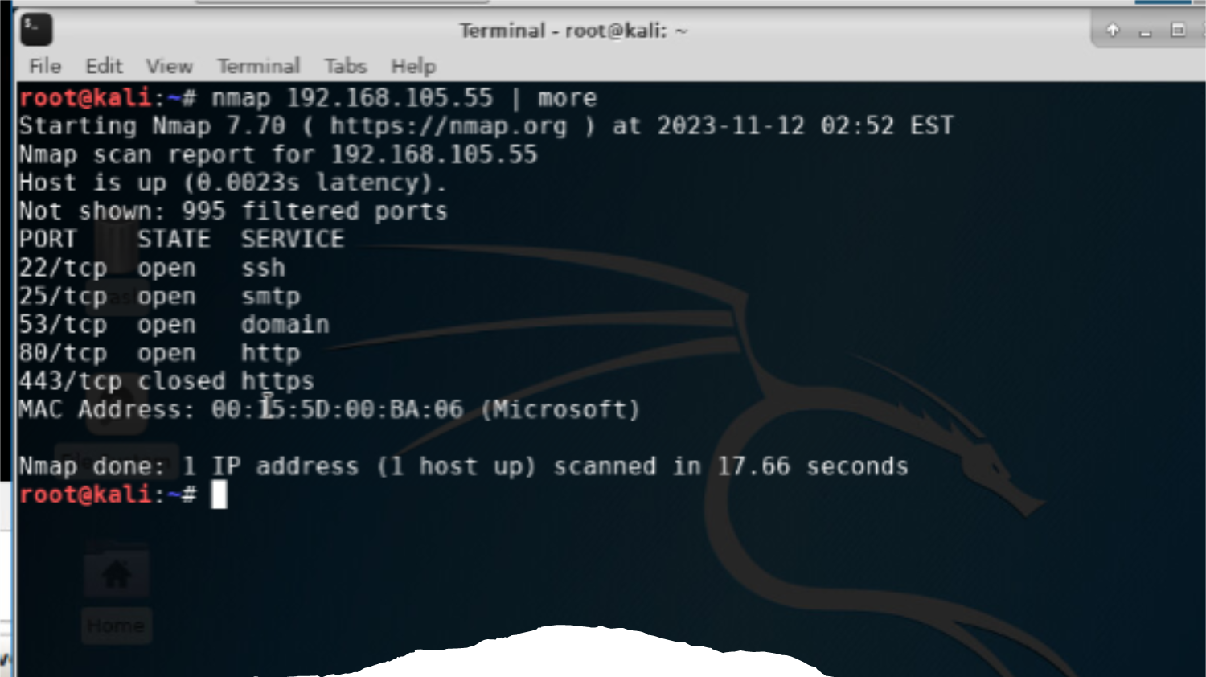
Nmap Scan
This screenshot shows the Nmap scan result of the Linux Server VM.

Slide 9

Bring Your Own Device (BYOD)
Security Policy

Slide 10
Overview:
Tablets, smartphones, and laptops have become widely used in modern enterprises, providing an increase in mobility, flexibility, and connectivity. Threats identified with BYOD devices include device loss or theft which, without data backup to a cloud server would result in data loss. BYOD devices are vulnerable to malware, ransomware, smishing and phishing attacks, as well as connections to unsecured Wi-Fi, resulting in compromised security and data breaches.
2. Purpose:
Regular monitoring and auditing of BYODs helps identify potential vulnerabilities in the devices and software. Maintaining procedures for prompt patching and device updates ensures known vulnerabilities are addressed in a timely manner, reducing the window of opportunity for attackers. Policy enforcement would include antivirus software, encryption, and strong authentication. A rapid response to security incidents for isolating affected devices from the corporate network limits the potential impact on other devices and resources. Network segmentation from critical internal resources limits the scope of potential attacks by isolating BYODs.

Slide 11
3. Scope:
BYODs, including smartphones, tablets, laptops, and wearable devices are typically allowed during business hours for specific applications or tasks, project-based access, remote work, and training. It is common practice for personnel to obtain formal approval before using BYODs for security compliance, risk assessment, and policy adherence, typically with consent for monitoring. Terms of usage would be outline in a company’s BYOD policy including work-related activities, corporate communication and collaboration, task management, document editing and creation, as well as internet browsing which would typically be limited through the company’s proxy server. Permission is granted via the IT department, BYOD policy administrator, or security team.
4. Policy:
BYOD policies include approved operating systems kept up to date with the latest software patches and updates. Reputable up to date antivirus software and firewalls are also required. Noncompliant devices are subject to remediation, including a notification, guidance, timeframe, and reassessment. The responsibility of the remediation process falls on the device owner, although the IT Helpdesk is usually available to provide assistance.

Slide 12
5. Policy Compliance:
Employees found not following the security policy will be subject to disciplinary actions, up to and including termination. It is the responsibility of the employee to be aware of BYOD policies and procedures. The InfoSec team utilizes various methods, including video monitoring, intrusion detection tools, internal and external audits, and business tool reports to ensure compliance.
6. Related Standards, Policies, and Processes:
Aside from HIPAA (Health Insurance Portability and Accountability Act) and PCI-DSS (Payment Card Industry Data Security Standards), ISO 27001 (International Organization for Standardization), GDPR (General Data Protection Regulation), NIST (National Institute of Standards and Technology) Cybersecurity Framework can all be linked to a BYOD policy to set the standards for security, compliance, and best practice.

Slide 13
7. Definitions and Terms:
Some key definitions and terms regarding BYOD policies include the following:
BYOD (Bring Your Own Device)
Mobile Devices (Smartphones, Tablets, Laptops, and Wearable Devices)
CIA (Confidentiality, Integrity, and Availability)
MDM (Mobile Device Management)
MAM (Mobile Application Management)
NAC (Network Access Control)
2FA/MFA (Two-Factor Authentication/Multi-Factor Authentication)
DLP (Data Loss Prevention)
SIEM (Security Information and Event Management)
8. Revision History:
Date of change | Responsible | Summary of change
August 2019 | SANS policy team | Updated and converted to new format
November 2023 | Cody Kyser | Updated and converted to new format

Slide 14

Multifactor Authentication (MFA)

Slide 15
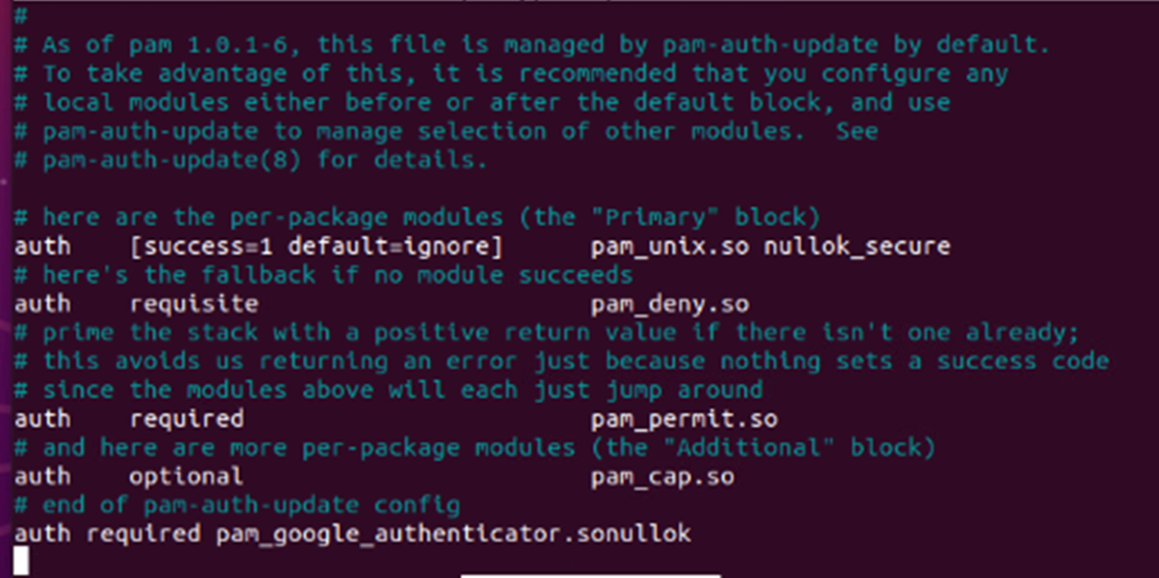
Common-auth Configuration File
This screenshot shows the entry that indicates the use of the Google Authenticator module.

Slide 16
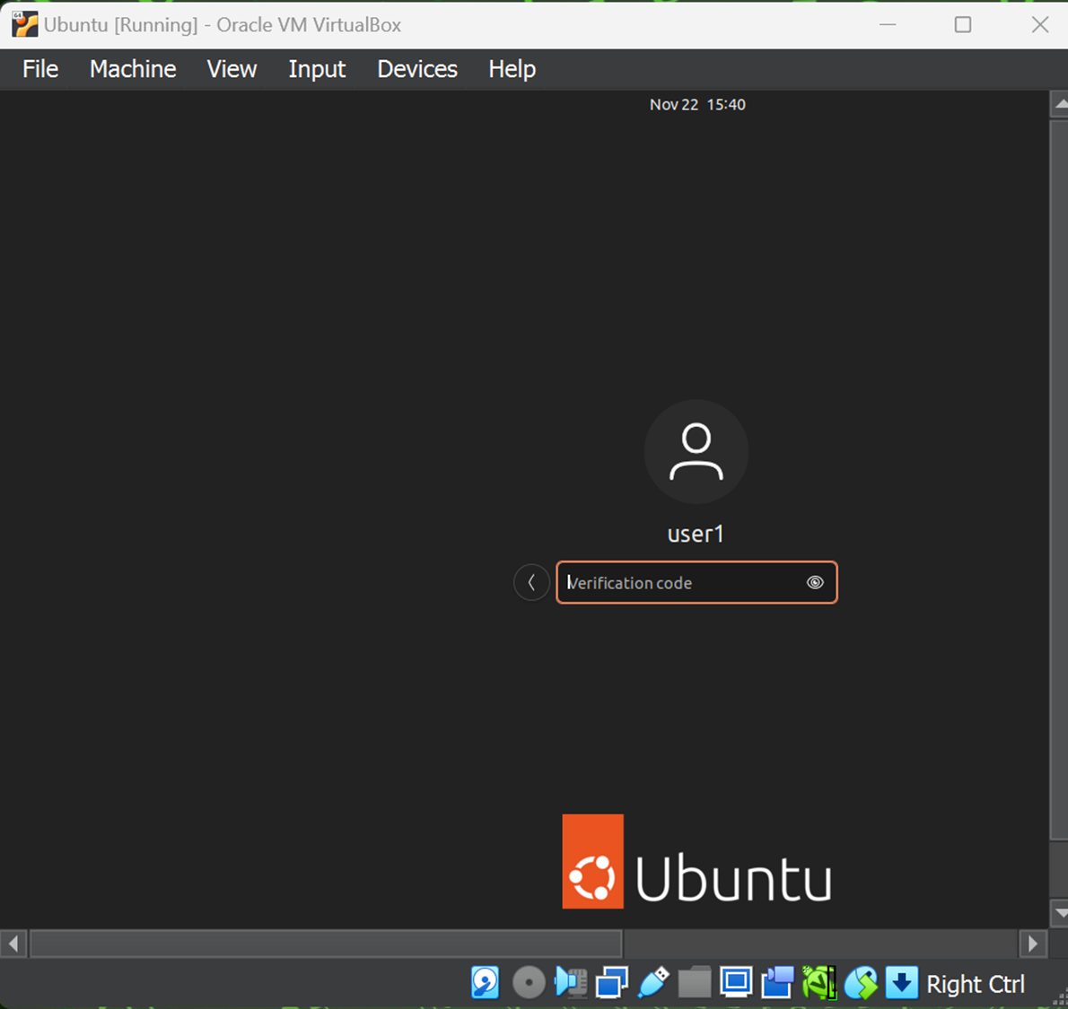
MFA Logon Screen
This screenshot shows the logon screen where a verification code is required.

Slide 17

Vulnerability Assessment

Slide 18
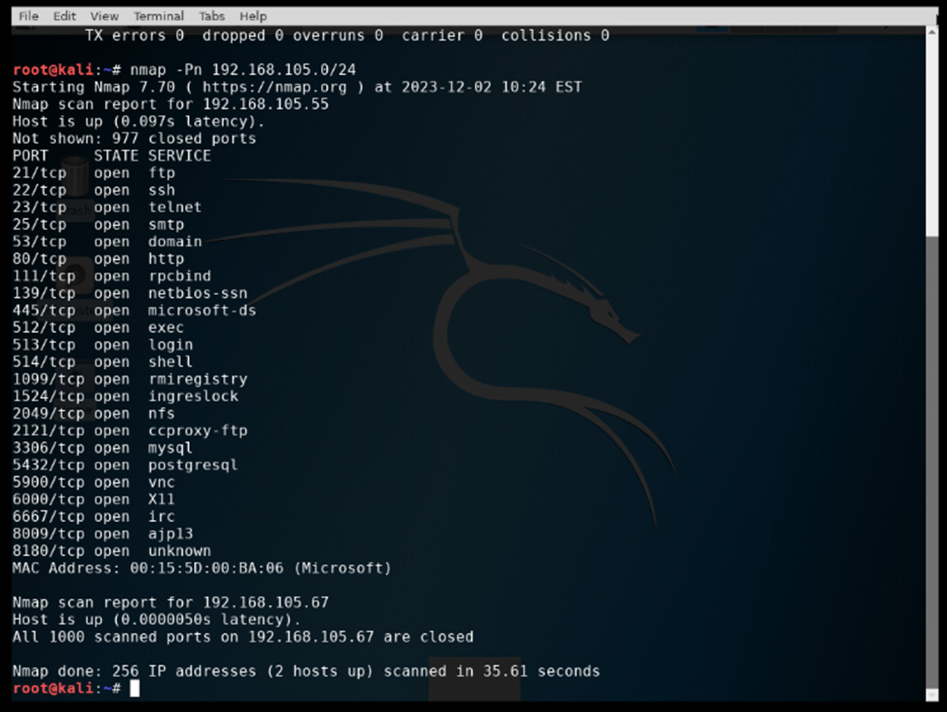
Nmap
This screenshot includes the scan result showing both the Kali and Linux Server VMs.

Slide 19
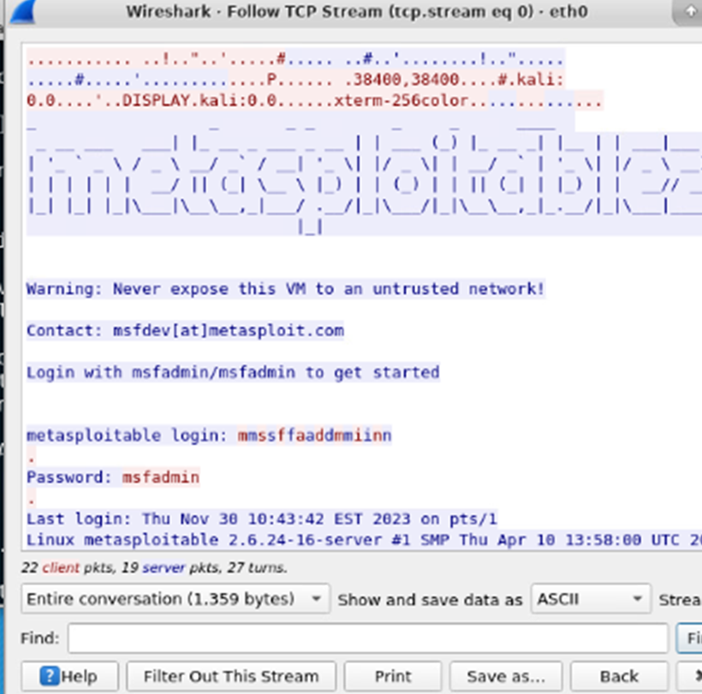
Wireshark
This screenshot includes the Wireshark—Follow TCP Steam window showing the Telnet username and password.

Slide 20
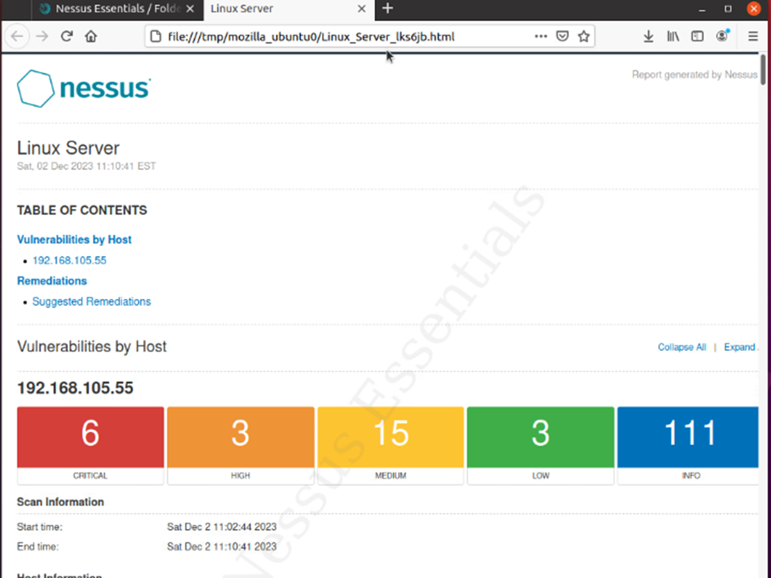
Nessus
This screenshot includes the high-level view of the Nessus vulnerability scan report (categories of vulnerability in different colors) showing.

Slide 21
Challenges
Getting the virtual machines to work correctly was definitely a challenge at times. For one of the projects included in this presentation I had to download Ubuntu and install it on my Hypervisor to complete the project.
Other challenges included ensuring the commands were typed correctly in the command line interface with the correct IP address when using Nmap or file encryption/decryption.

Slide 22
Career SKills
Competence in using cybersecurity tools and technologies
Familiarity with networking protocols and systems
Effectively conveying security concepts
Advocating for best security practices within the organization
Understanding the broader landscape of cybersecurity

Slide 23
Conclusion:
Empowering the Digital Defender
In conclusion, cybersecurity awareness emerges as a vital skill in the digital age, serving as the cornerstone of our collective defense against evolving cyber threats. The landscape of digital security is dynamic, requiring not only initial understanding but a commitment to continuous learning. As we've explored, maintaining a proactive defensive posture is not just advisable but necessary for adapting to the relentless pace of technological advancements.

Slide 24
References
Comptia Security+ exam guide: wm. Arthur Conklin, Phd, & Gregory white, phd
comptia linux+ certification exam guide: ted Jordan & sandor strohmayer

